Slide 1

Wi-BFI: Extracting the IEEE 802.11 Beamforming Feedback Information from Commercial Wi-Fi Devices
Khandaker Foysal Haque*, Francesca Meneghello§, Francesco Restuccia*
*Northeastern University, US
§ University of Padova, Italy
WiNTECH - Oct. 6 2023, Madrid (Spain)
Notes:
First tool that allows capturing and decding the beamforming feeedback angles, and reconstructing the beamforming feedback matrices

Slide 2
Contents
Motivation and general idea
Background concepts
Wi-BFI overview
Examples of application

Slide 3


Motivation and general idea
The channel frequency response (CFR) is a necessary information for the correct functioning of wireless networks
  recently it is being leveraged also to deliver sensing services through Wi-Fi
Challenge: The CFR is not not made available outside the Wi-Fi devices
Current approach
custom tailored tools (AX-CSI, NEXMON-CSI, Atheros CSI, Intel CSI extractors)
Wi-BFI main idea
  use the MIMO beamforming feedback information (BFI) as a proxy for the CFR

Slide 4
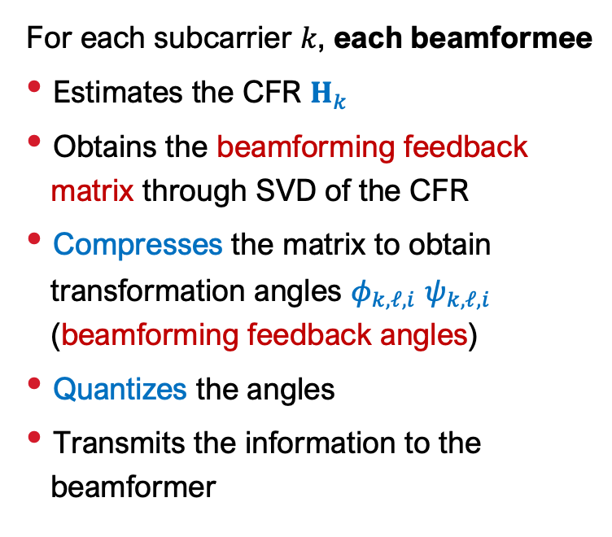
Background: from CFR to BFI
For each subcarrier $k$, each beamformee
Estimates the CFR $H_{k}$
Obtains the beamforming feedback matrix through SVD of the CFR
Compresses the matrix to obtain transformation angles $φ_{k,ℓ,i}$ $ψ_{k,ℓ,i}$ (beamforming feedback angles)
Quantizes the angles
Transmits the information to the beamformer
transmitted unencrypted

Slide 5
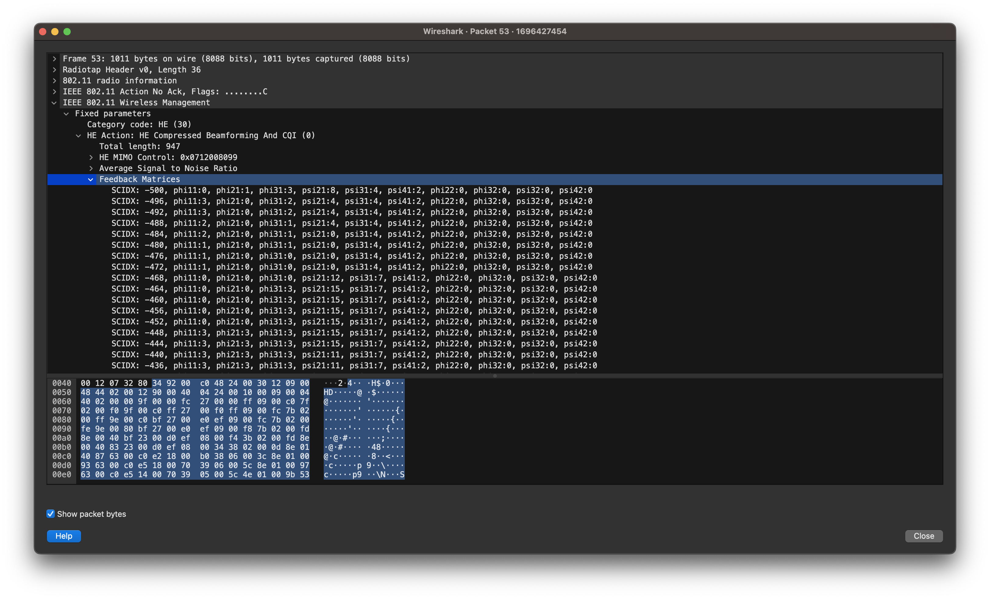
Beamforming feedback matrices
transmitted unencrypted

Slide 6
Wi-BFI operations
Capture the beamforming feedback packet
Decode the Wi-Fi BFAs based on the network configuration
Reconstructing the beamforming feedback matrix

Slide 7
Wi-BFI features
IEEE 802.11ac and 802.11ax networks
Radio channels with 160/80/40/20 MHz bandwidth
Single-user and multi-user MIMO
Real-time and offline extraction and storage

Slide 8
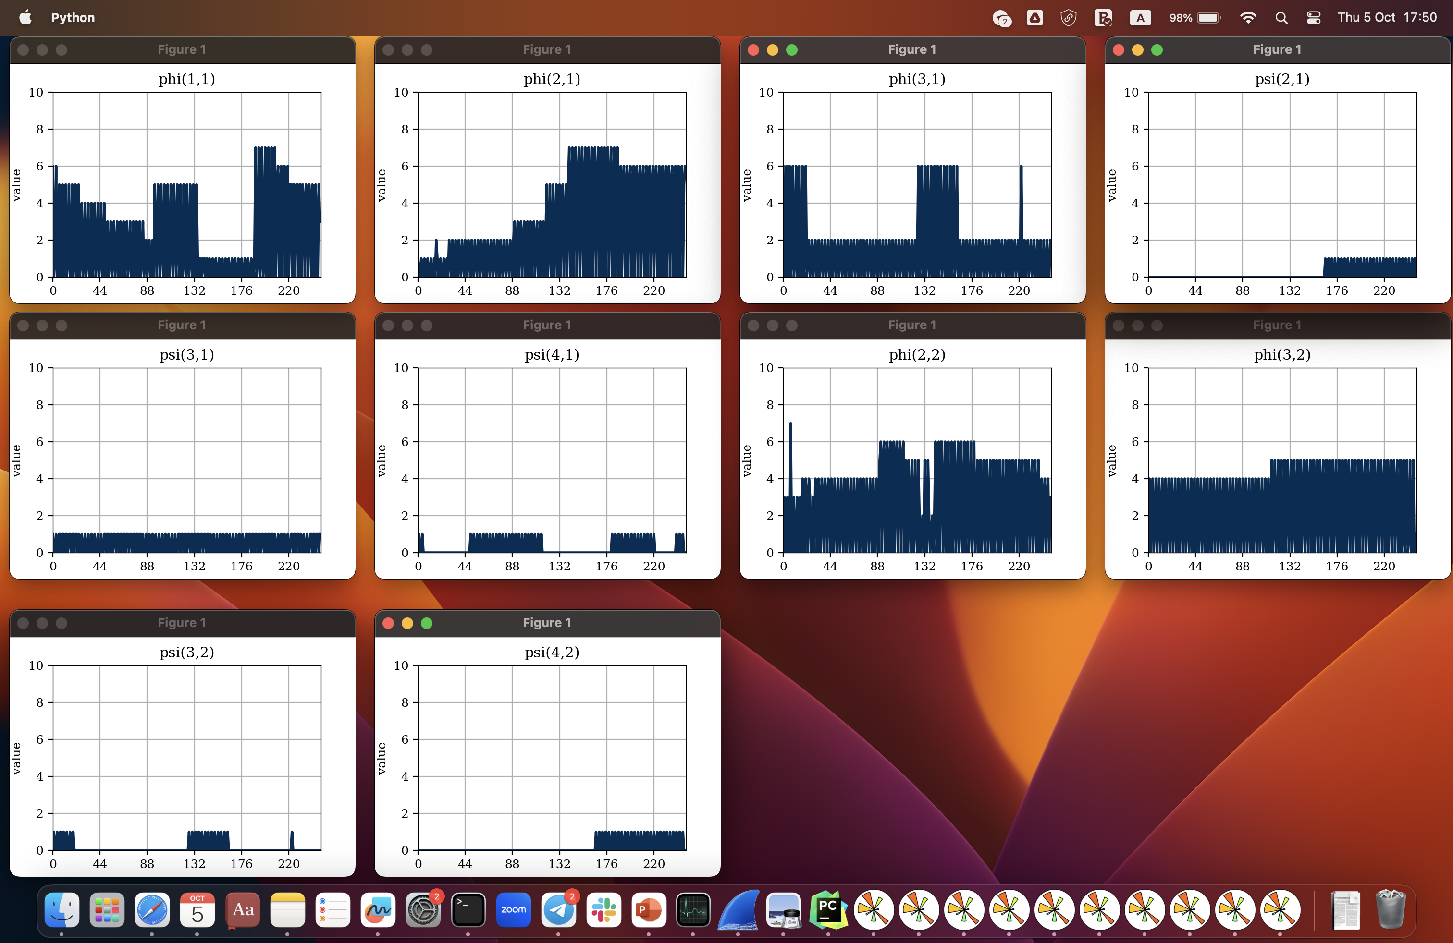
Real-time angles visualization
4 x 2 SU-MIMO

Slide 9
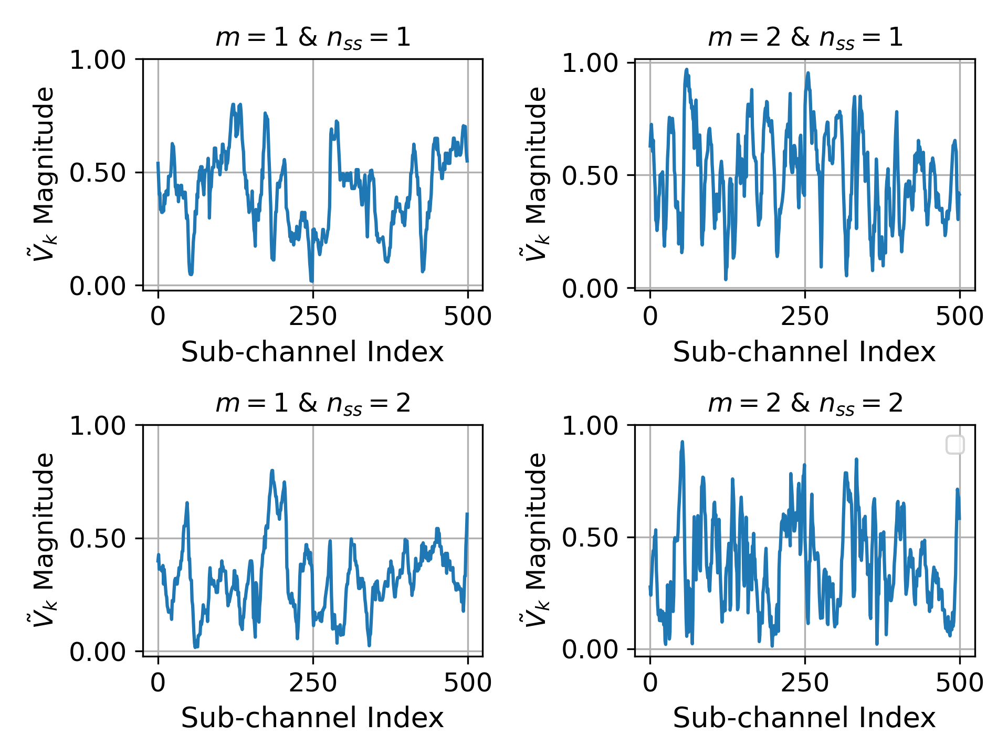
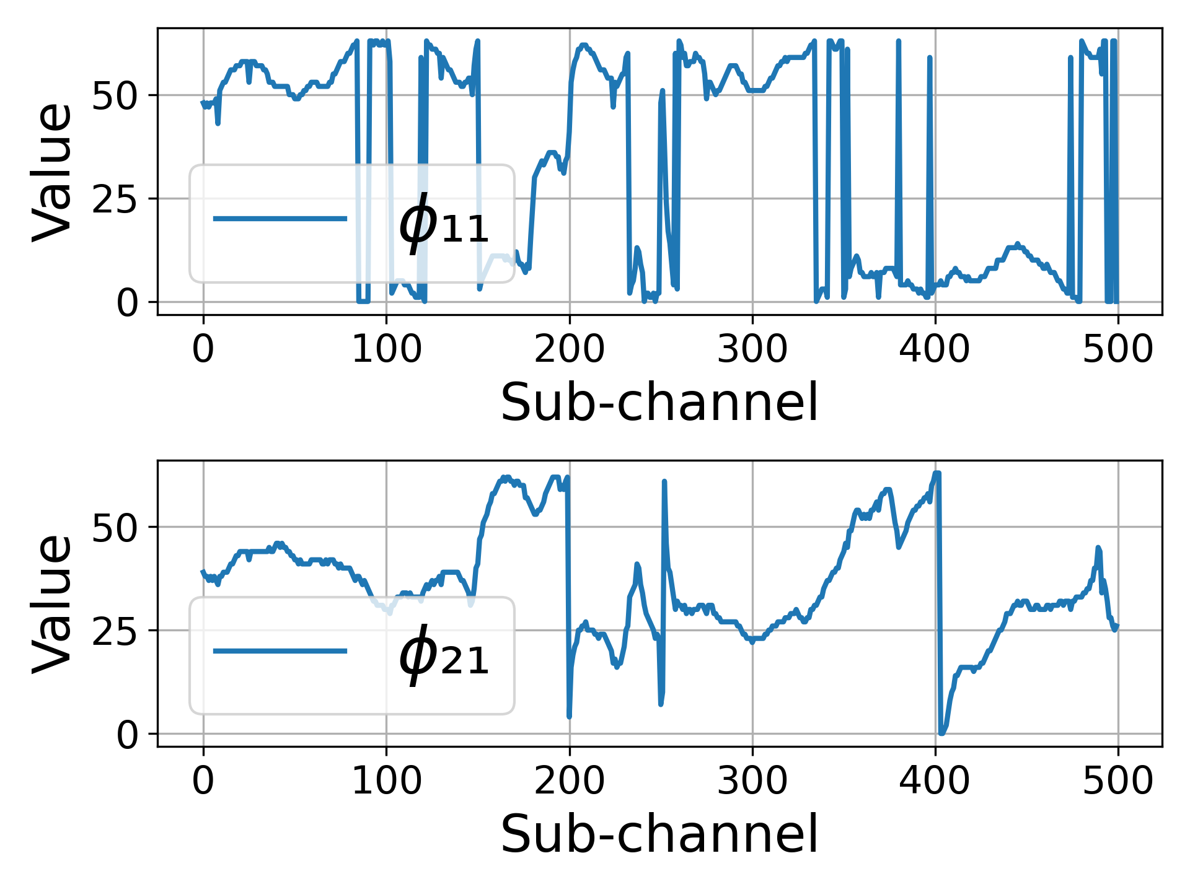
Example of captures and processing offline
Reconstructed beamforming feedback matrix for different antennas (m) and streams (n_{ss})
Raw beamforming feedback angles

Slide 10
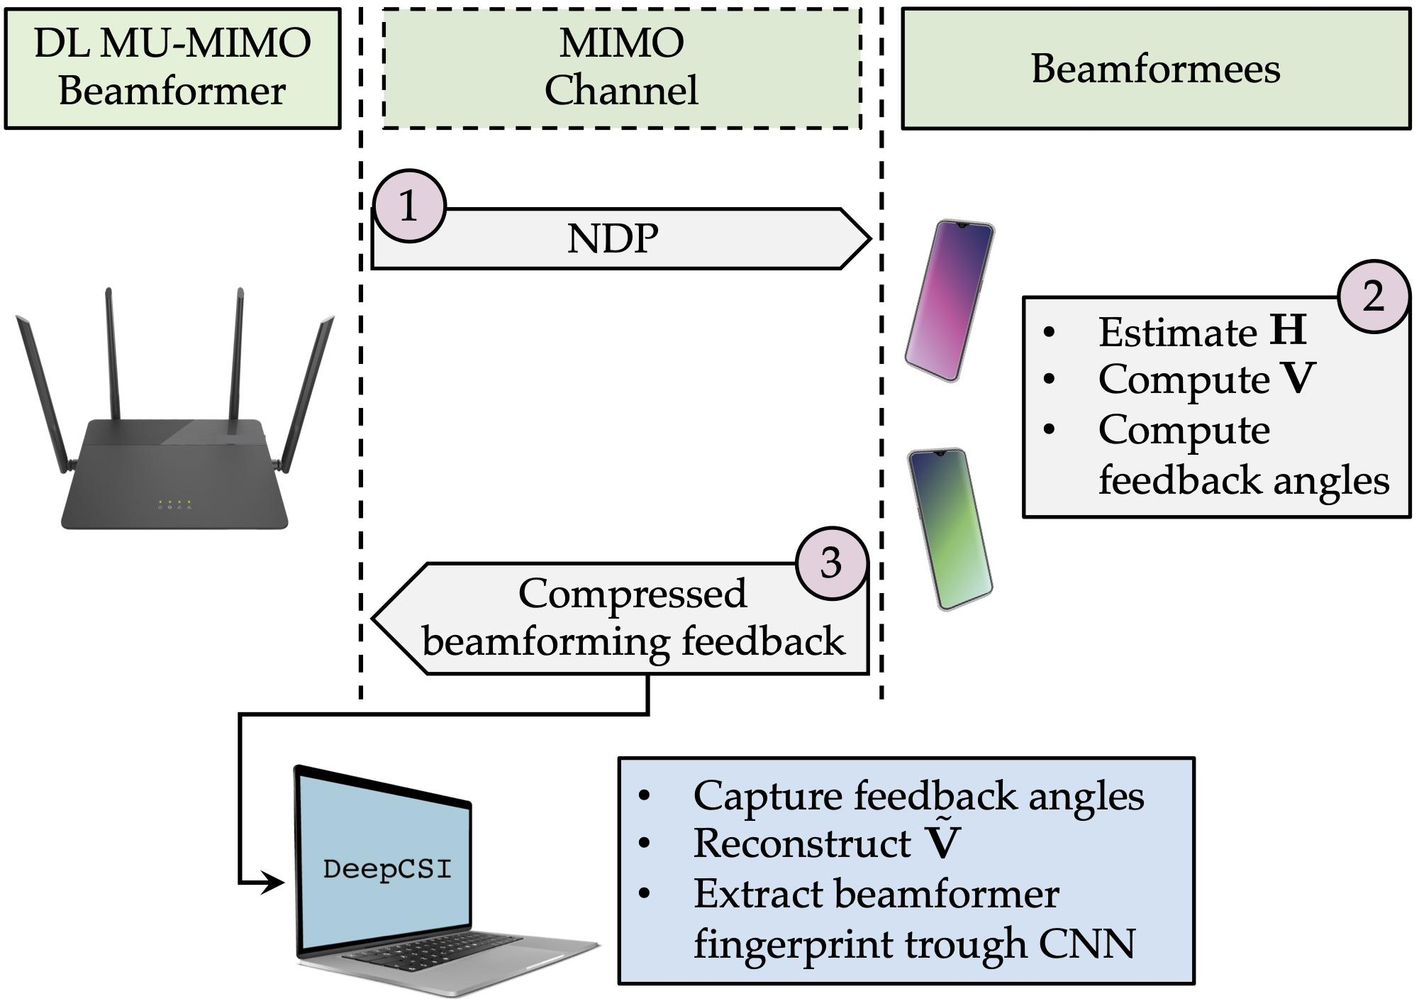
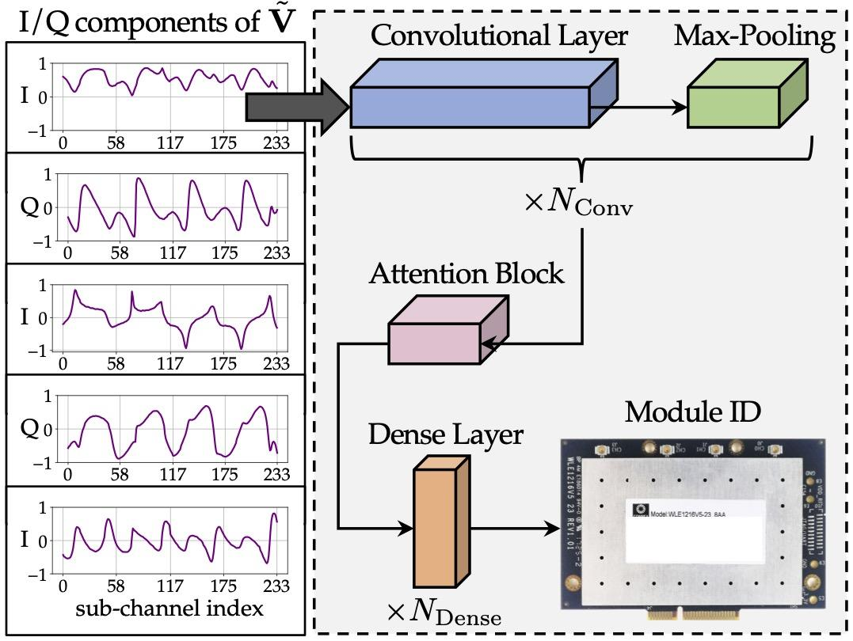
Example of application - DeepCSI
Objective: obtain a fingerprint of the beamformer for 802.11 device authentication
reconstructed beamforming feedback matrices as input
F. Meneghello, M. Rossi and F. Restuccia, “DeepCSI: Rethinking Wi-Fi Radio Fingerprinting Through MU-MIMO CSI Feedback Deep Learning”, in Proc. of IEEE ICDCS 2022

Slide 11
Example of application - BeamSense
Objective: human activity recognition through 802.11ac/ax beamforming feedback
raw beamforming feedback angles as input
K. H. Haque, M. Zhang, F. Meneghello, and F. Restuccia, “Bemasense: Effective and Efficient Wi-Fi Sensing with MU-MIMO Beamforming Feedback”, 2022

Slide 12
Concluding remarks
First tool that allows capturing and decding the beamforming feeedback angles, and reconstructing the beamforming feedback matrices
Works with packets transmitted with 20/40/80/160 MHz BW
Works at multiple bands simultaneously
SU- and MU-MIMO are supported
802.11ac and 802.11ax support
Notes:
Wi-BFI, the first tool to extract IEEE 802.11ac/ax beamforming feedback angles (BFAs) and reconstruct the beamforming feedback information (BFI) in the wild from both SU-MIMO and MU-MIMO systems op- erating at 20 MHz/40 MHz/80 MHz/160 MHz bandwidth and with any network configuration. Wi-BFI operates at multi- ple bands and with multiple Wi-Fi standards simultaneously without the need for any direct access to the beamformer or beamformees.

Slide 13
Wi-BFI: Extracting the IEEE 802.11 Beamforming Feedback Information from Commercial Wi-Fi Devices
Khandaker Foysal Haque*, Francesca Meneghello§, Francesco Restuccia*
*Northeastern University, US
§ University of Padova, Italy
WiNTECH - Oct. 6 2023, Madrid (Spain)

