Slide 1

SAWEC:
Sensing-Assisted
Wireless Edge Computing
Foysal Haque, Francesca Meneghello, Ebtidaul Karim, Francesco Restuccia
Institute for the Wireless Internet of Things (WIoT)
Northeastern University
MENTIS Group Website: http://mentislab.info

Slide 2

AR/VR: Next Frontier in Pervasive Computing
We are very far from truly seamless
and immersive AR/VR experiences
Notes:
Immersive, interactive, and persistent shared virtual experiences
Through the Metaverse, individuals will enter a space where the cyber and physical worlds converge, thus enabling new entertainment applications, providing ultra-realistic online learning experiences and transforming healthcare through remote surgery opportunities
The Metaverse will also improve sustainability by reducing work commuting and help companies reduce their carbon footprint

Slide 3
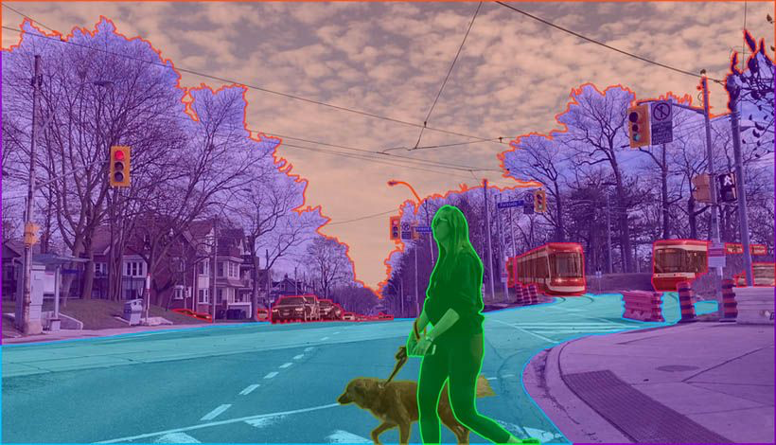

What is the current bottleneck?
Semantic Segmentation
Compute-Intensive
AI/ML Tasks
120 Hz frame rate and 8K resolution are needed!
Object
Recognition​
M Gallagher, ER Ferrè, "Cybersickness: a multisensory integration perspective", Multisensory Research, 2018.
Ars Technica, "Virtual Perfection: Why 8K resolution per eye isn't enough for perfect VR", 2013.
Notes:
to avoid pixelation and motion sickness

Slide 4
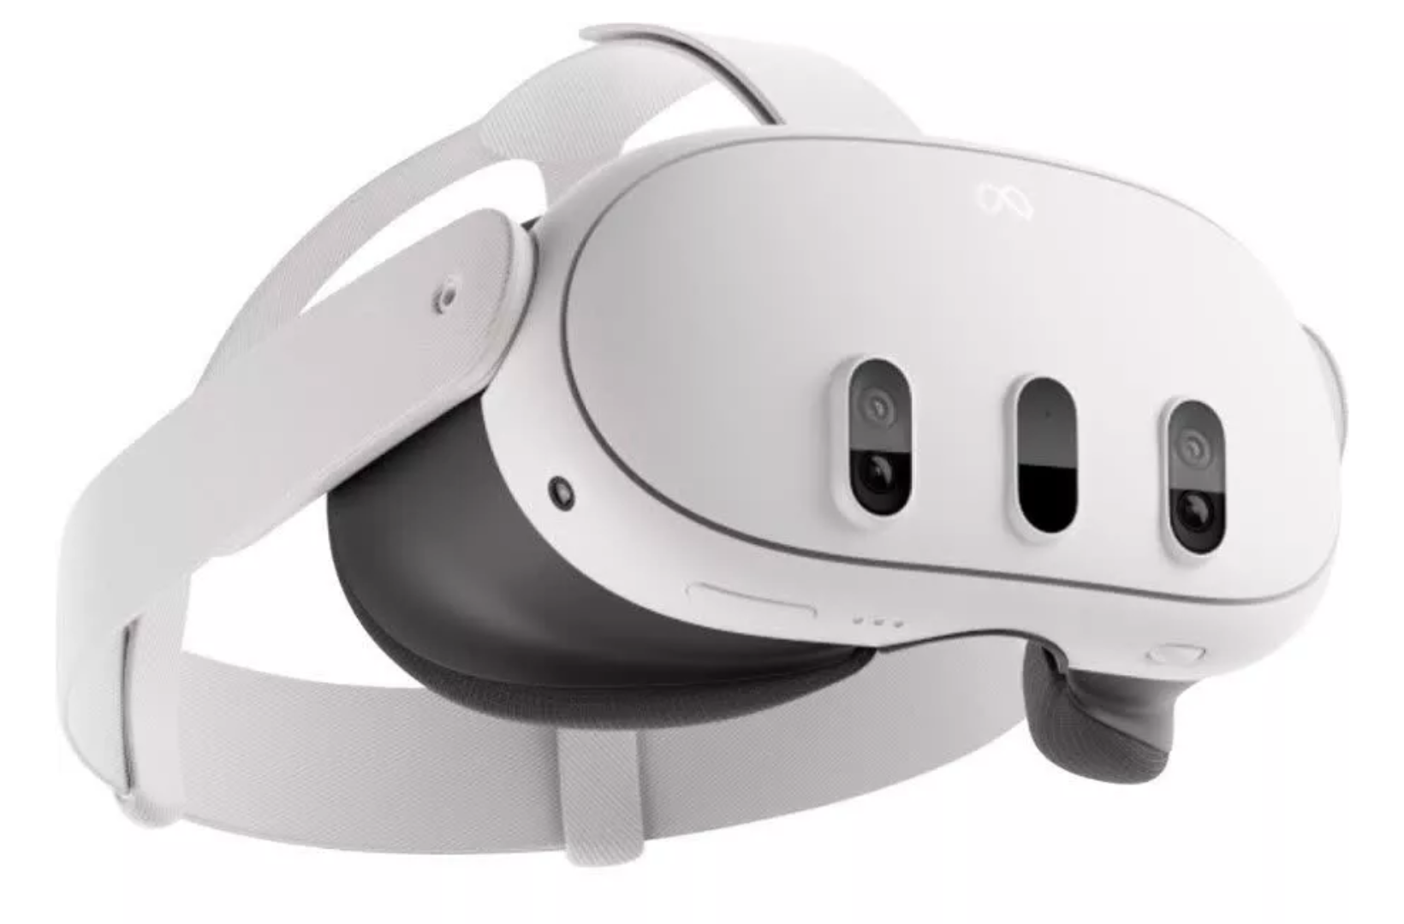
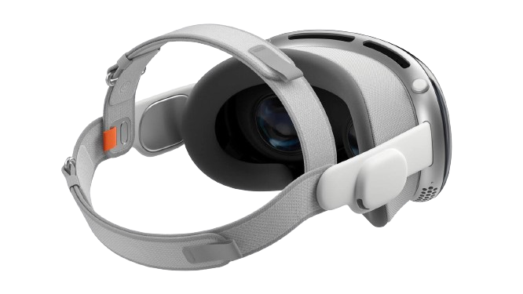
State of current wireless AR/VR headsets
Weight
515 grams
Refresh Rate
Up to 90 Hz
Meta Quest 3
1.5-2 hours
Weight
650 grams plus
353 grams battery
Refresh Rate
Up to
90 Hz
Apple Vision Pro
Up to 2 hours

Slide 5


Wireless Edge Computing
120 Hz → E2E latency of 8 milliseconds
...
120 Hz @ 8K → 40 Gbps → Wi-Fi supports 1.2 Gbps

Slide 6
What Has Been Done So Far?
Z. Yang et al., “Edgeduet: Tiling Small Object Detection for Edge Assisted Autonomous Mobile Vision,” IEEE/ACM Transactions on Networking, 2022.
Frame partitioning
DNN partitioning
S. Laskaridis wt al., “SPINN: Synergistic Progressive Inference of Neural Networks Over Device and Cloud,” in Proceedings of MobiCom, 2020, pp. 1–15.
Prior Work
in
WEC
R. Xu et al., “ApproxDet: Content and Contention-Aware Approximate Object Detection for Mobiles,” in Proceedings of SenSys, 2020, pp. 449–462
Full task offloading
Downsize & Compression
W. Jiang, Z. Teng, M. Li, and L. P. Qian, “Energy-Efficient Data Compression and Resource Allocation for Edge Assisted IoT Networks,” in Proc. of ICCC, IEEE, 2023, pp. 1–6.

Slide 7
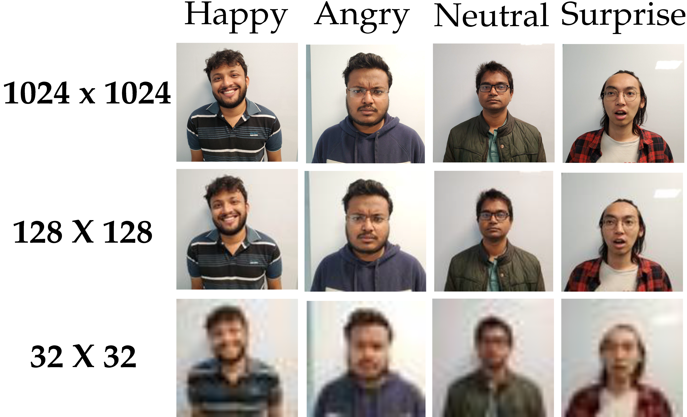
Does Compression Degrade Performance?
Six facial emotion classes from six different subjects

Slide 8
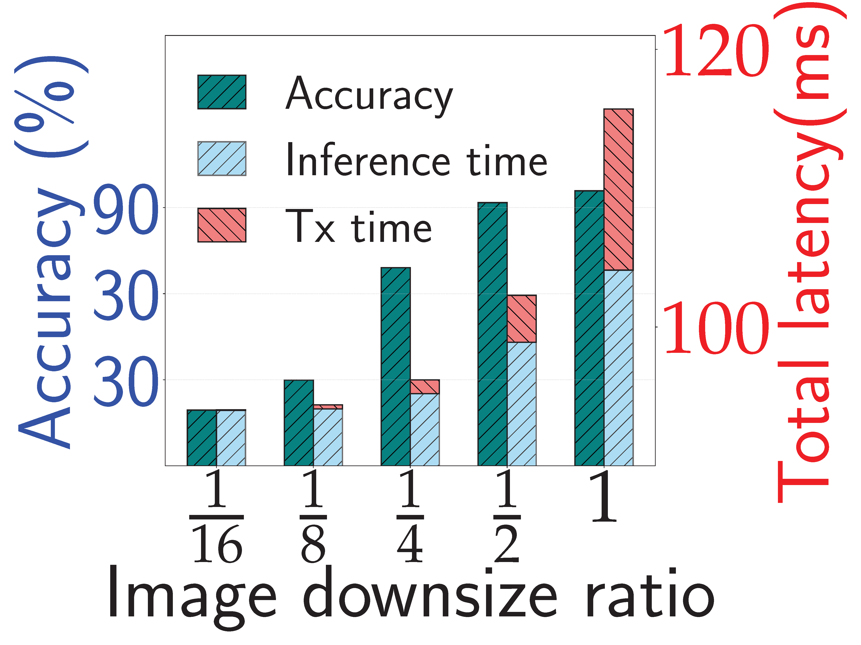
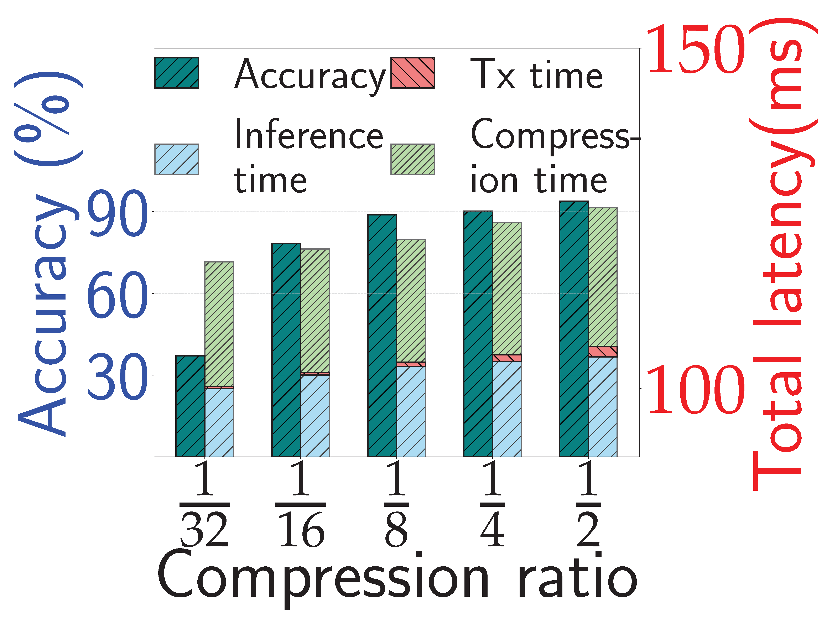
Does Compression Degrade Performance?
Up to 50% drop with 1/4
~30 ms compression time!

Slide 9
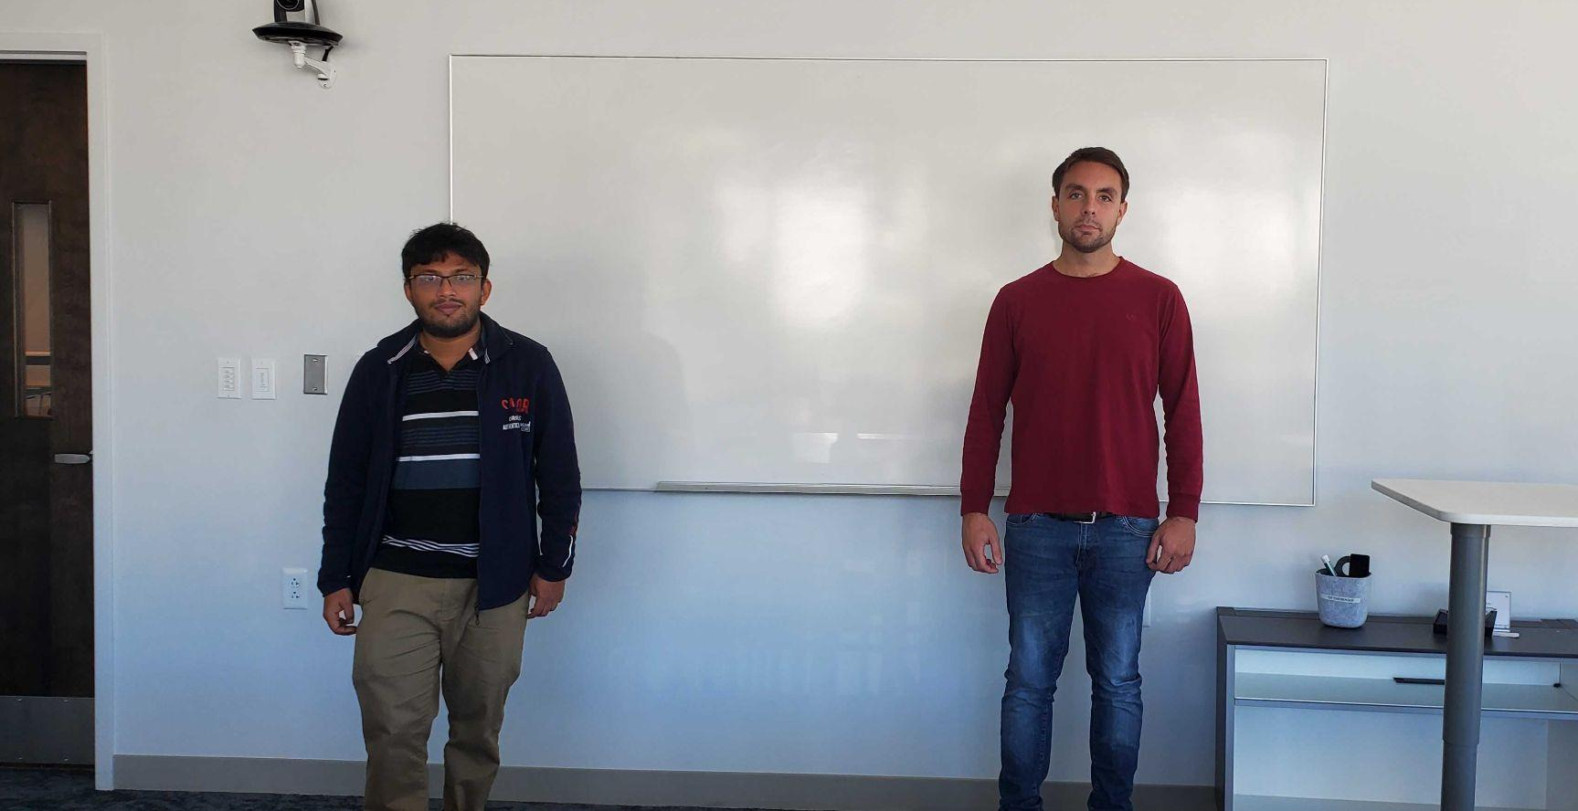

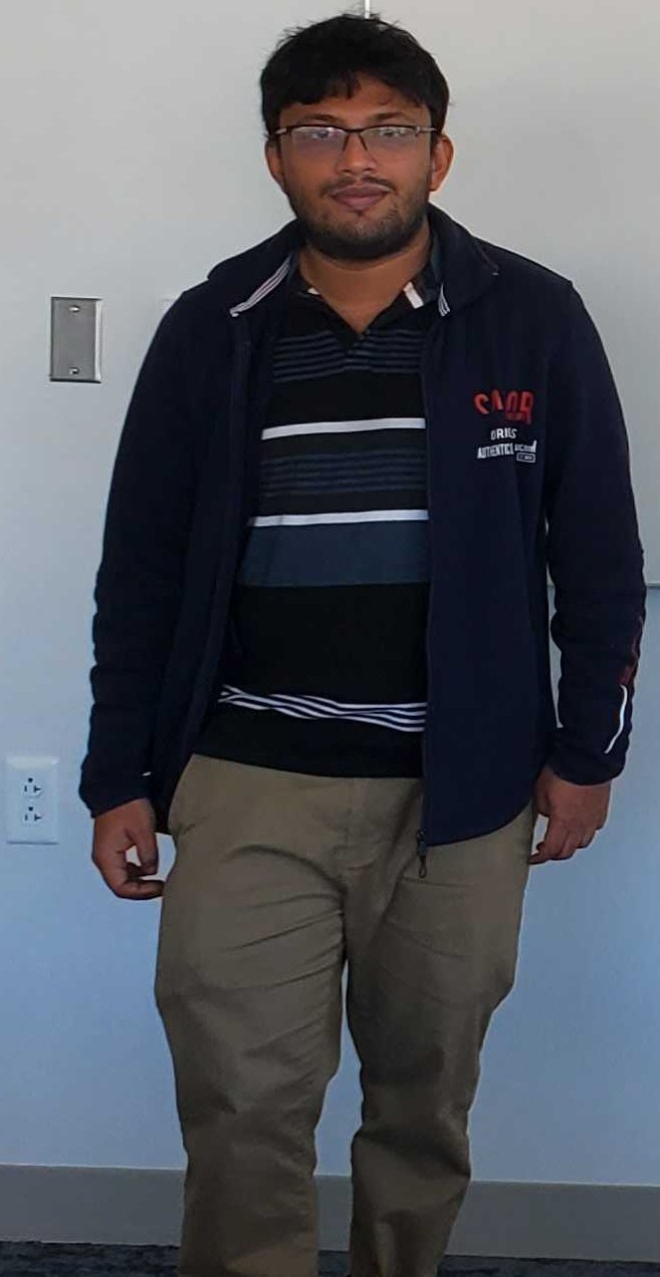
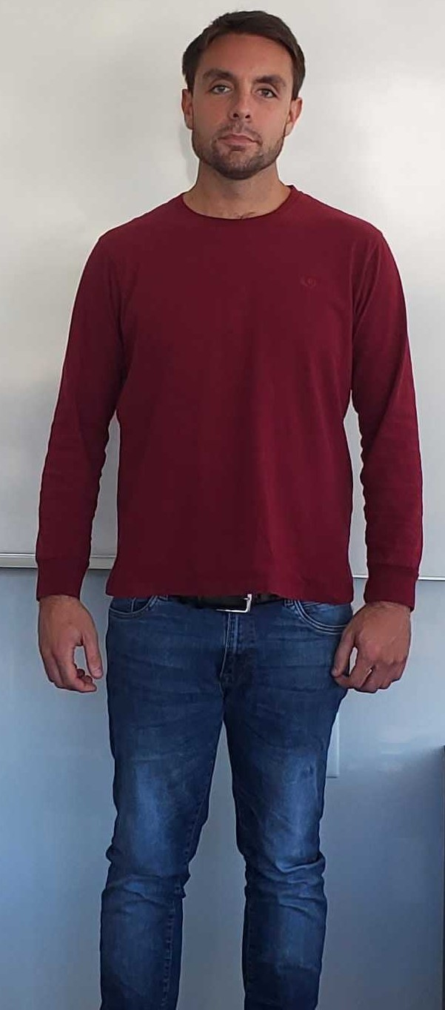

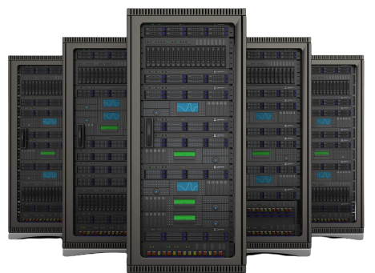
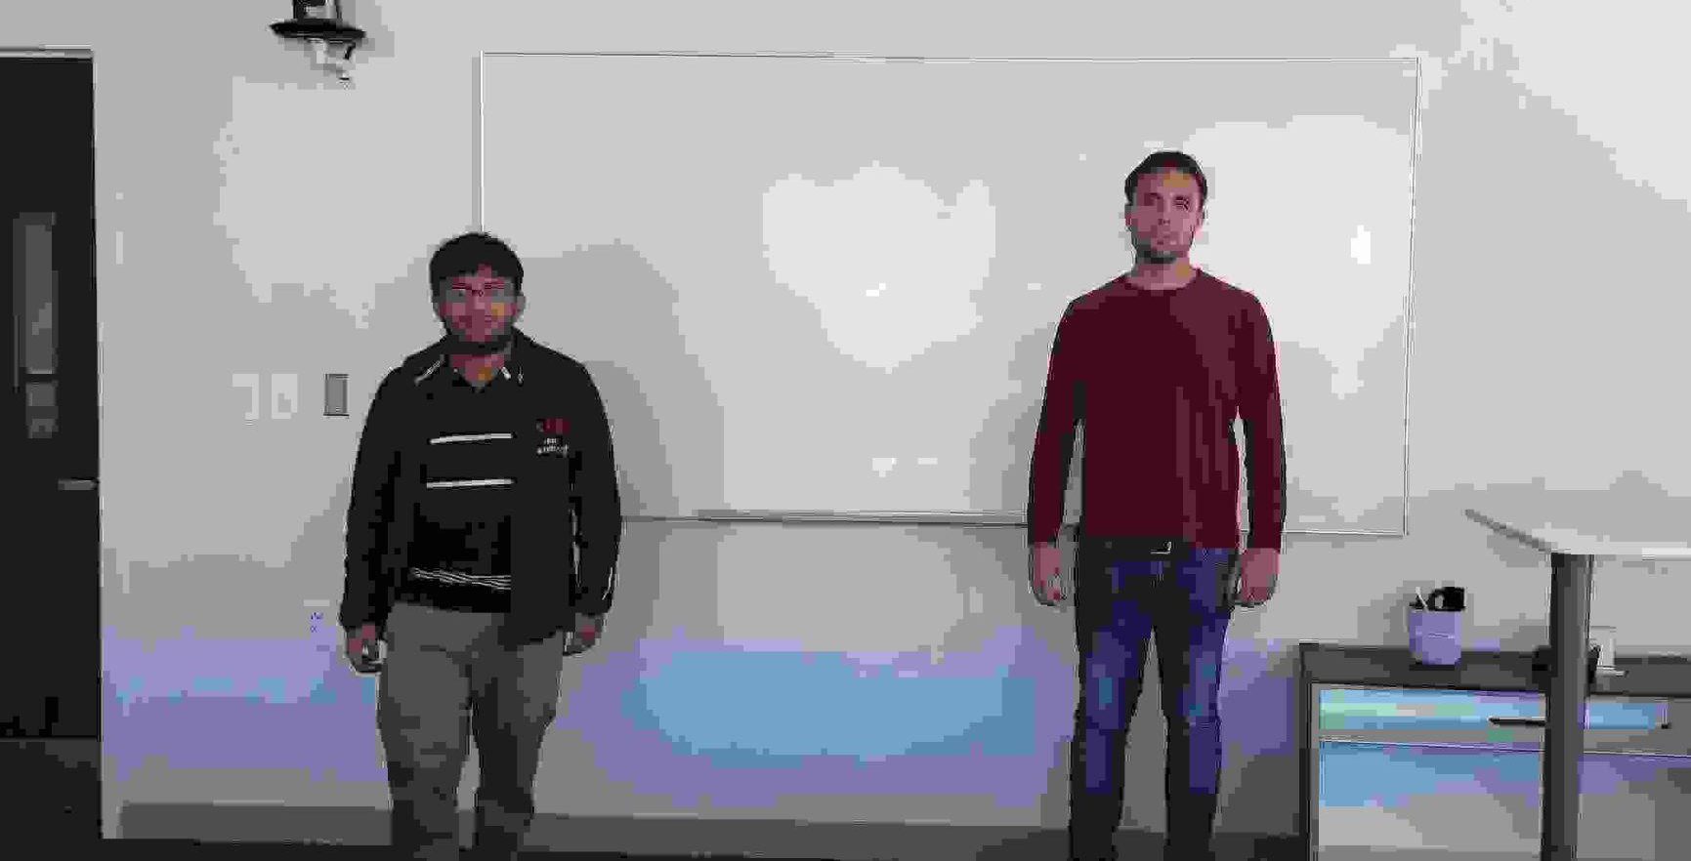
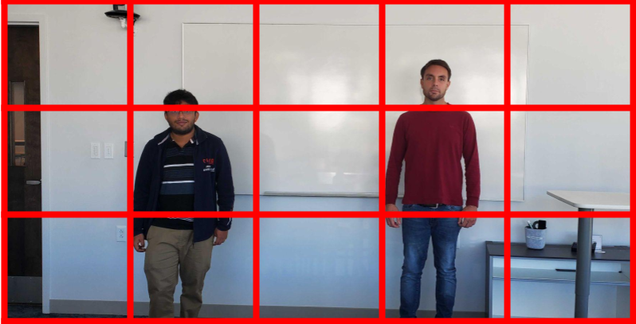
SAWEC: Sensing-Assisted Wireless Edge Computing
SAWEC
Traditional WEC for High-Resolution Data
High-Res Partial Frames Through Sensing
Edge Server
Frame Resize
Frame Partition

Slide 10

Summary of Key Contributions
We propose SAWEC, a new paradigm for wireless edge computing
E2E latency is optimized by offloading only the relevant data
SAWEC reduces the channel occupation and E2E latency by 94% and 96%
Improves the instance segmentation performance by 47%

Slide 11

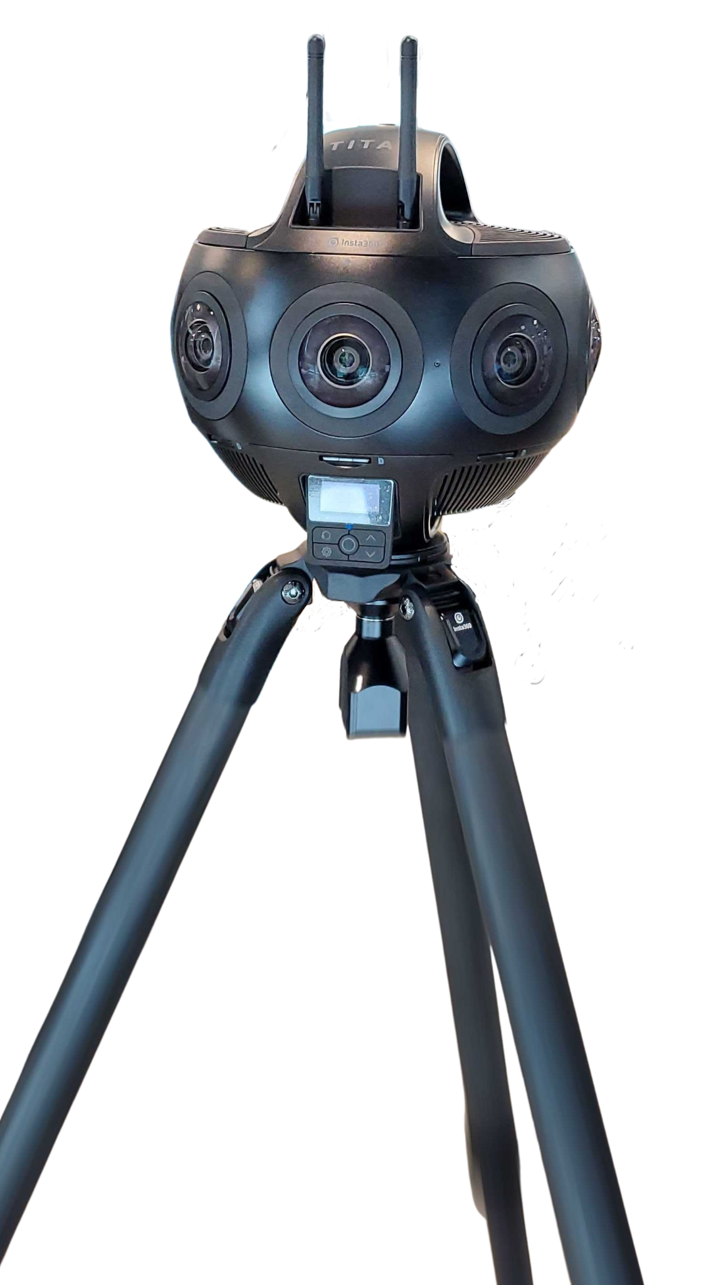



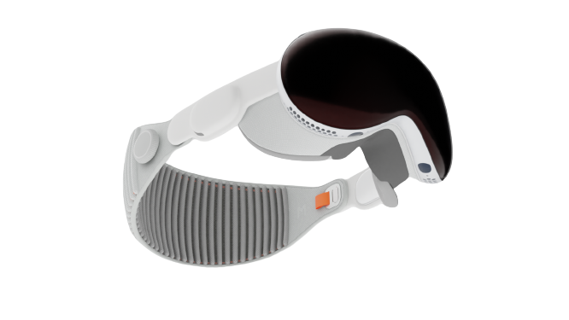


Overview of SAWEC
1
2
3
Sensing-Assisted
ROI Detection
ROI Offloading
Task Execution at Server
ROI 1 ROI N
360 Frame
Find ROI with Wireless Sensing
ML
Task
VR
System
A₁
A₂
B₁
B₂
0º
90º
180º
270º
360º
Edge
Server
Find A_{x},B_{x} For all ROI_{N}
N = 1, 2, 3, ……n
talking avatar
walking avatar

Slide 12
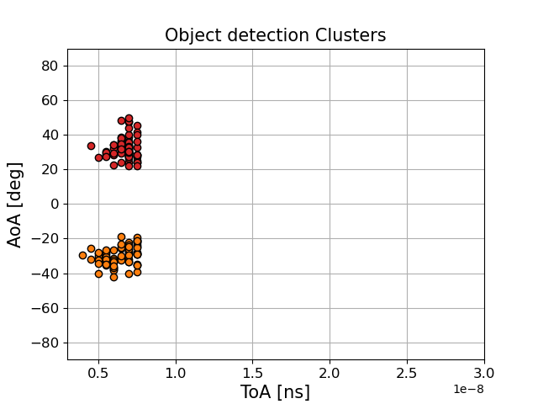
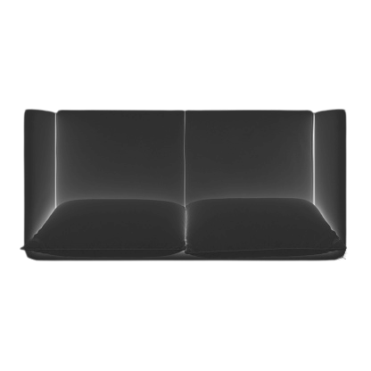
Detection of the Region of Interest (ROI)
1
3
Localization based on AoA and ToA
Find ROI based on AoA, ToA and Cluster Radius
90º
Cluster 1
90º
Cluster 2
0º
AoA: 40º
AoA(deg)
0º
ToF: 7 ns
-90º
-90º
5 10 15 20
ToA(ns)
2
Track Environmental Change
Through Moving Cluster
Calculate the range of the Cluster
AoA
ToA
Cluster 1
Cluster 1
Moving Cluster
Cluster 2
Cluster 2
Calculate ROI
Time= 1.2 s
Time= 2.2 s

Slide 13
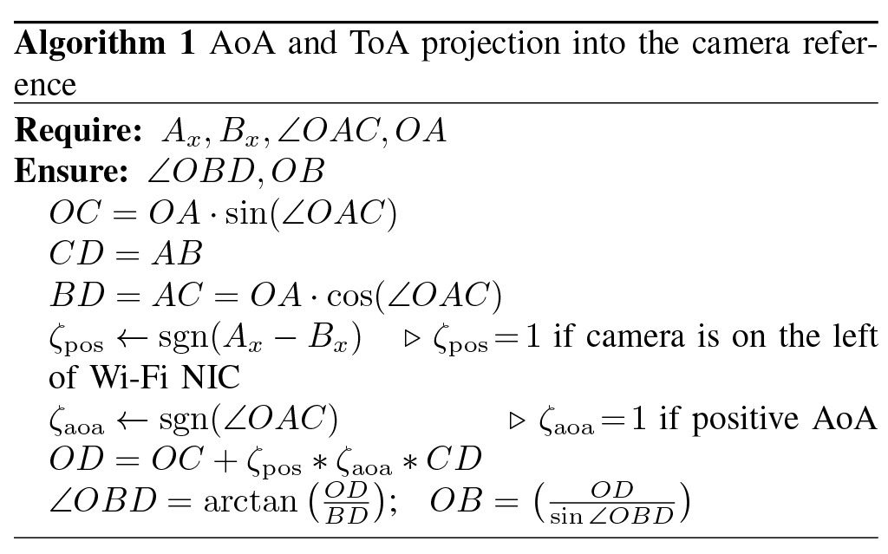
Cluster Projection to Camera Ref. System (1)

Slide 14
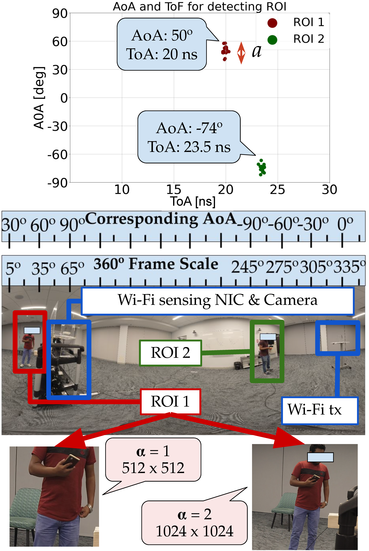
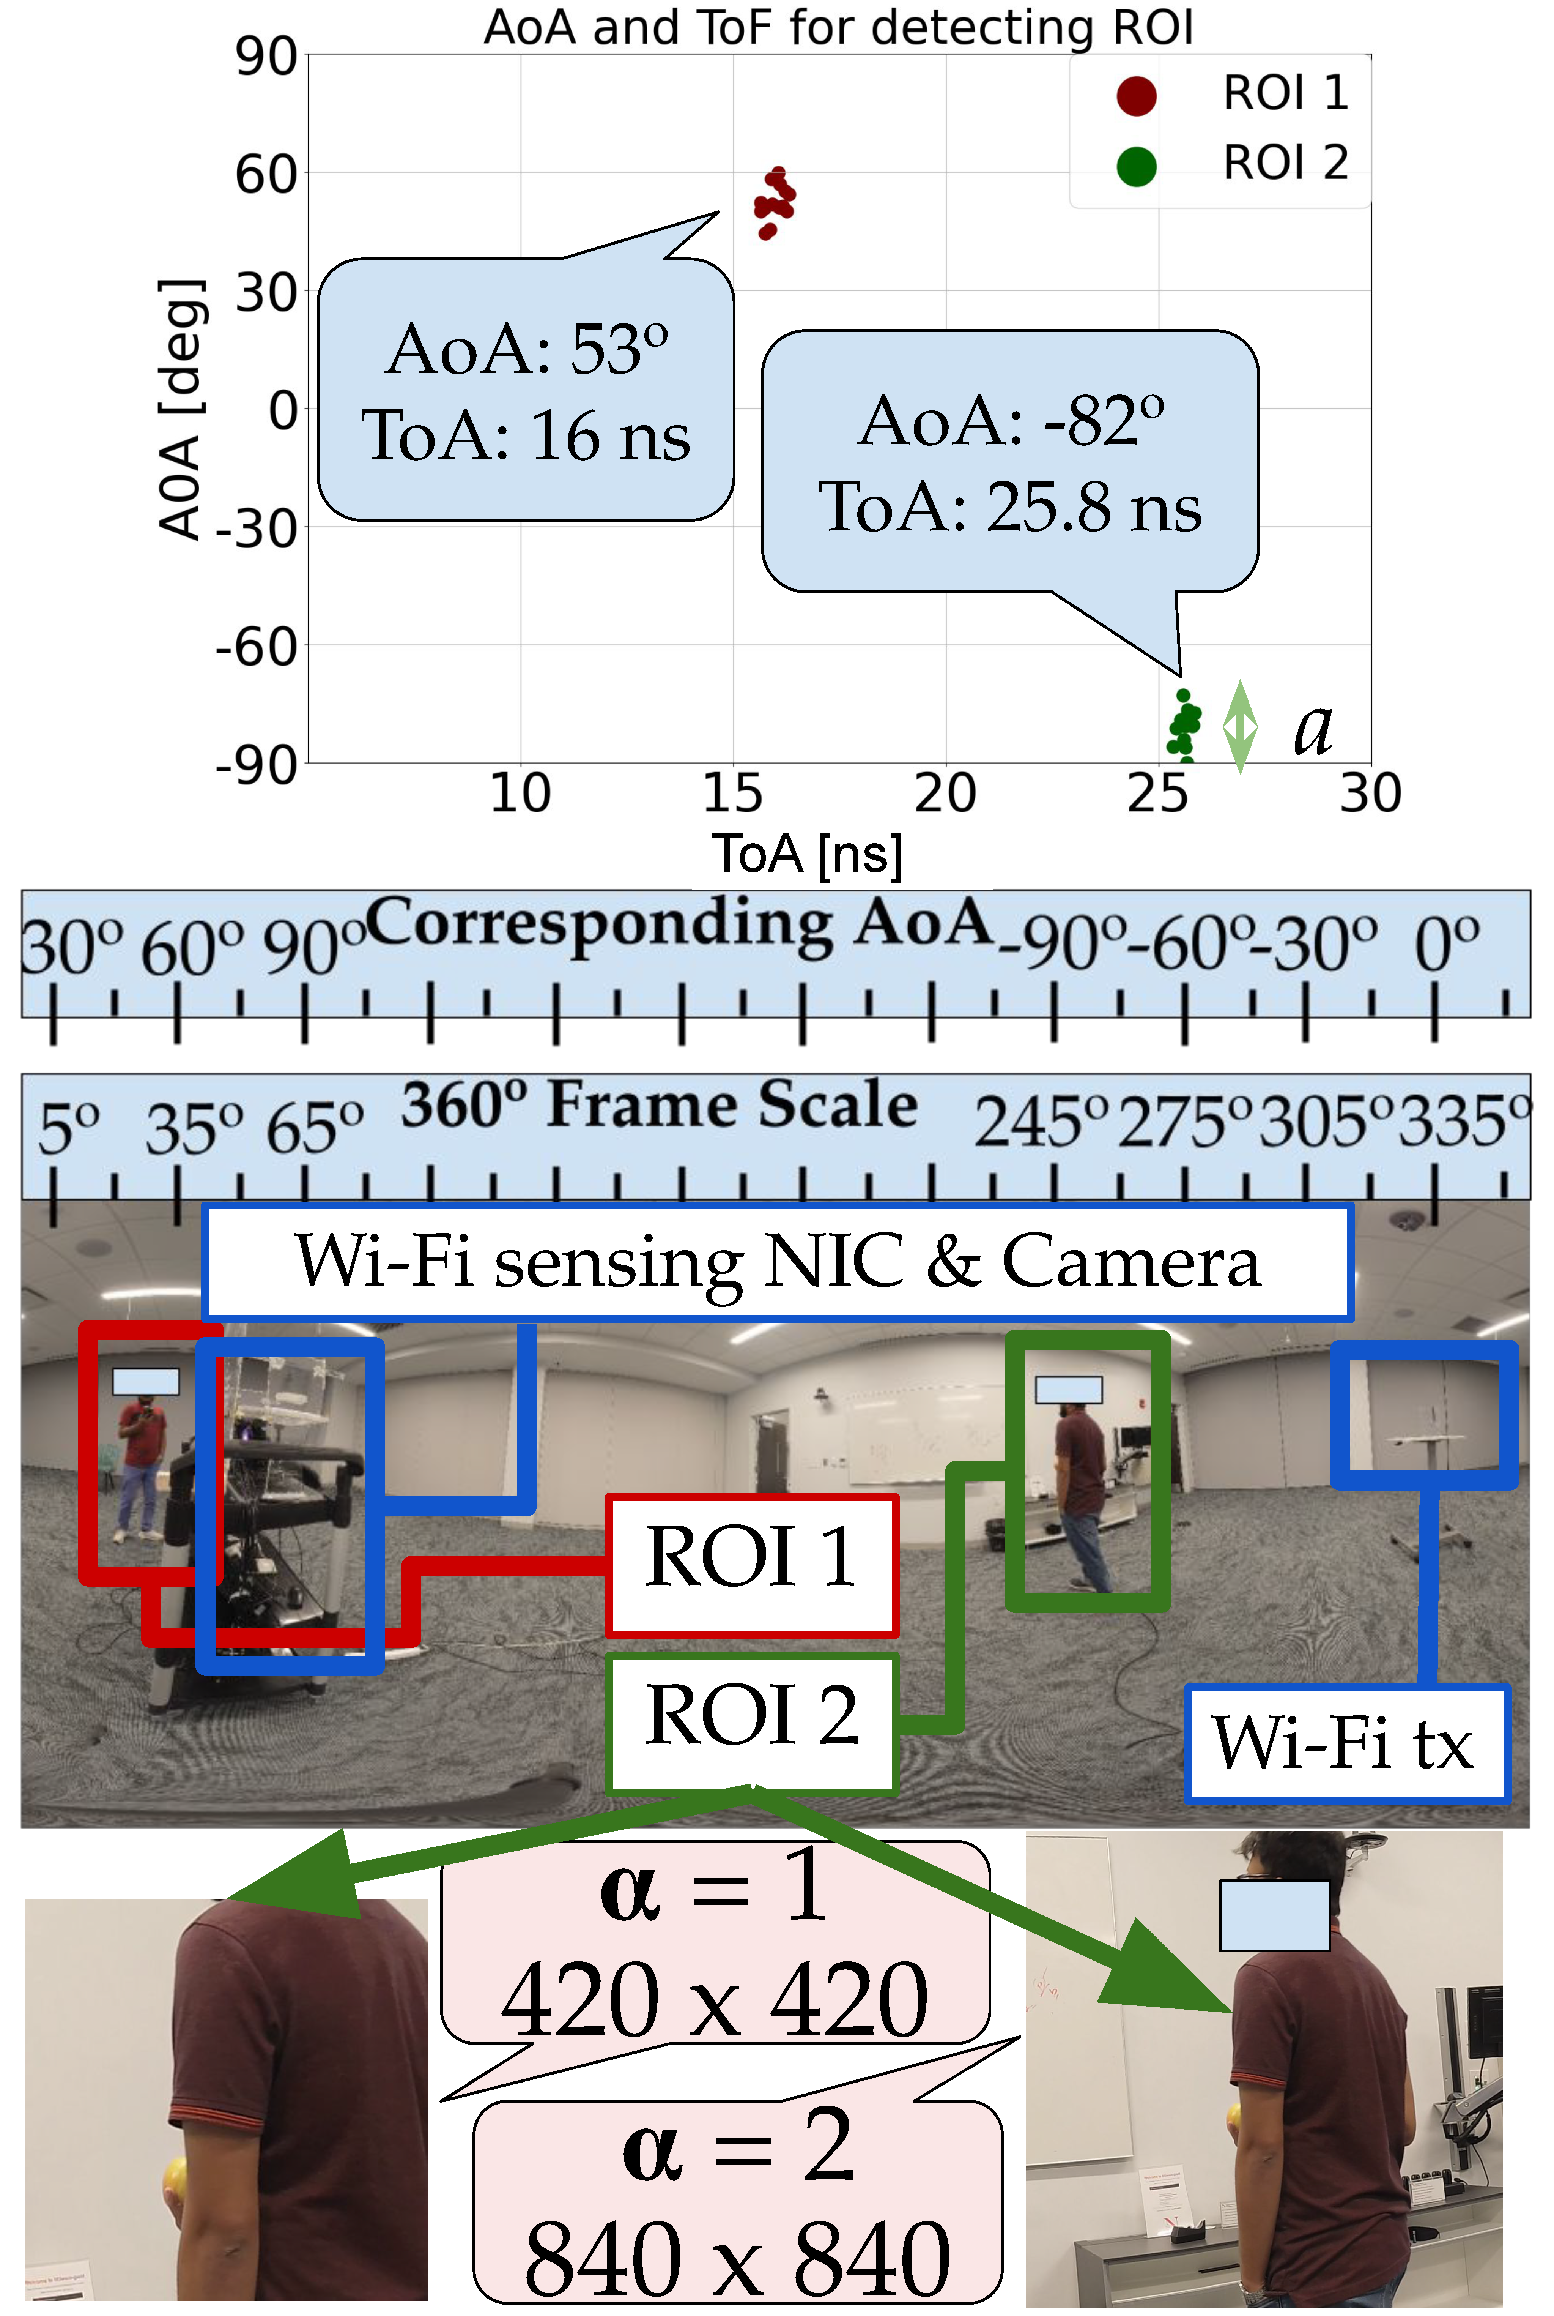
Cluster Projection to Camera Ref. System (2)
θ = [(∠OBD + θ_{tx}) mod 360]
Where,
  ∠OBD is AoA for camera ref. system
  θ is the object in 360 frame scale
  θ_{tx} is Wi-Fi tx in 360 frame scale
  mod represents modulo operation

Slide 15
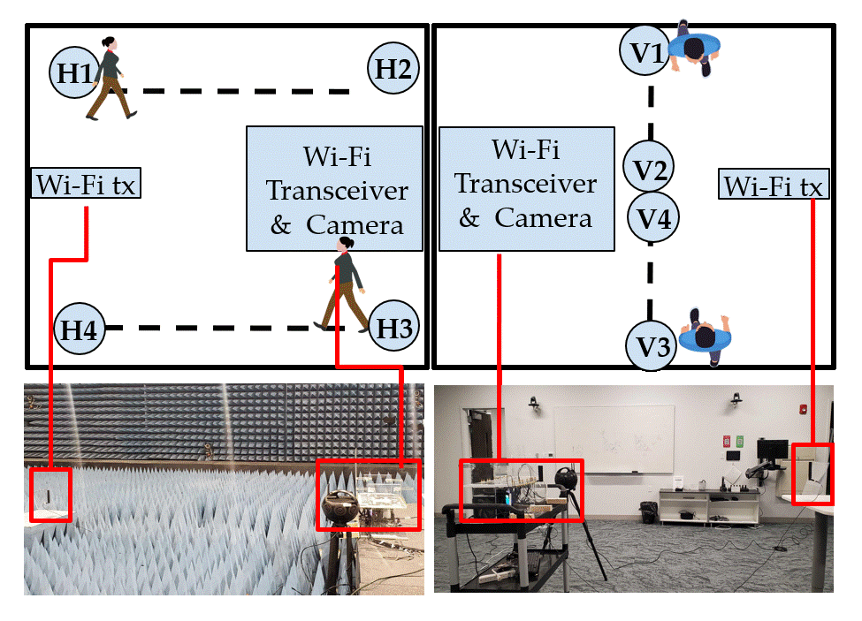
Experimental Setup
Components:
  Insta 360 camera
  Co-located IEEE 802.11ax client operating at 160 MHz
PicoScenes tool is used for CFR collection
360° video capture and CFR collection is synchronized
Six different tests are performed in each of two different environment: anechoic chamber and hall room

Slide 16
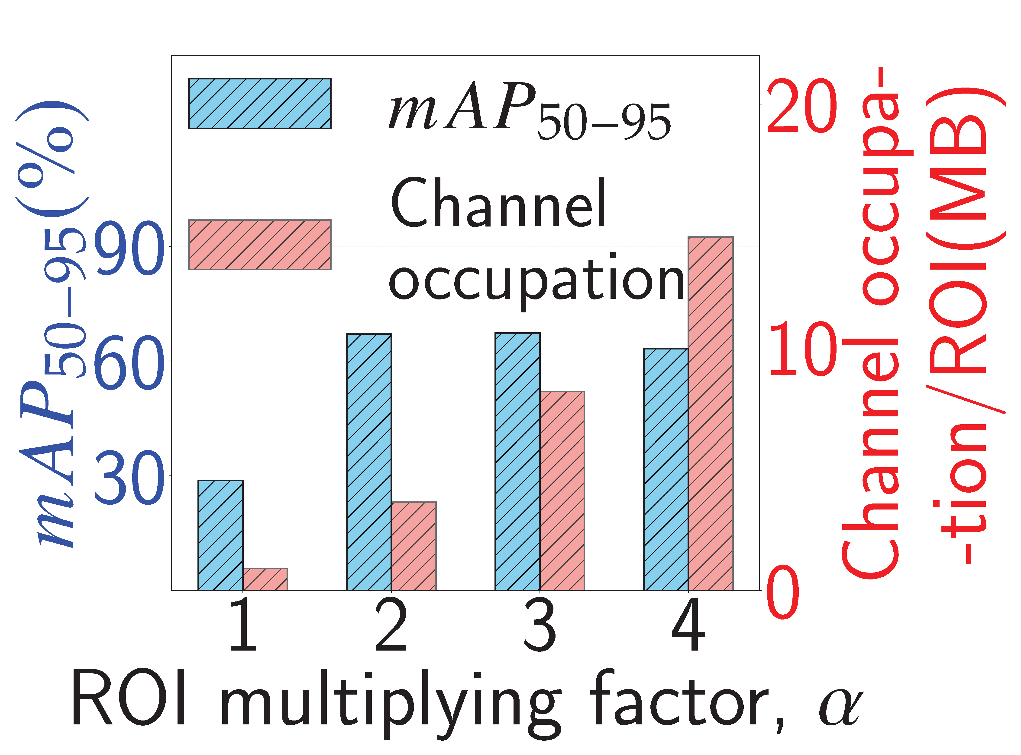
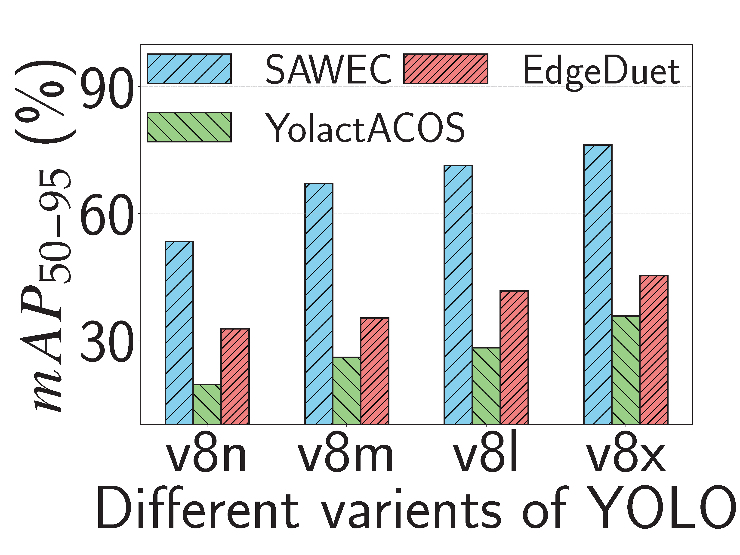
SAWEC Performance
Instance segmentation mAP₅₀₋₉₅ VS channel occupation at different α:
Instance segmentation mAP₅₀₋₉₅ with different variants of YOLOv8
At α = 2 the ROI is sufficiently large, and the mAP₅₀₋₉₅ reaches 67% with YOLOv8m
YOLOv8x achieves an mAP₅₀₋₉₅ of 76% while YolactACOS and EdgeDuet achieve only 36% and 45% respectively

Slide 17
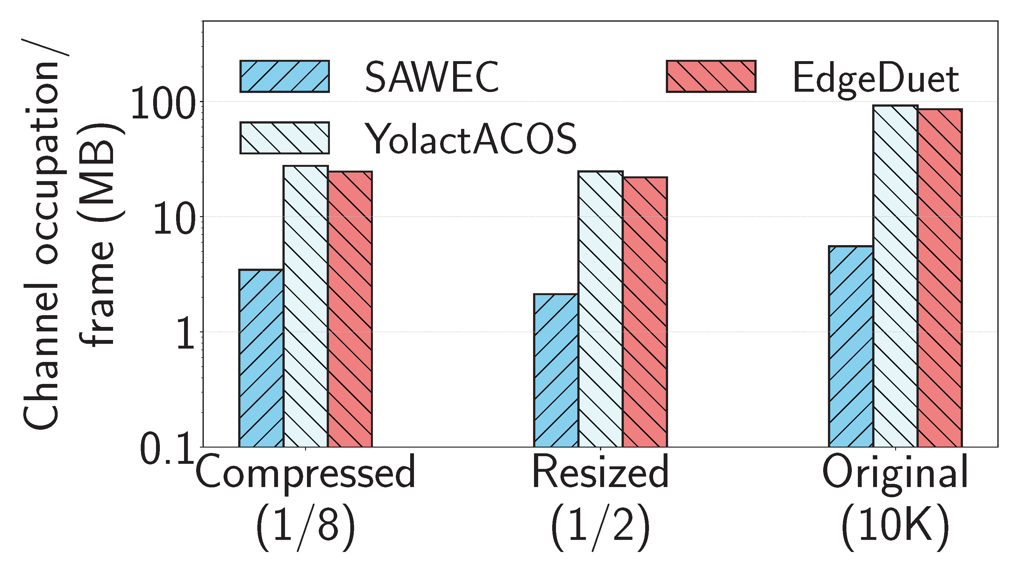
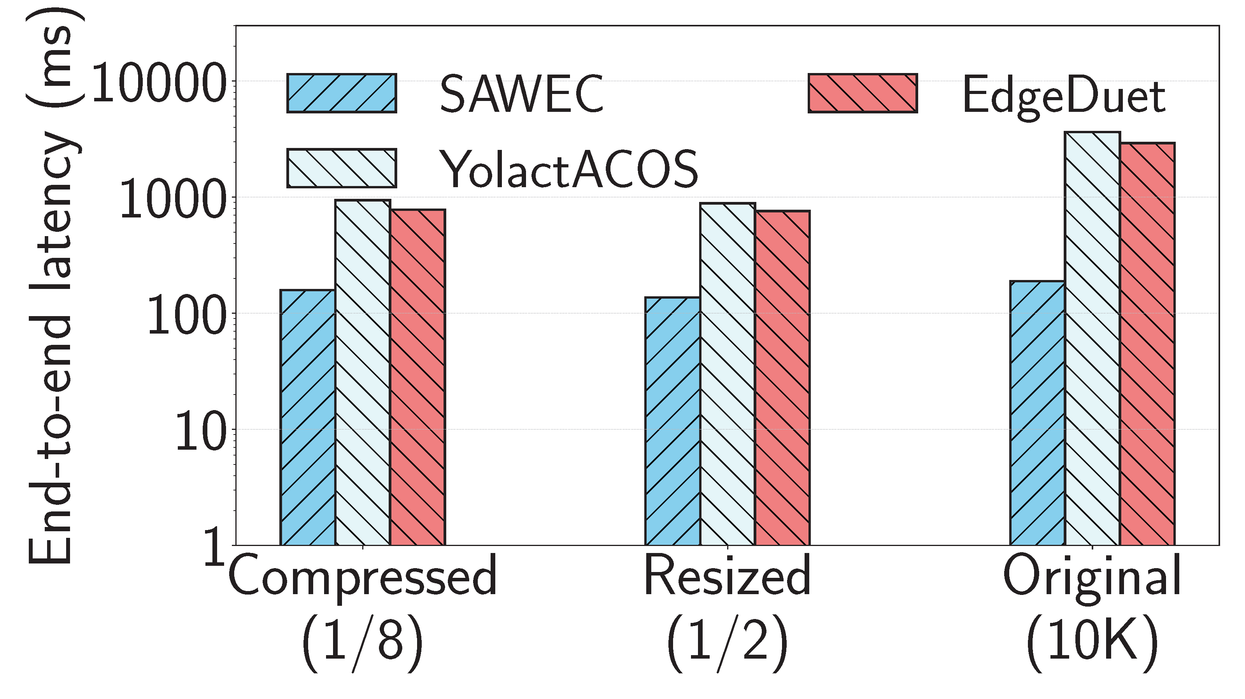
Comparative analysis of SAWEC
Analysis with original (10K), and tolerable compressed (1/8) and resized images (1/2)
Channel Occupation
End-to-end Latency
The size of a 10K frame is 138.88 MB
SAWEC, YolactACOS, and EdgeDuet require 5.5 MB, 92.2 MB and 85.9 MB per frame respectively
At 10K resolution, SAWEC improves the latency by 94% on an average

Slide 18
Summary of Key Contributions
We have proposed SAWEC, a new paradigm for wireless edge computing
E2E latency is optimized by offloading only the relevant data
SAWEC reduces the channel occupation and E2E latency by 94% and 96%
Improves the instance segmentation performance by 47%

Slide 19

Possible Next Steps?
This work 💪🏻
⚠️ Improve
localization
accuracy
⚠️ Scale the system to several moving objects
Things
to do 😅

Slide 20

Thank You
haque.k@northeastern.edu

