Slide 1
Beamsense: Rethinking Wireless Sensing with MU-MIMO Wi-Fi Beamforming Feedback
K. Foysal Haque
MENTIS Lab
Institute for the Wireless Internet of Things (WIoT)
Northeastern University

Slide 2

AR/VR: Shaping the Future of Interactions
Global market value is predicted to reach 1066 Billion by 2034 [1]
We are very far from truly seamless and immersive
AR/VR experiences
1. Precedence Research. "Spatial Computing Market Size, Share, Trends, Analysis Report, 2025-2034." Accessed October 21, 2025. https://www.precedenceresearch.com/spatial-computing-market

Slide 3
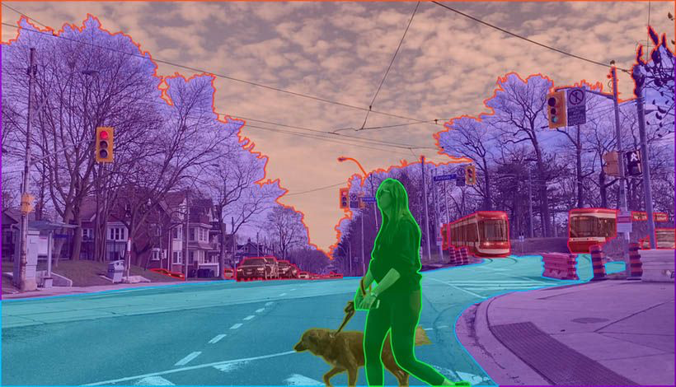
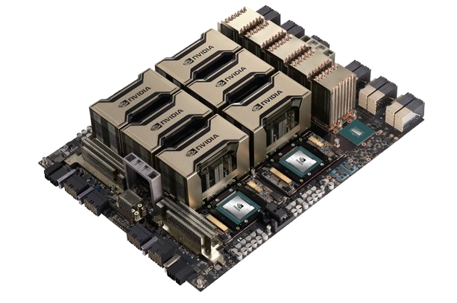

What is the Current Bottleneck?
Semantic segmentation
Compute-intensive
AI/ML tasks
120 Hz frame rate and 8K resolution are needed! [1]
Object recognition​
1. M Gallagher, ER Ferrè, "Cybersickness: a multisensory integration perspective", Multisensory Research, 2018. Ars Technica, "Virtual Perfection: Why 8K resolution per eye isn't enough for perfect VR", 2013.

Slide 4
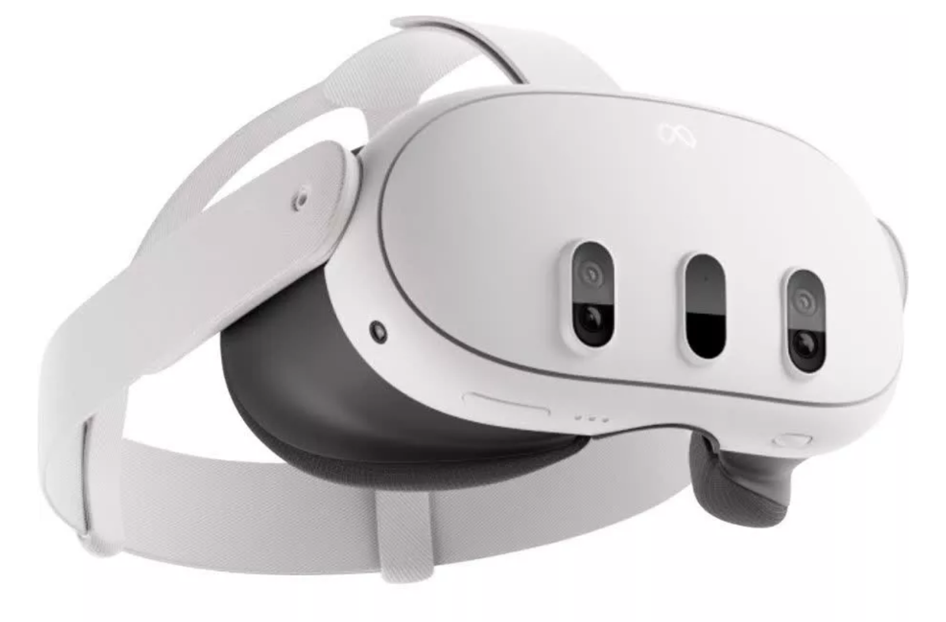
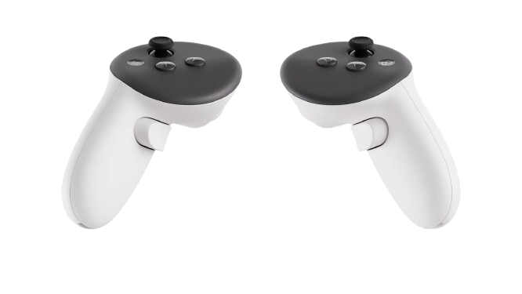
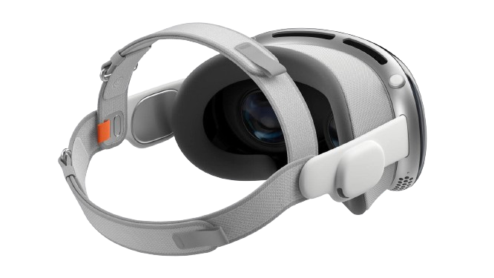
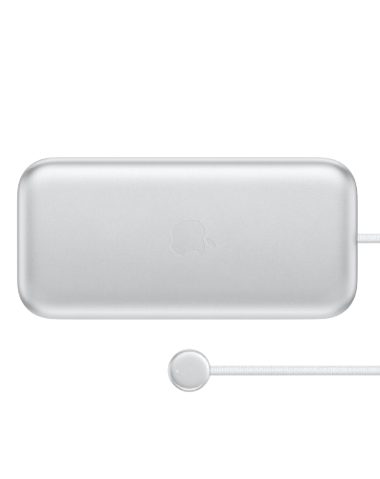
State of Current Wireless AR/VR Headsets
Weight
515 grams
Refresh rate
Up to 90 Hz
Meta Quest 3
1.5-2 hours
Controllers
Weight
650 grams plus
353 grams battery
Refresh rate
Up to 90 Hz
Apple Vision Pro
Up to 2 hours
External
battery

Slide 5

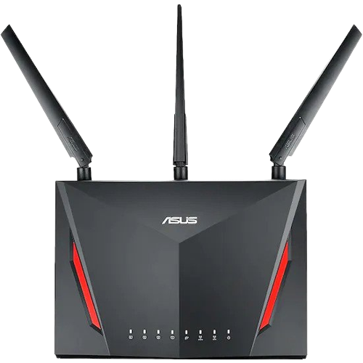
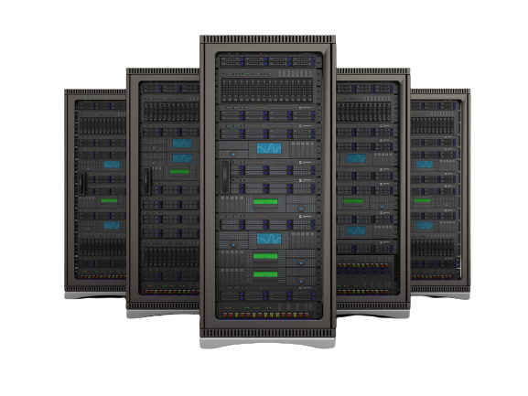
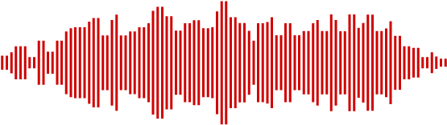
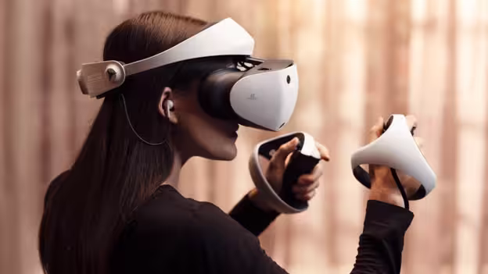
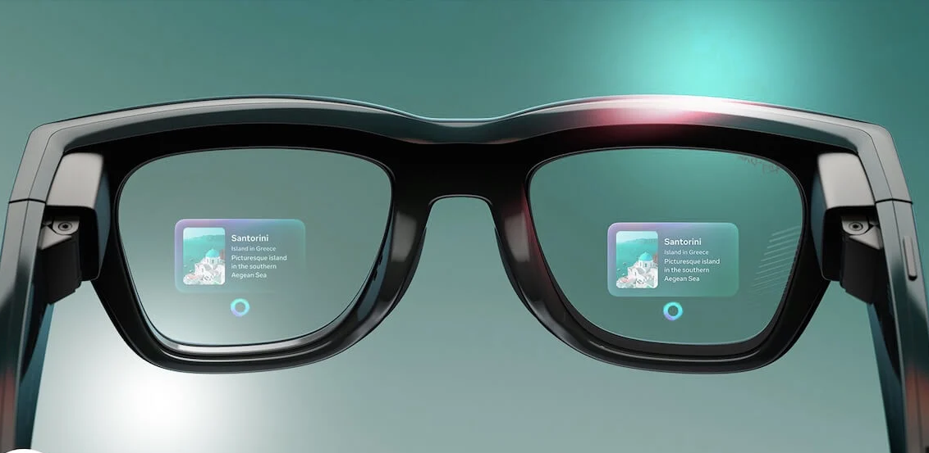
Wireless Edge Computing and Sensing
Offload intensive compute task to edge server
Wireless sensing for surrounding awareness
Light-weight & device free
AR/VR experience

Slide 6
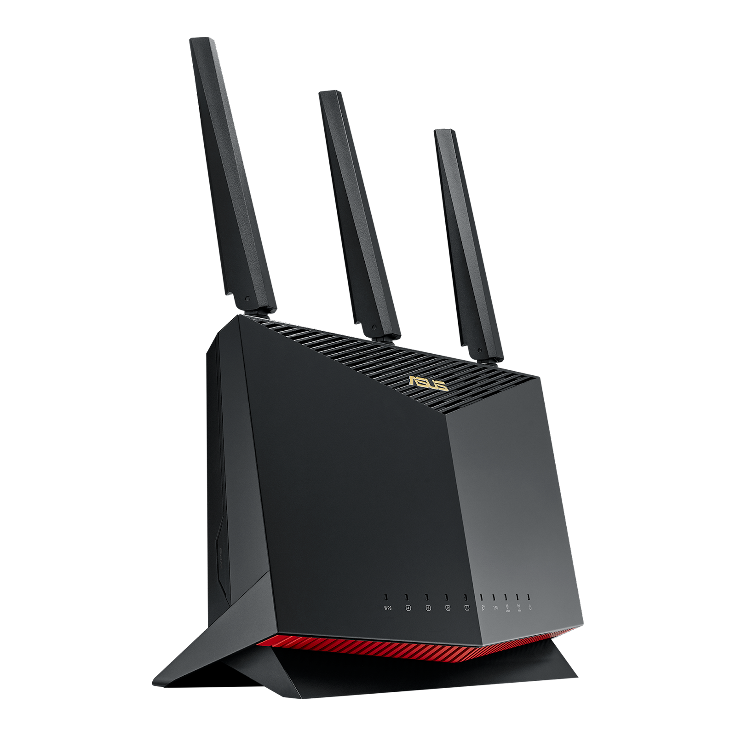
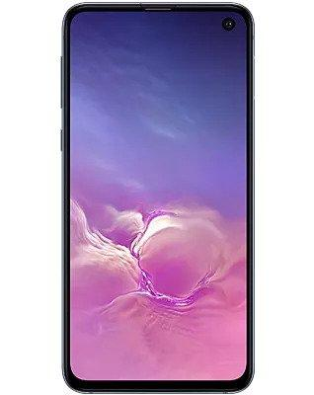



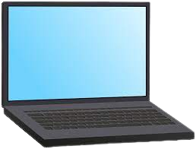
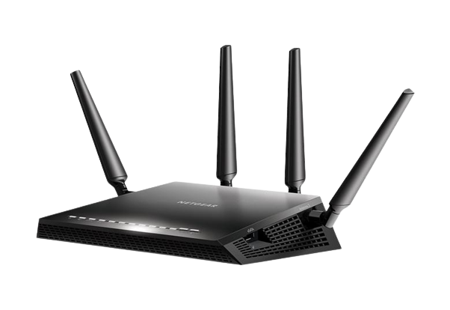
Introduction on Wireless Sensing
Perceived by the changes in the received signal
Main approaches [1] are based on:
  Received Signal Strength
  Passive Wi-Fi Radar
  Channel Frequency Response (CFR)
Transmitted Wi-Fi
Signals
Activity
Recognition
Health Monitoring
Presence Detection
Received
Wi-Fi Signals
Channel Information
Feature Extraction
Classification
1. Khandaker Foysal Haque, Milin Zhang, Francesca Meneghello, and Francesco Restuccia. "Beamsense: Rethinking wireless sensing with mu-mimo wi-fi beamforming feedback." Computer Networks 258 (2025): 111020.

Slide 7



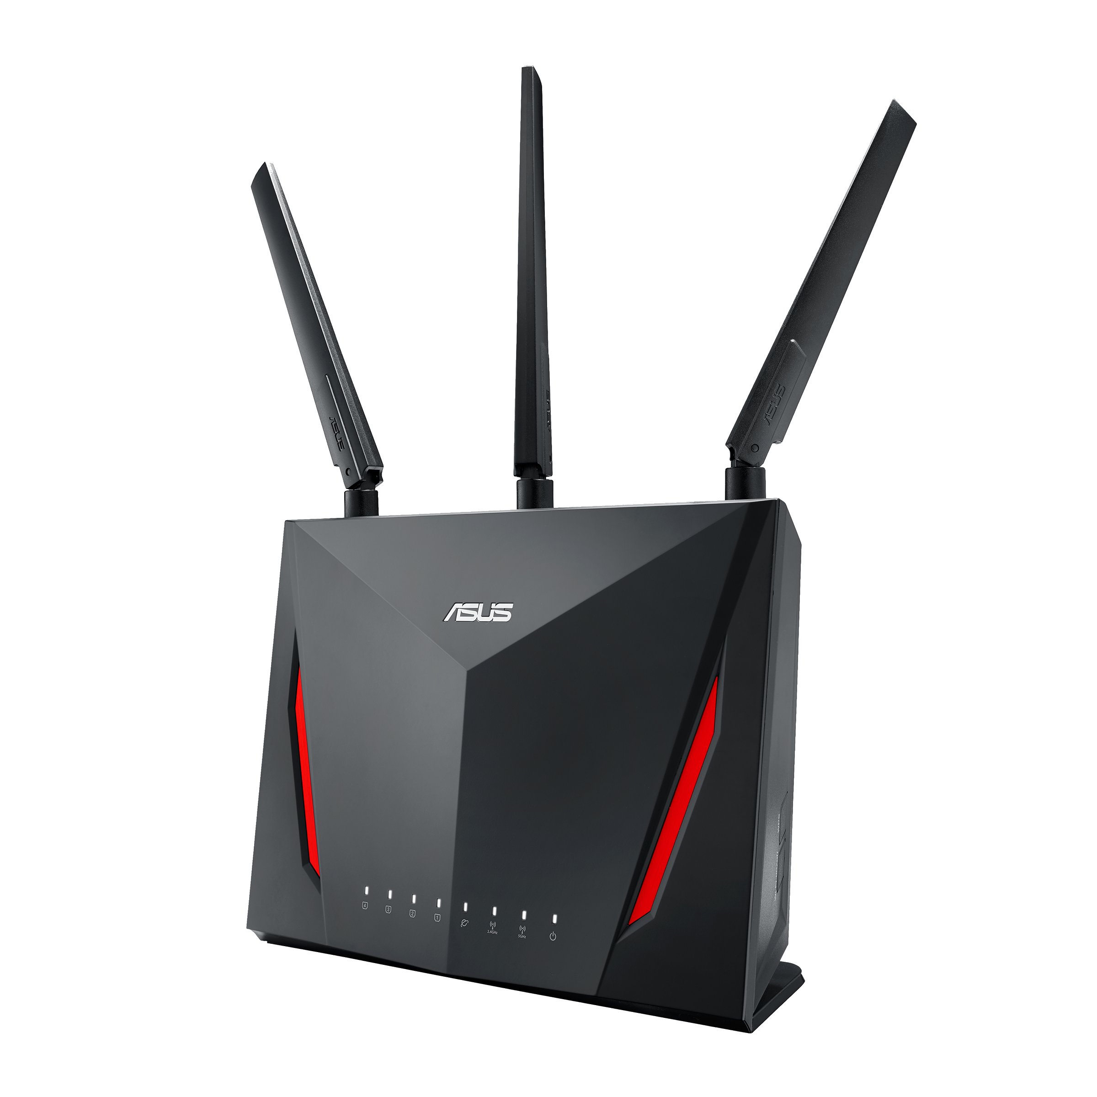
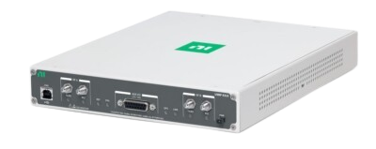
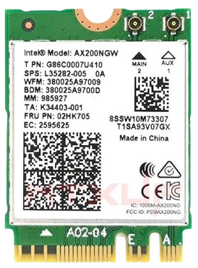


Prior Work and Existing Challenges
Need Firmware Modifications
802.11n CSI Tool
Need Dedicated CSI Tools
Limited Hardware
Can’t Generalize Domains
Bahadori, N., Ashdown, J. and Restuccia, F., 2022, June. ReWiS: Reliable Wi-Fi sensing through few-shot multi-antenna multi-receiver CSI learning. In 2022 IEEE WoWMoM (pp. 50-59).
Meneghello, D. Garlisi, N. Dal Fabbro, I. Tinnirello, and M. Rossi, “SHARP: Environment and Person Independent Activity Recognition with Commodity IEEE 802.11 Access Points,” IEEE TMC, 2022.
R. Xiao, J. Liu, J. Han, and K. Ren, “OneFi: One-Shot Recognition for Unseen Gesture via COTS WiFi,” in Proceedings of the ACM Conference on Embedded Networked Sensor Systems (SenSys), pp. 206–219, 2021
Yin, G., Zhang, J., Shen, G. and Chen, Y., 2022. FewSense, towards a scalable and cross-domain Wi-Fi sensing system using few-shot learning. IEEE TMC, 23(1), pp.453-468.
Ma, Y., Zhou, G., Wang, S., Zhao, H. and Jung, W., 2018. SignFi: Sign language recognition using WiFi. Proceedings of the ACM IMWUT, 2(1), pp.1-21.

Slide 8







BeamSense: Overview and Novelties
Existing CFR based Approaches
BeamSense- based on BFI
CSI
Collectors
MU-MIMO Beamformees
CSI
Access
Point
Access
Point
CSI
Beamforming Feedback
Requires specialized equipment
Requires Direct Access to Devices
Introduces additional overhead
No specialized equipment
No Direct Access Required
No additional overhead

Slide 9
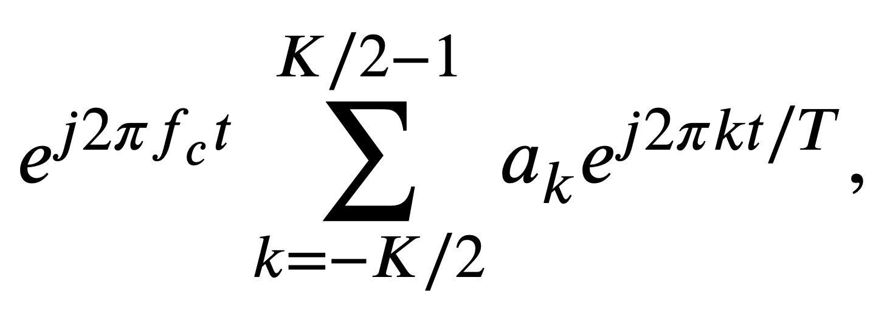
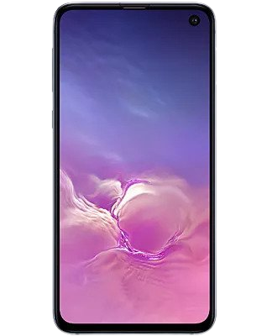
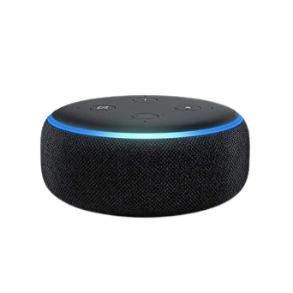
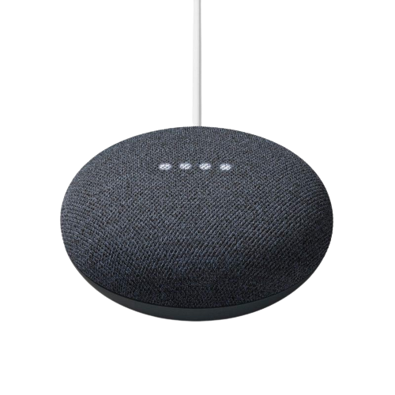
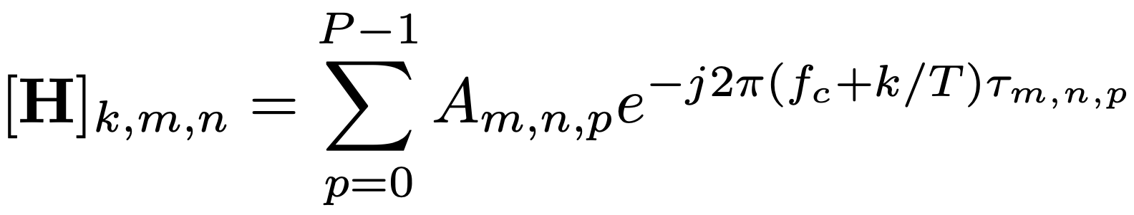
From CFR to BFI
1
2
Null Data Packet (NDP)
MU-MIMO Beamformees
MU-MIMO Beamformer
Estimate CFR, H
Compress CFR, V_{k}
Create BFI Frame
Beamforming Feedback Information
4
3

Slide 10
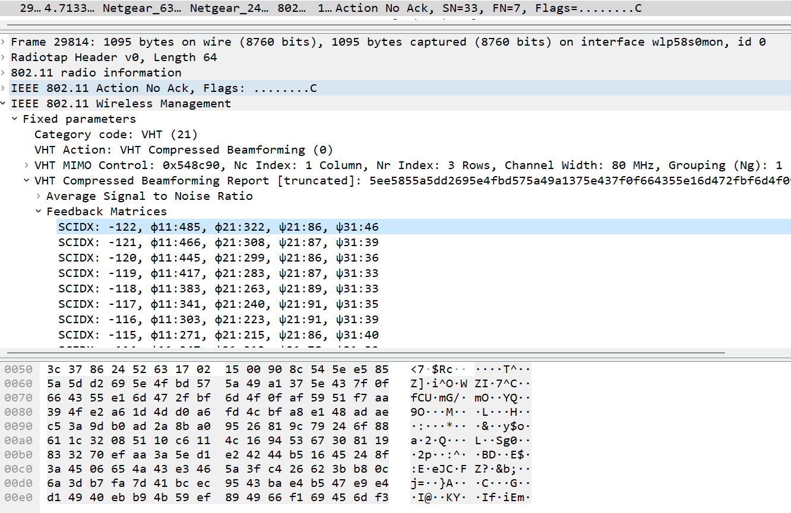
Beamforming feedback matrices
Transmitted unencrypted
Packet Bytes

Slide 11

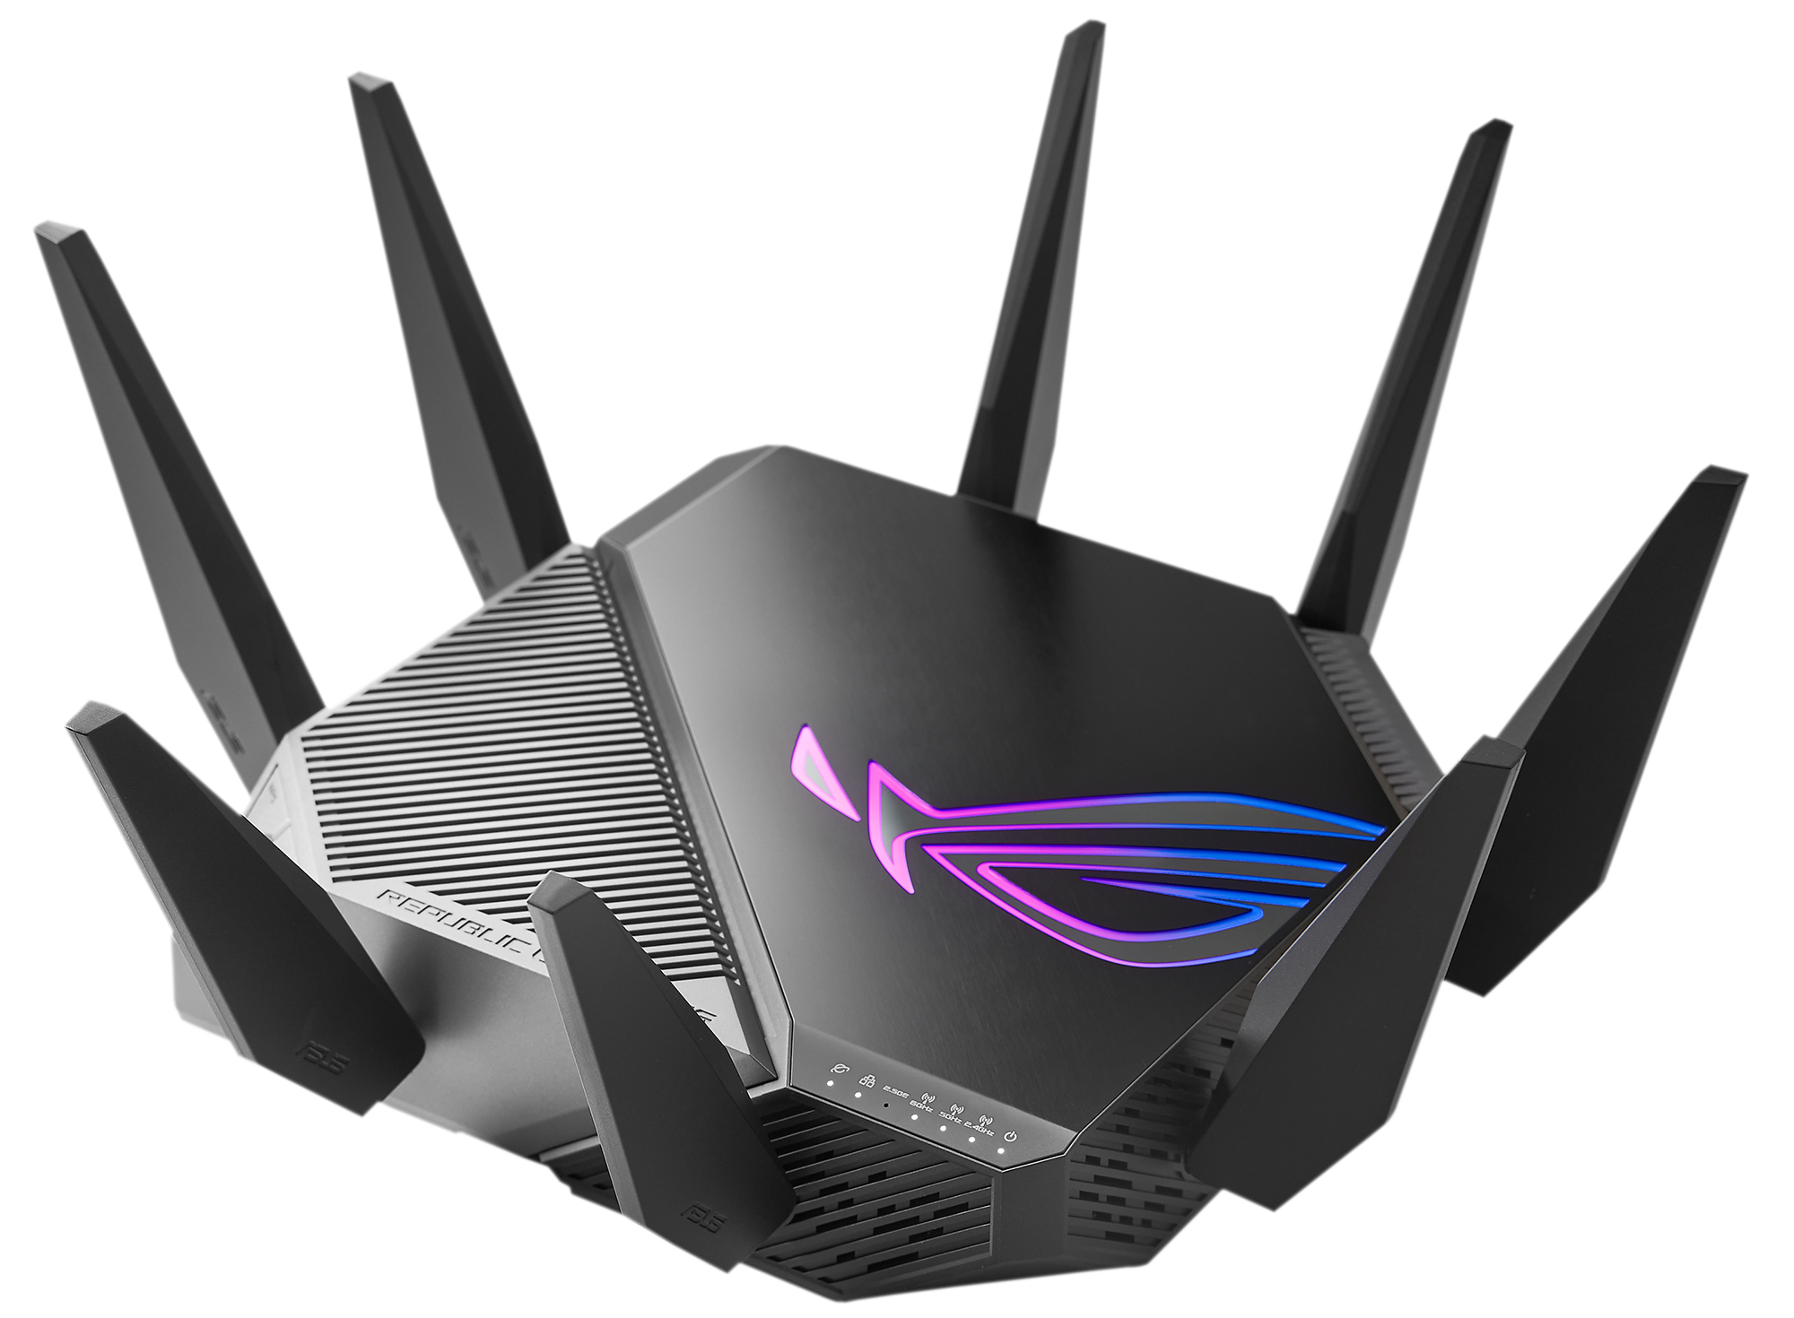
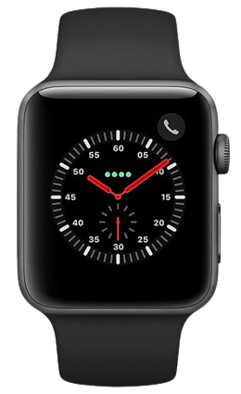
Operation of BeamSense
Woks with any device supporting MIMO
Support across multiple standard
Works with multiple bands simultaneously
No direct access to the network needed
Can be collected with a single capture
IEEE 802.11 ac/ax stations
AP
IEEE 802.11ac
STA 1
BW: 80 MHz
IEEE 802.11ax
STA 2
BW: 160 MHz
...
...
Edge Server
IEEE 802.11ax
STA N
BW: 40 MHz

Slide 12
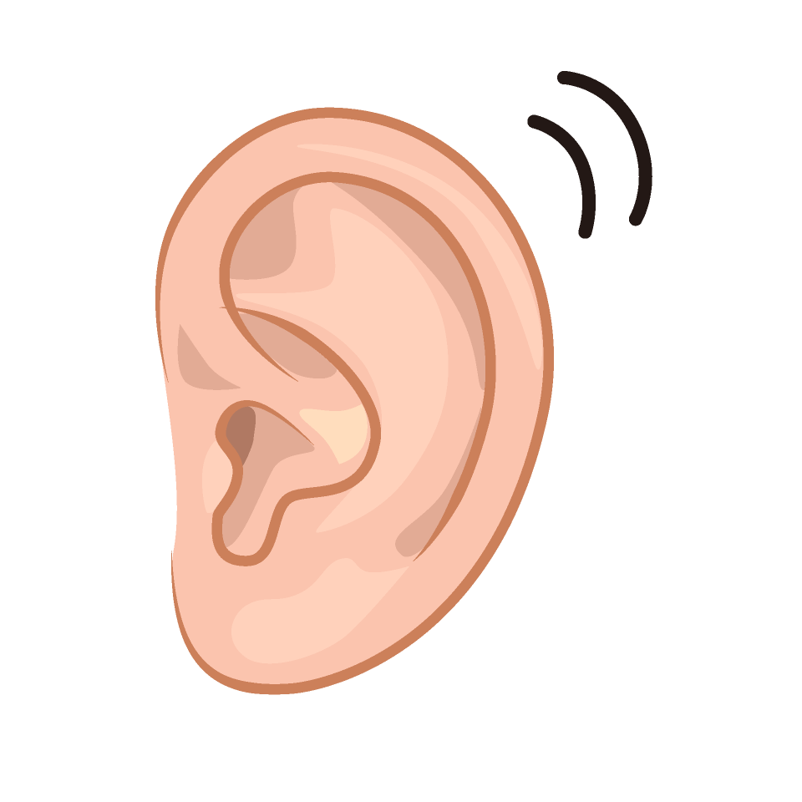
Capture BFI with Wi-BFI Tool
1
2
MU-MIMO Beamformees
Null Data Packet (NDP)
MU-MIMO Beamformer
4
3
Beamforming Feedback Information
Estimate CFR
5
Feedback Frame Capture with
Wi-BFI [1, 2]
Compress CFR
Create BFI Frame
Wi-BFI captures the beamforming feedback packet
Decode the Wi-Fi BFAs based on the network configuration
Supports both online and offline extraction for IEEE 802.11ac and 802.11ax
Khandaker Foysal Haque, Francesca Meneghello, and Francesco Restuccia. "Wi-BFI: Extracting the IEEE 802.11 beamforming feedback information from commercial Wi-Fi devices." In Proceedings of the 17th ACM Workshop on Wireless Network Testbeds, Experimental evaluation & Characterization, pp. 104-111. 2023.
https://github.com/kfoysalhaque/Wi-BFI

Slide 13
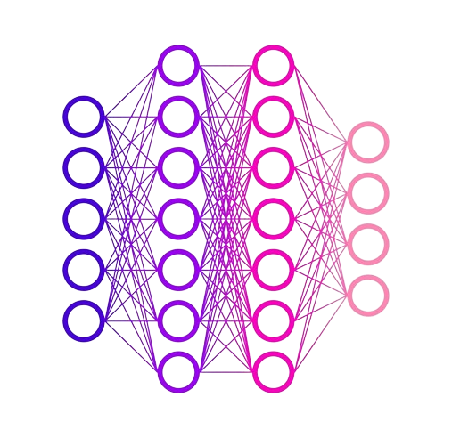

BeamSense Walkthrough
1
2
MU-MIMO Beamformees
Null Data Packet (NDP)
MU-MIMO Beamformer
4
3
Beamforming Feedback Information
Estimate CFR
5
Feedback Frame Capture with
Wi-BFI [1, 2]
Compress CFR
Create BFI Frame
6
8
BeamSense Model training
BeamSense
Inference
7
Classification
output
BeamSense Dataset Creation

Slide 14
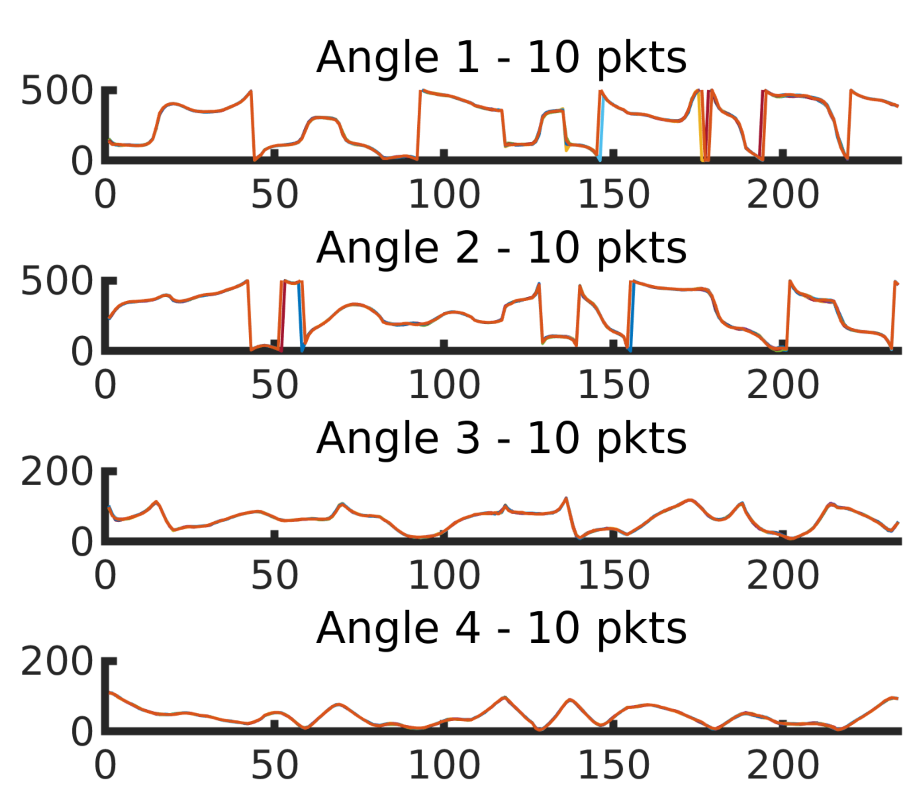
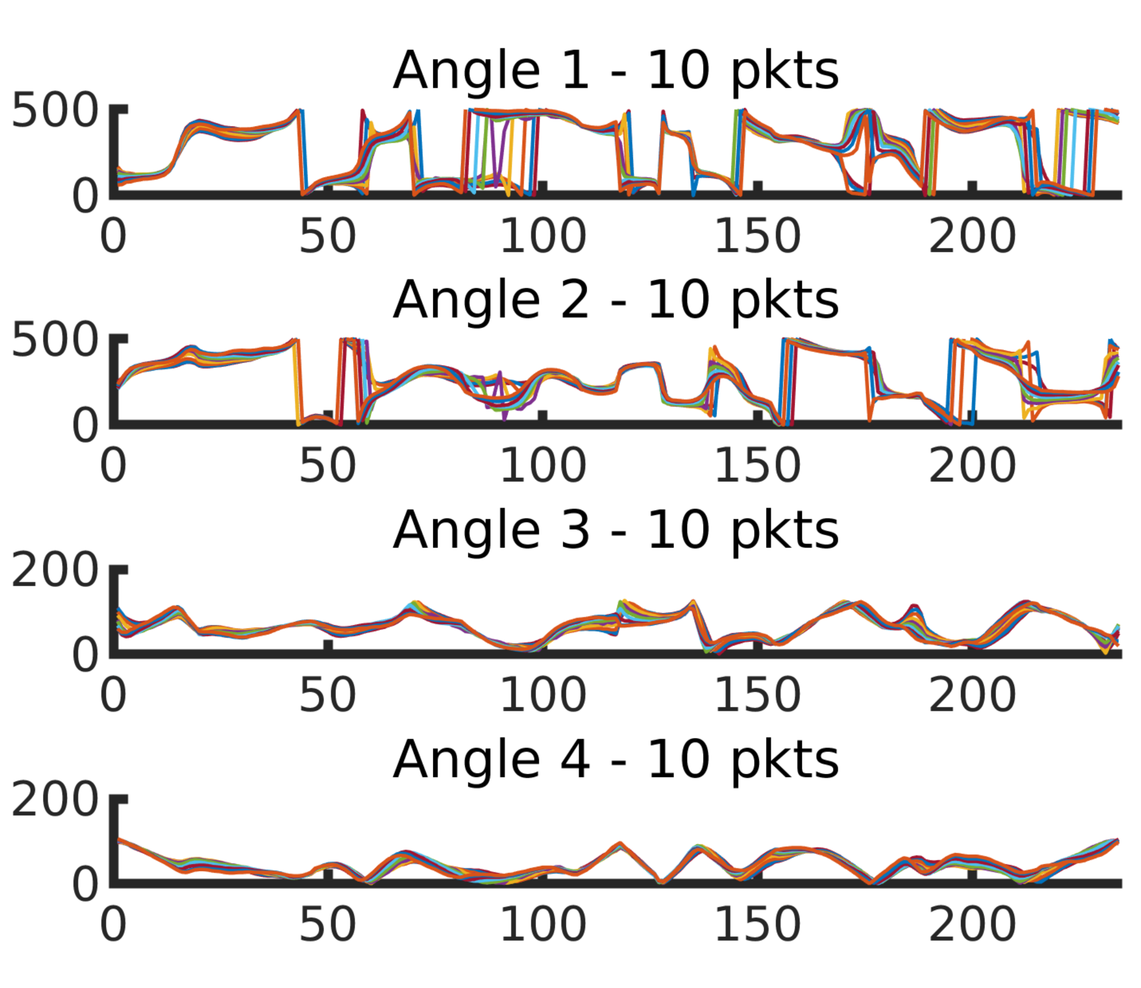
Data Preprocessing
Each sample captures the variations of Angle 1 over subcarriers (234) and time (0.1s)
BFI packets in a window
S BFI packets collection
BFI, STA #1, t = 0.001
Browsing phone
Walking
...
Beamforming
angles extraction
BFI, STA #3, t = 0.086
BFI, STA #1, t = 0.095
Data aggregation
S: no. samples
K: no. OFDM sub-channels
A: no. BFI angles in a packet
U: no. MU-MIMO users
(S x K x A x U)
Input Tensor
Sub-channels
Sub-channels

Slide 15
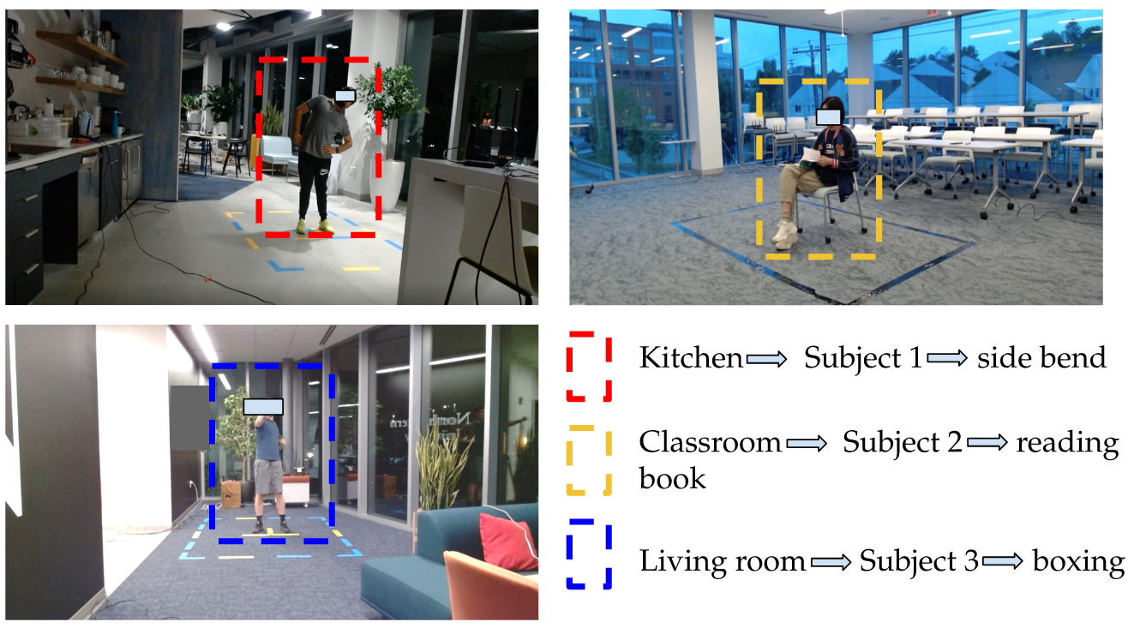
Data Collection Campaign
Data collection campaign is done with 3 different persons, with 20 activities each in 3 different environment
Data has been collected with 3 different orientations at different times of day
Video Streams has been recorded as ground truth

Slide 16
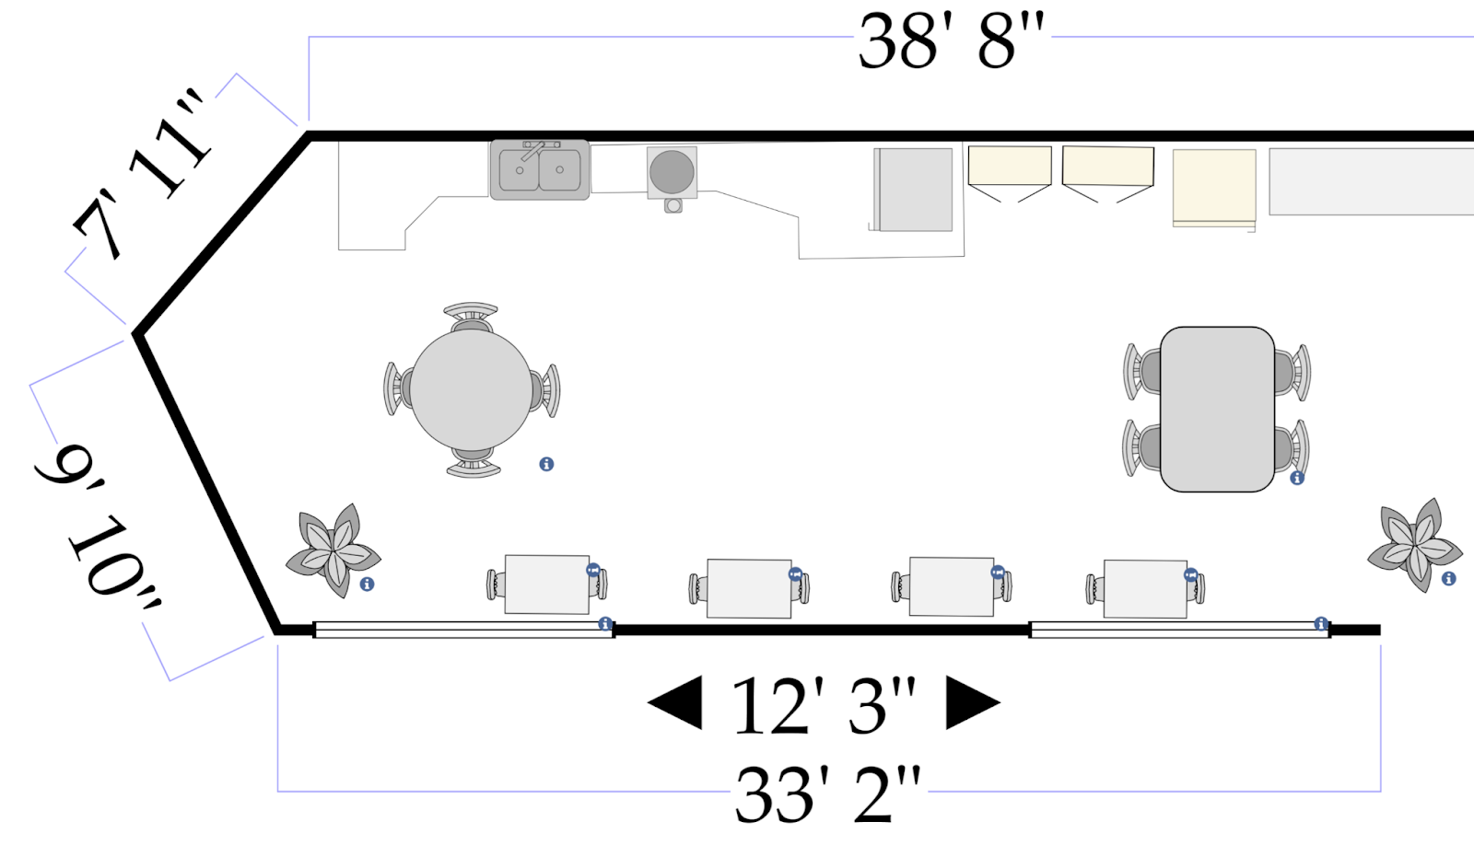
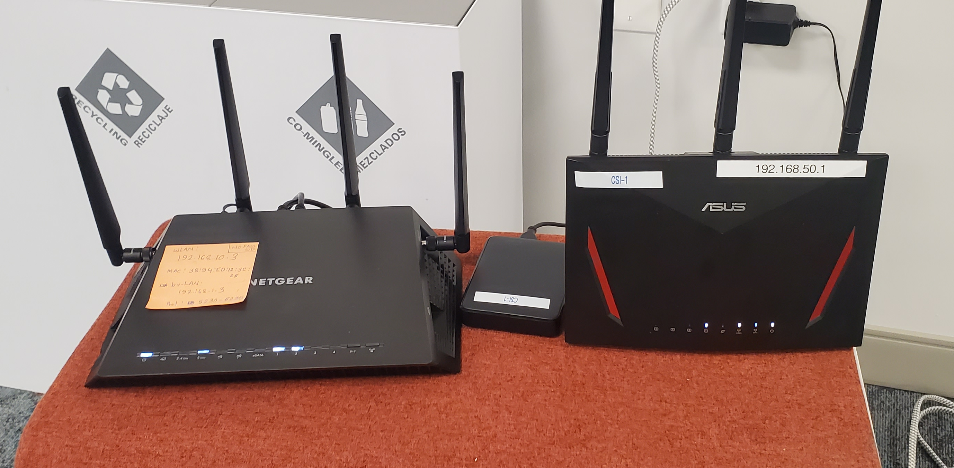

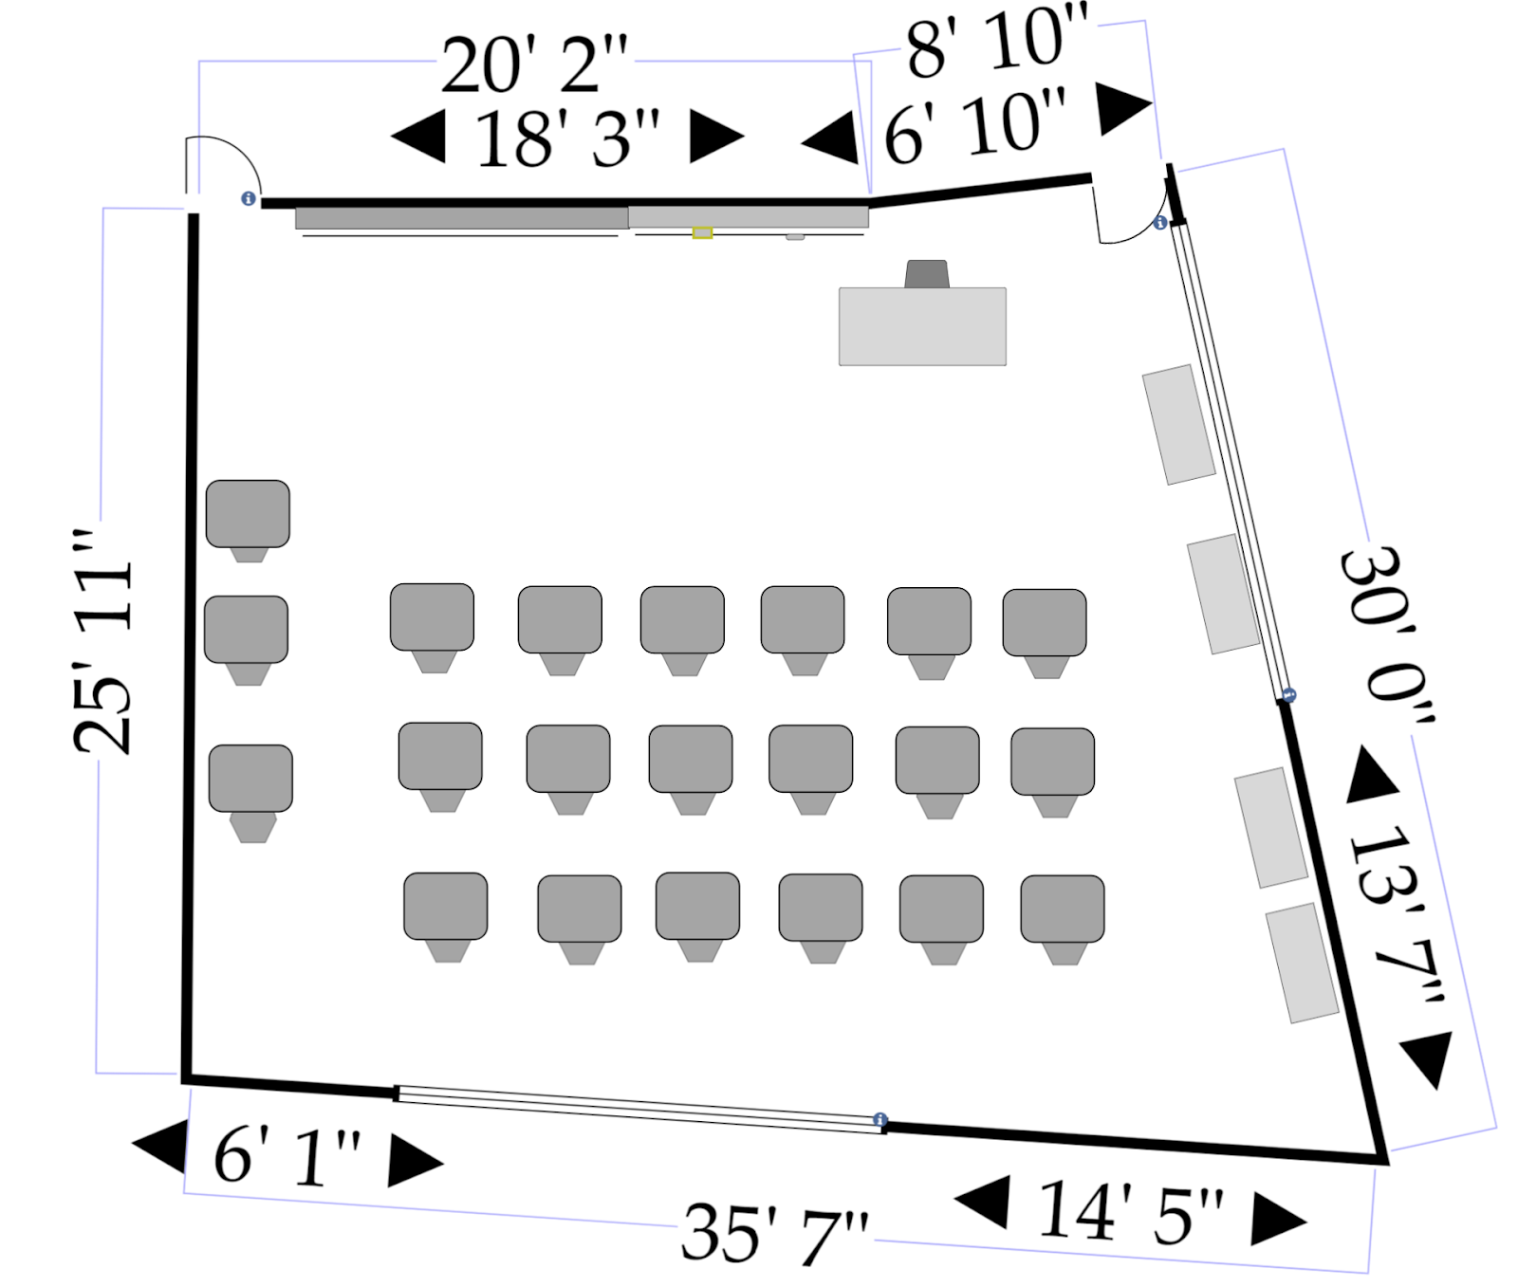
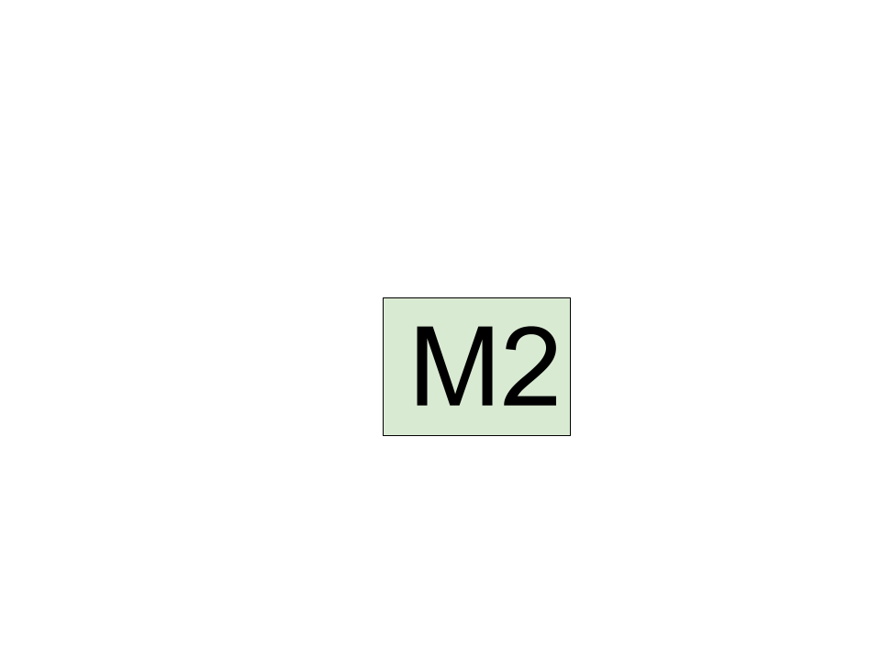




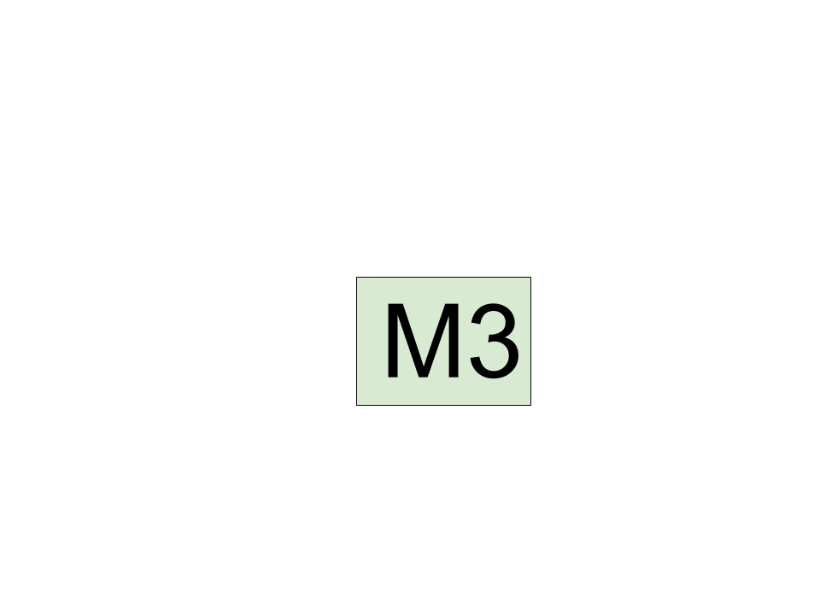


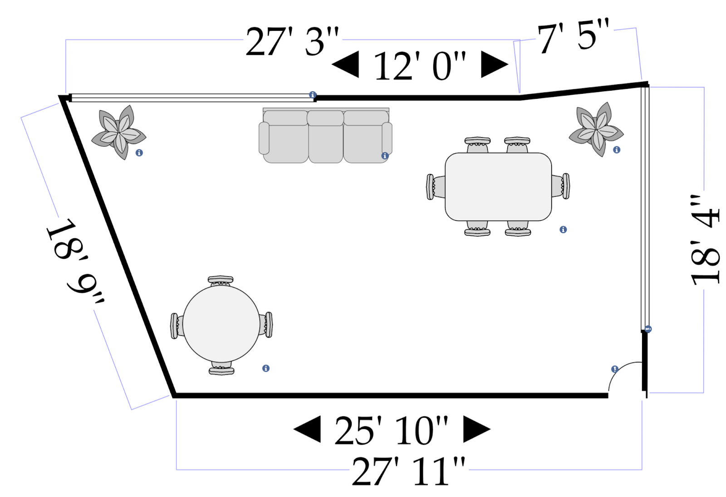
Experimental Testbeds
Kitchen
Classroom
BeamSense STA:
Netgear X4S AC2600
CSI Monitor:
ASUS AC86U
Standard: IEEE 802.11ac
MU-MIMO Config: 3 X 3
Channel BW: 80 MHz
Living Room
Access
Point
CSI Access
Point
Station
CSI
Monitor

Slide 17
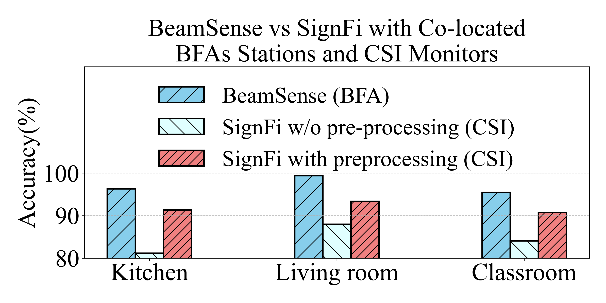
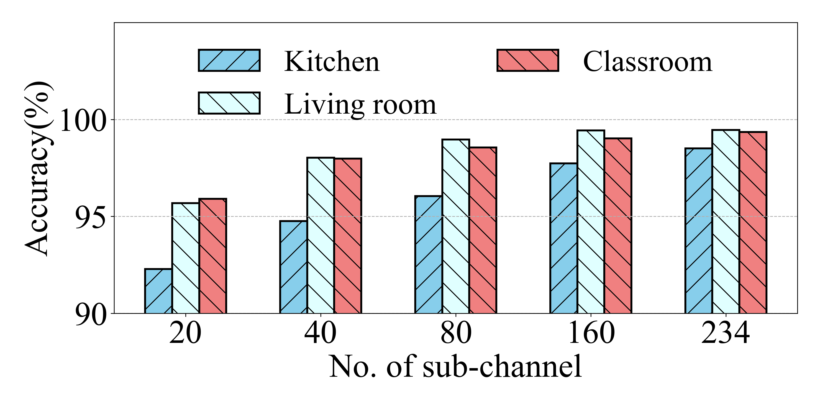

Performance with CNN Baseline
The baseline CNN consists of three conv-blocks with 128, 64 and 32 filters
BeamSense improves the performance by 11%, compared to SOTA
Conv-block
Batch Normalization
Conv2D
Conv2D
ReLU
Input
Conv-block
128
Conv-block
64
Conv-block
32
The accuracy decreases by only 4.52% switching from 234 to 20 sub-channels
MaxPool
Flatten
Softmax
Activity label
VGG-based CNN [1]
CNN cannot generalize to new domains
1. Simonyan, Karen, and Andrew Zisserman. "Very deep convolutional networks for large-scale image recognition." arXiv preprint arXiv:1409.1556 (2014).

Slide 18
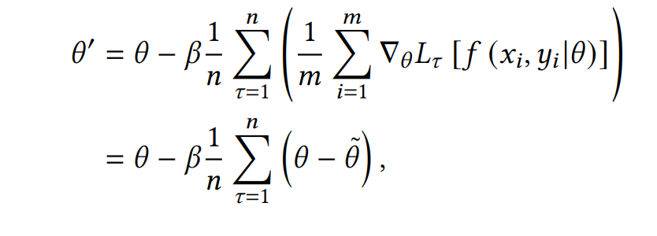
Meta-Learning through Few-shots
Find common features among different tasks
Meta-learning is the warm-up phase before learning
Fine-tuning on a specific task is faster with meta-learned weights
Meta-Learning
Adaptation
𝜏₁
𝞱
𝞱*₁
𝞱’
𝜏₃
𝜏₂
𝞱*₃
𝞱*₂
A. Nichol, J. Achiam, and J. Schulman, “On first-order meta-learning algorithms,” arXiv preprint arXiv:1803.02999, 2018

Slide 19
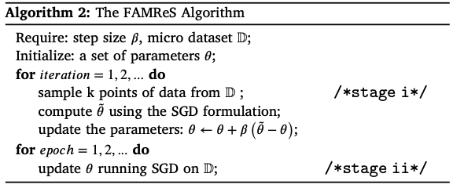
FAMReS: Fast and Adaptive Micro Reptile Sensing
Due to infinite number of tasks Reptile can’t be directly adopted
We consider each batch of training data as a new task in meta-learning
𝜏₁
Batches
𝞱
𝜏₂
𝞱’
𝜏₃
𝜏_{n}
𝜏₄
we only use a small portion of data in meta-learning and micro-learning for domain adaptation

Slide 20
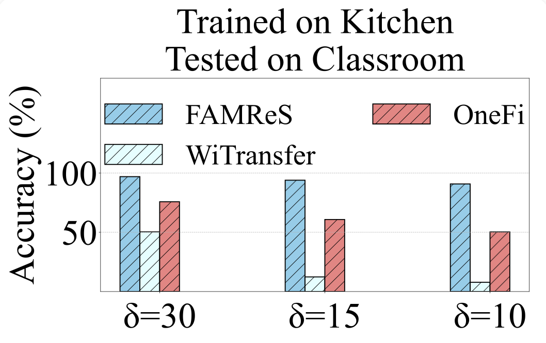
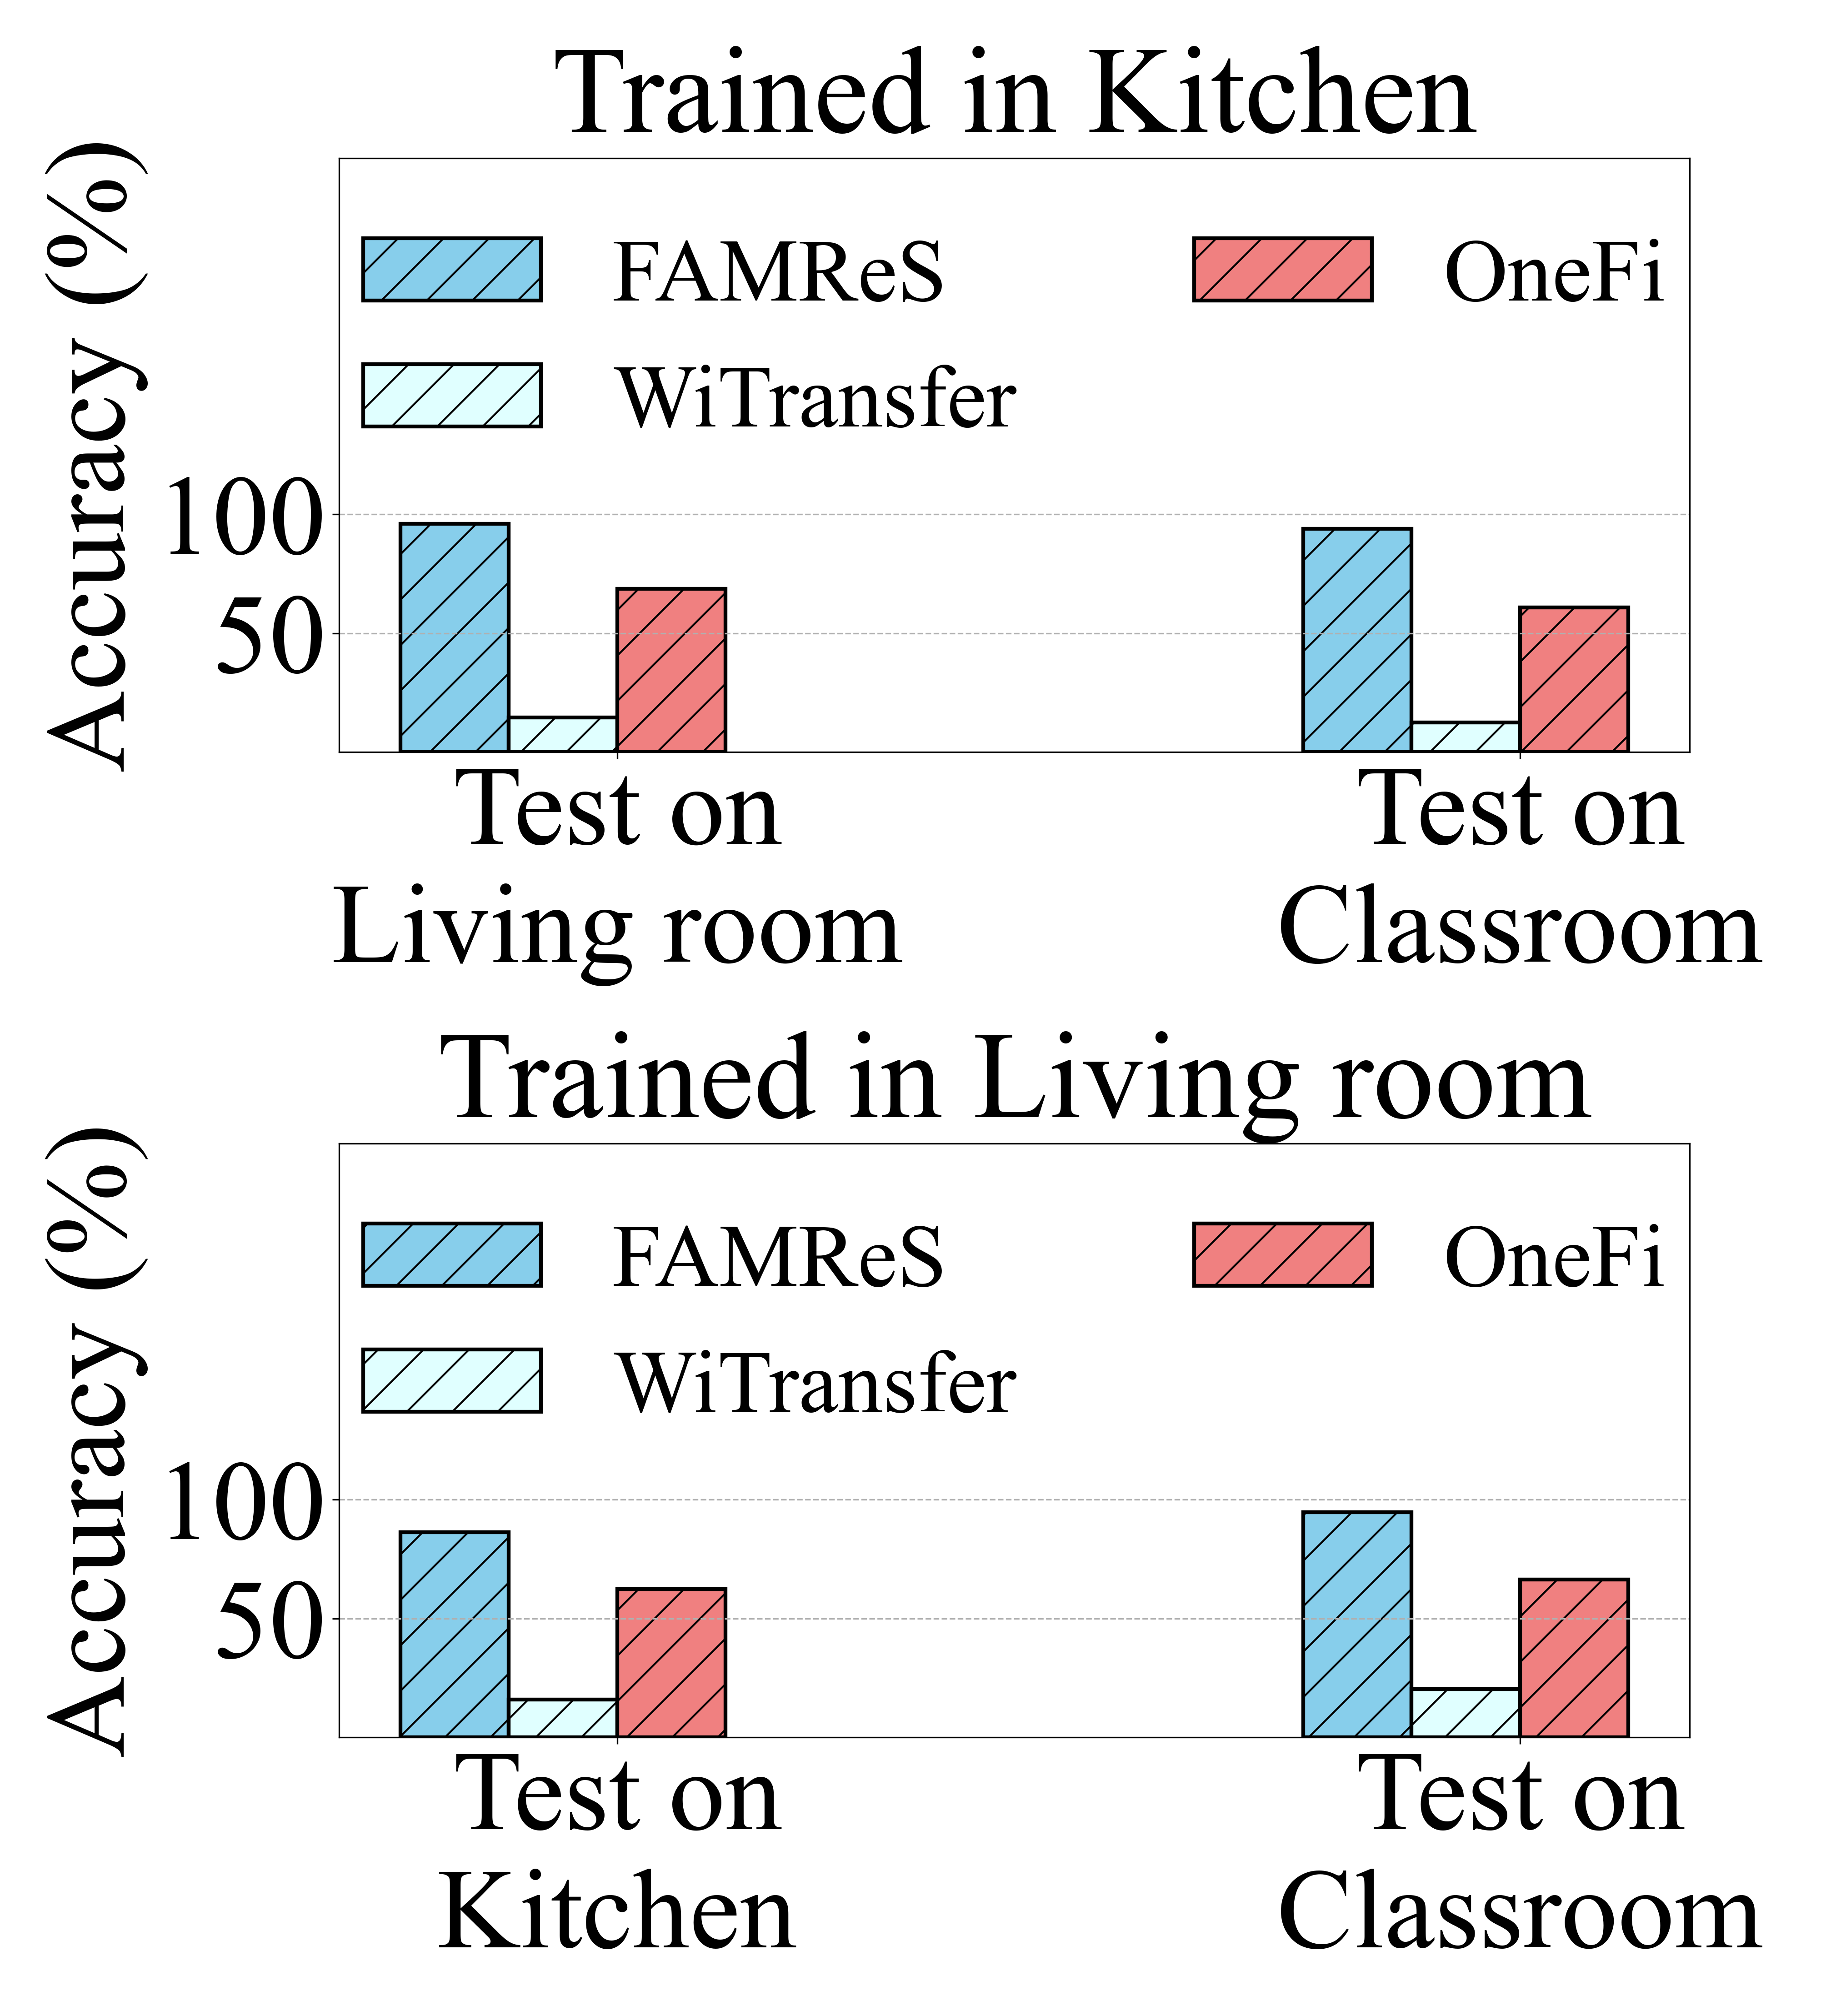
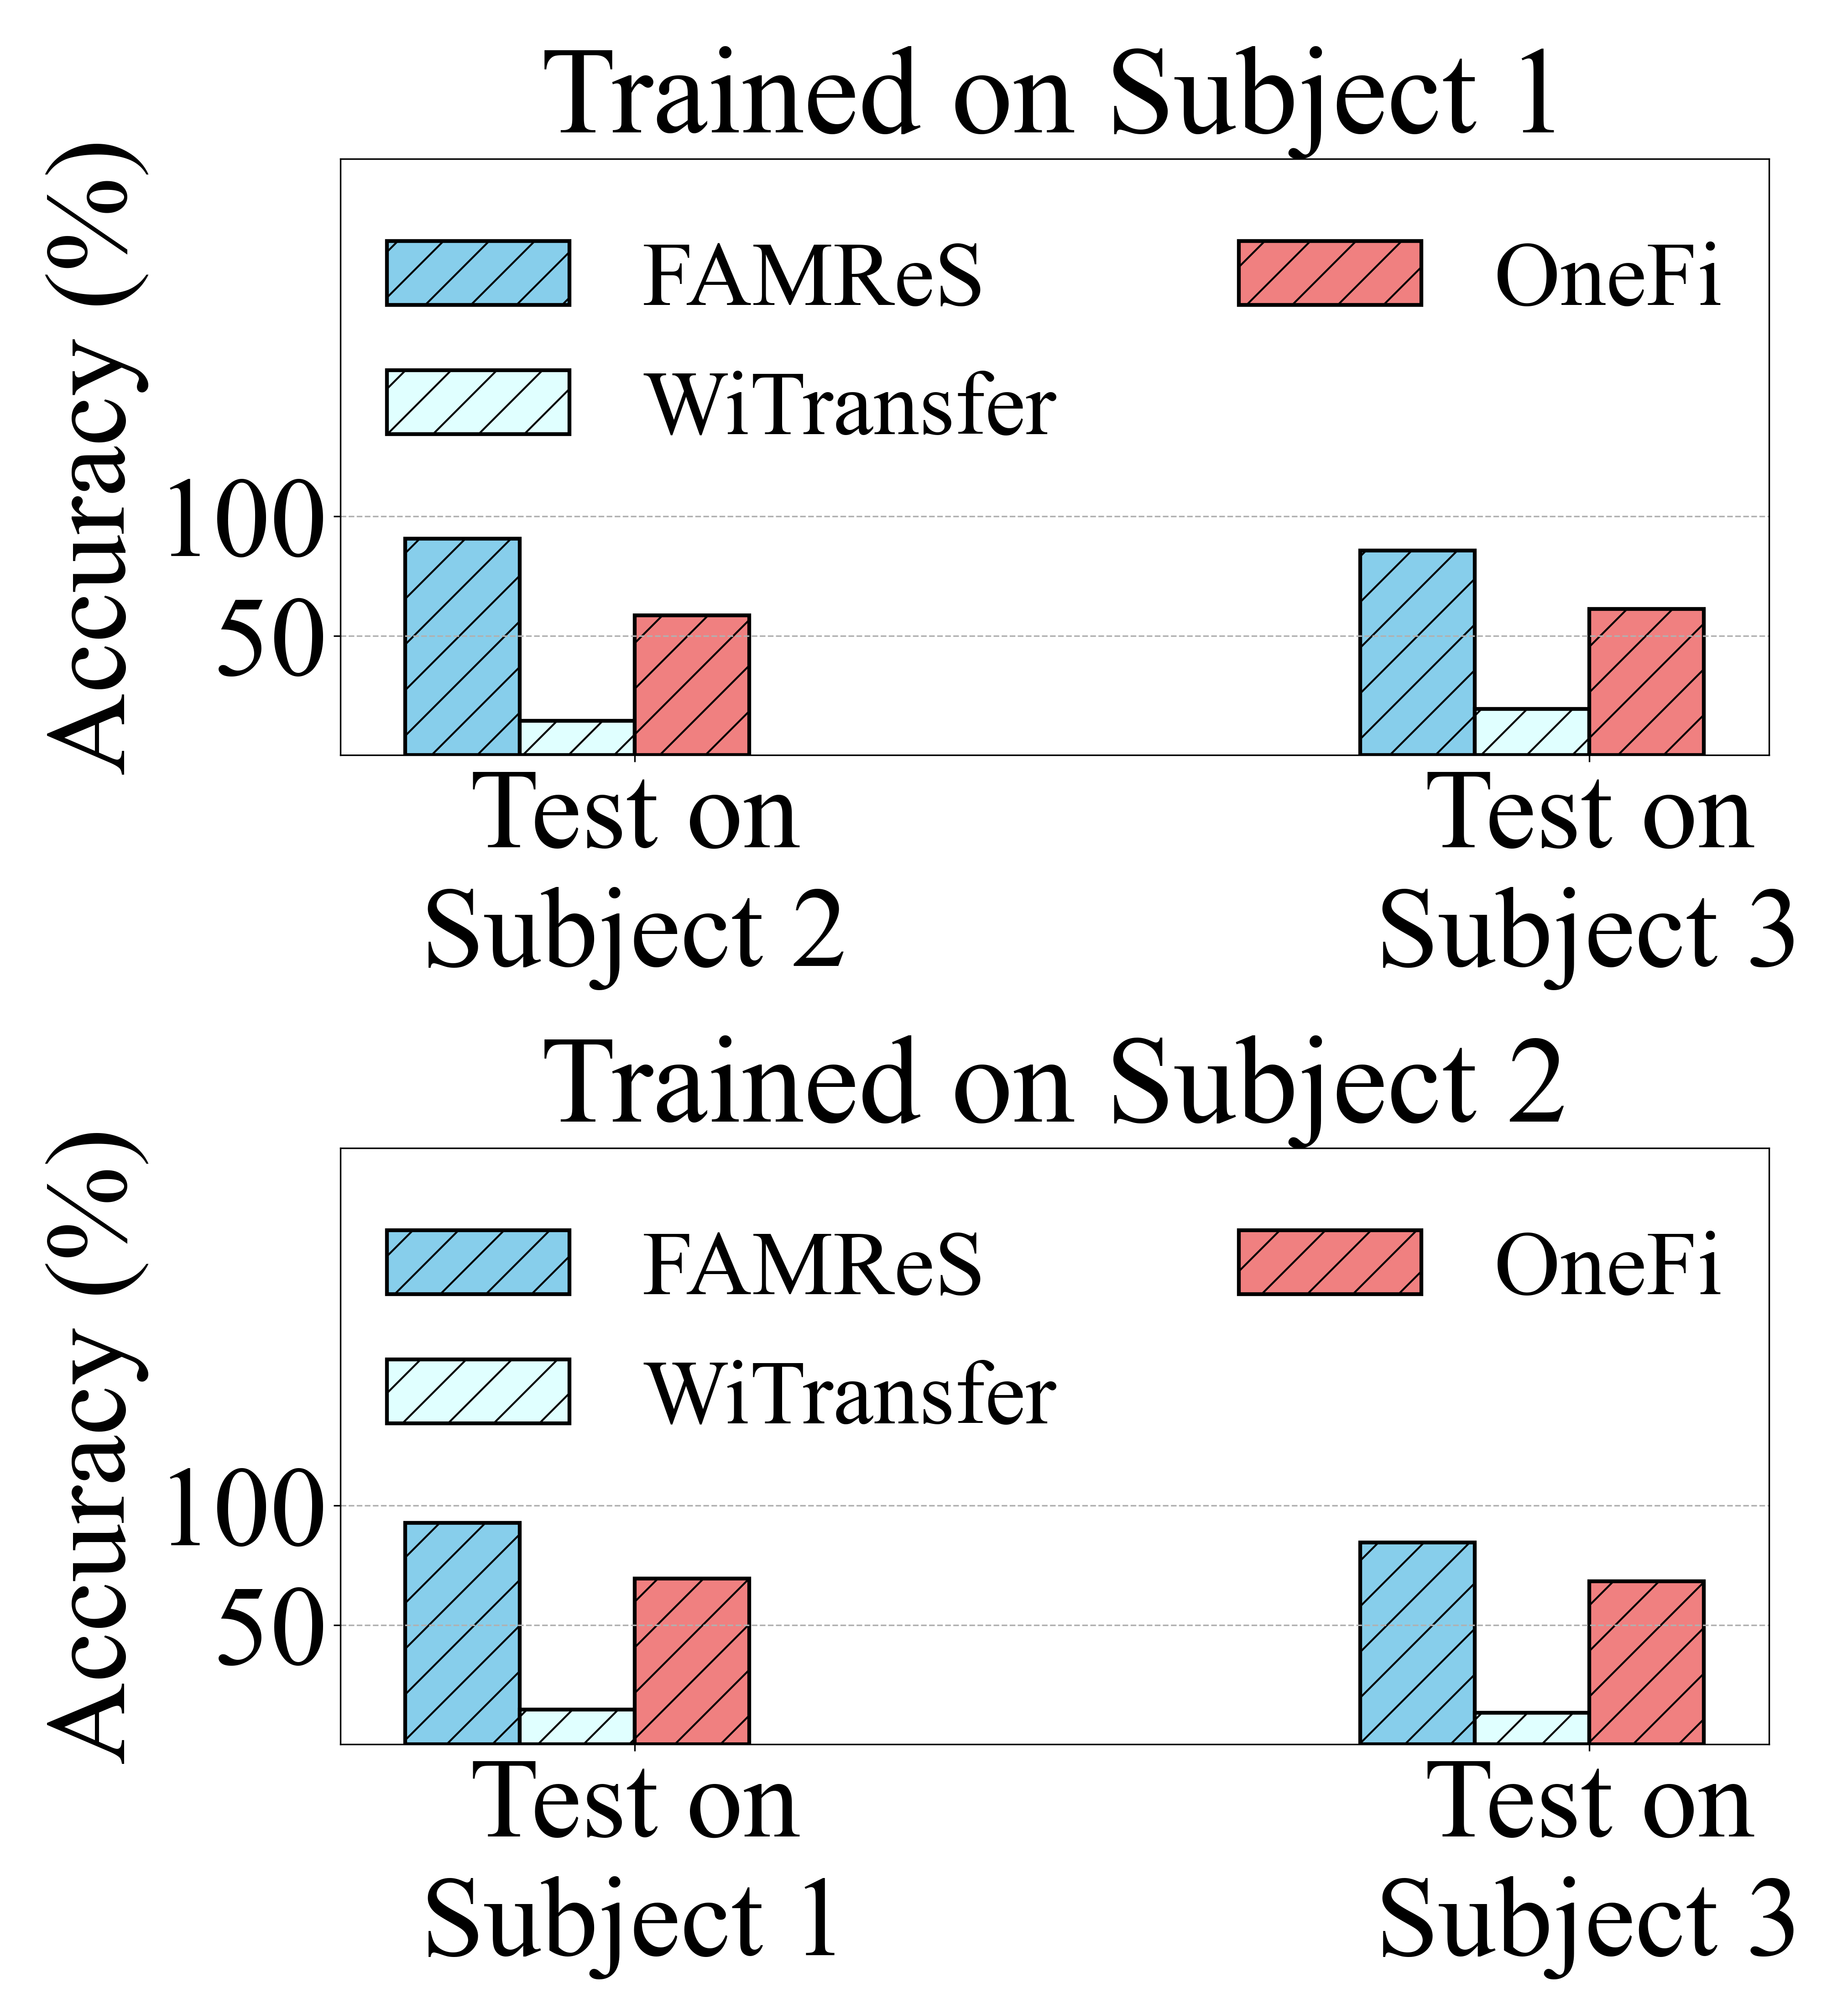
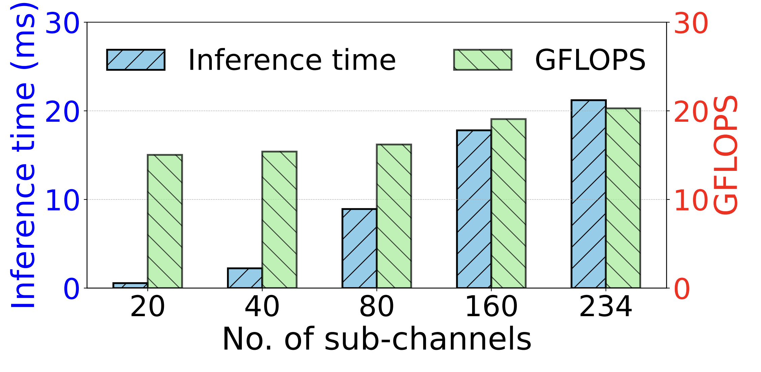
Performance of Domain Adaptation
FAMReS improves cross-environment and cross-subject accuracy by up to 35%
From 30s to10s of data from new Env.
, FAMReS accuracy drop by only 5.30%
20 GFLOPs of computation with
20 ms of inference time

Slide 21
Key Findings
Beamsense: Rethinking Wireless Sensing with MU-MIMO Wi-Fi Beamforming Feedback
  No hardware specific firmware, or firmware modification needed
  Data Extraction can be performed with any Wi-Fi compliant device
  No dedicated extraction tool needed with tight synchronization
  Can generalize to new environments, subjects or orientations

Slide 22

Future Work
  Sensing without no additional data at all from new environment
  Sensing with larger band to have more sensing granularity

Slide 23
Thank You

