Slide 1

BandWeave: Enhanced Channel Estimation in
MIMO Networks with Multi-Band Fusion
(Best Paper INFOCOM-2026)
K Foysal Haque*, Francesca Meneghello*, Jonathan Ashdown†, Francesco Restuccia*
*Institute for Intelligent Networked Systems, Northeastern University, Boston, USA
†Spectrum AI Solutions, USA

Slide 2

AR/VR: Shaping the Future of Interactions
Global market value is predicted to reach 1066 Billion by 2034 [1]
We are very far from truly seamless and immersive
AR/VR experiences
1. Precedence Research. "Spatial Computing Market Size, Share, Trends, Analysis Report, 2025-2034." Accessed October 21, 2025. https://www.precedenceresearch.com/spatial-computing-market

Slide 3
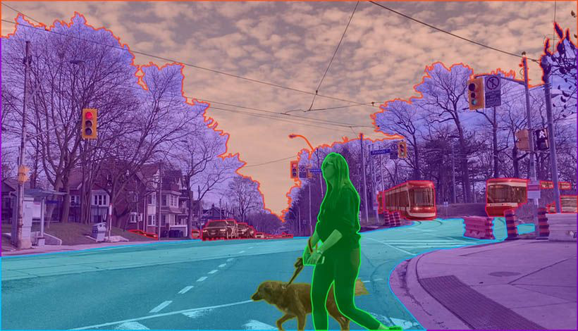
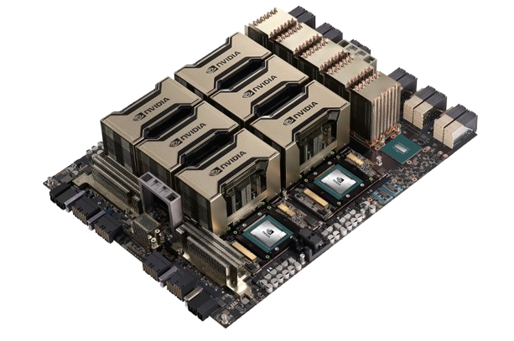
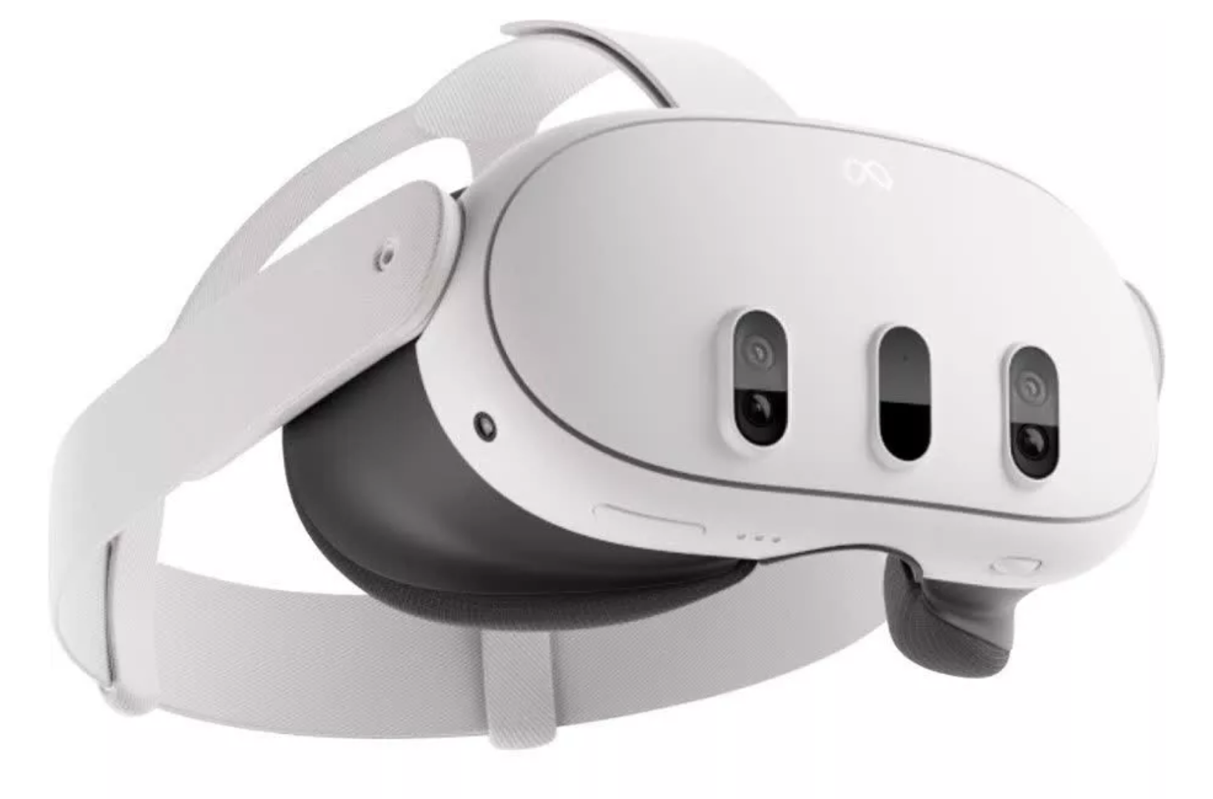
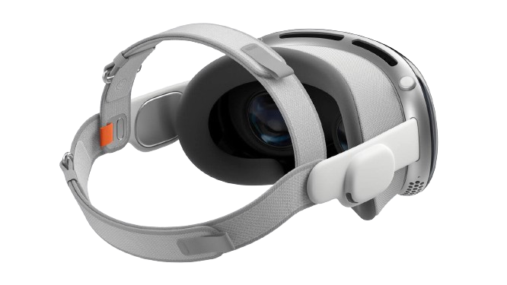
What is the Current Bottleneck?
Object recognition​
Semantic segmentation
Compute-intensive
AI/ML tasks
120 Hz frame rate and 8K resolution are needed! [1]
Weight
515 grams
Weight
650 grams plus
353 grams battery
Meta Quest 3 (1.5-2 hours)
Apple Vision Pro (Up to 2 hours)
1. M Gallagher, ER Ferrè, "Cybersickness: a multisensory integration perspective", Multisensory Research, 2018. Ars Technica, "Virtual Perfection: Why 8K resolution per eye isn't enough for perfect VR", 2013.

Slide 4


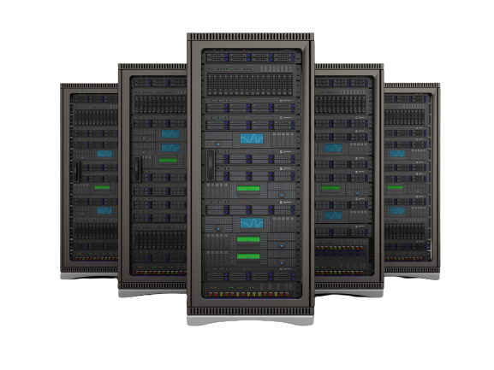
Wireless Edge Computing For Next-Gen App
Offload compute intensive task to edge server
Edge Devices
Wireless Link
Edge Server
120 Hz @ 8K → 40 Gbps → Wi-Fi supports 1.2 Gbps
1. M Gallagher, ER Ferrè, "Cybersickness: a multisensory integration perspective", Multisensory Research, 2018. Ars Technica, "Virtual Perfection: Why 8K resolution per eye isn't enough for perfect VR", 2013.

Slide 5
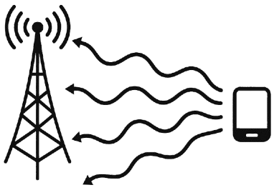
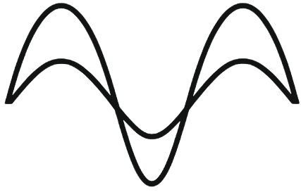
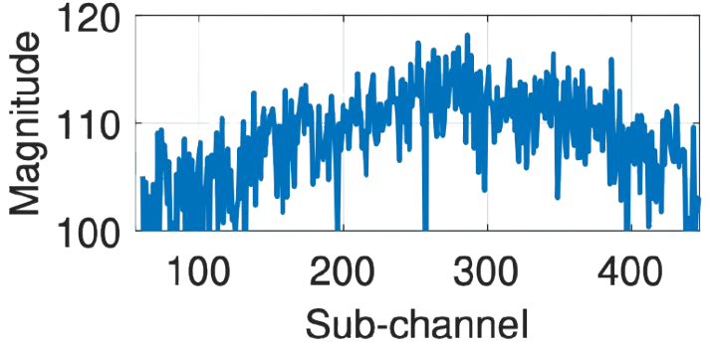
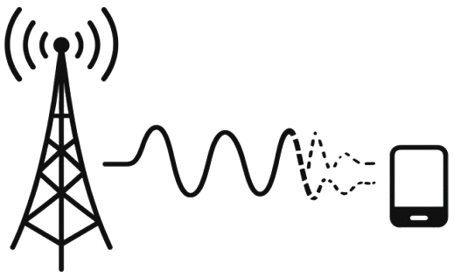
Channel-Estimation– the Key Enabler of MIMO
Accurate channel estimation enables spatial multiplexing
and interference mitigation in MIMO systems
Multi-path superposition
Destructive interference
Degraded Channel estimation
Hamper Communication

Slide 6
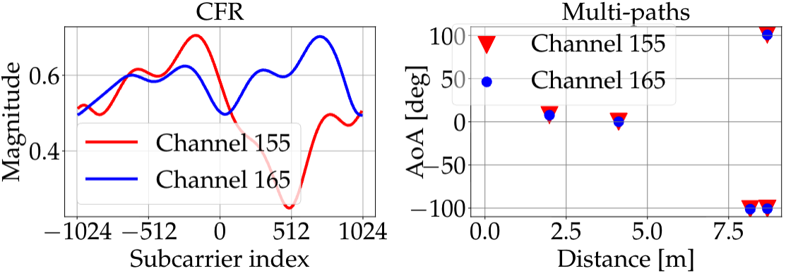
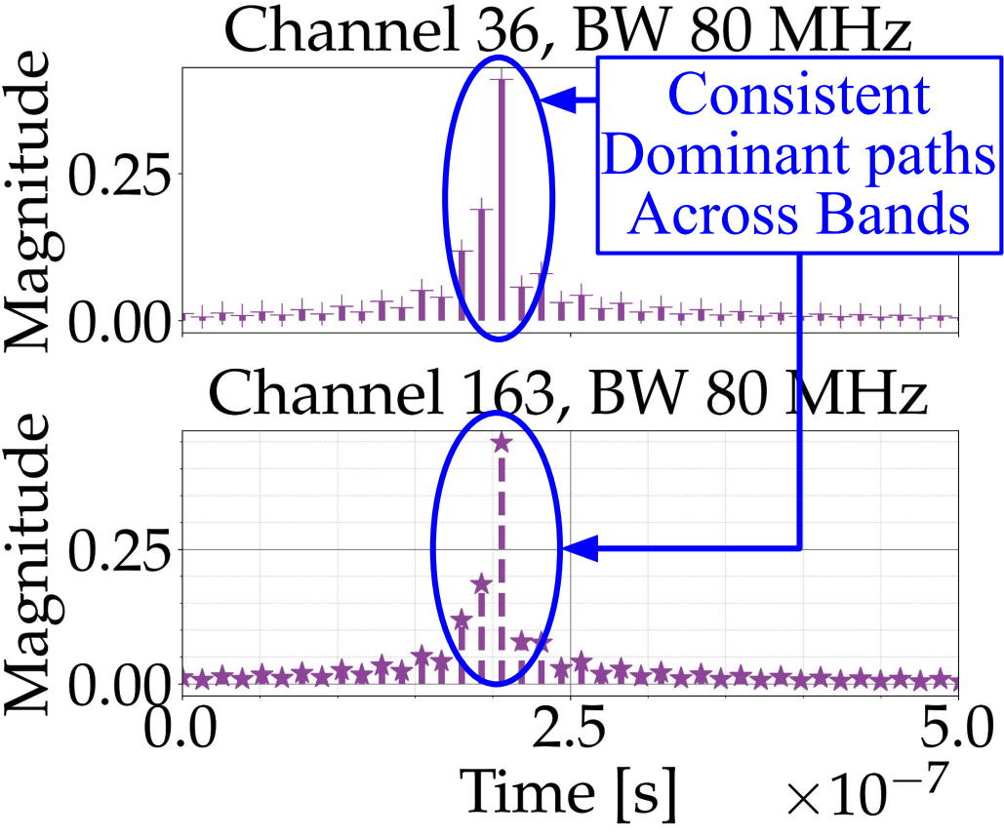
Analyzing CFR at Different Center Freq.
CIRs from different center frequencies exhibit consistent dominant multi-paths
CFR is band-specific
Multipath components are band-independent
Diff. bands provide complementary views of the same instances

Slide 7
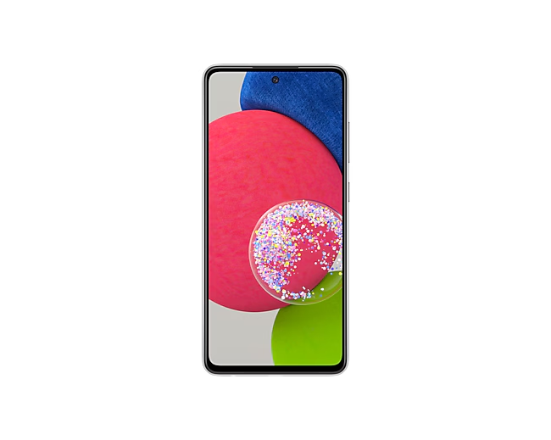
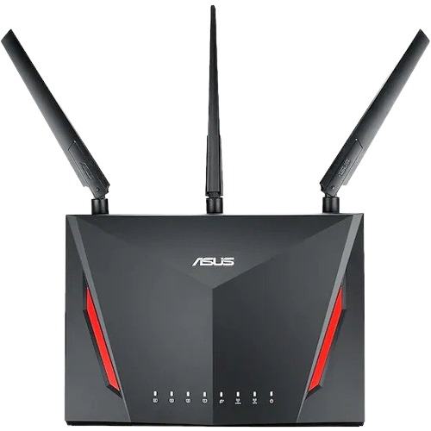
BandWeave: Enhanced Ch. Est. with Band Fusion
BandWeave
Beamformer
BandWeave
Beamformee
Pilots for Band
1, 2… N_{B}
-Est. Ch. Response for
Bands 1 to N_{B}
Feedback from Fused Ch.
- Estimate Precoding Matrix
- Fuse Responses in Time Domain
Beamformed Data
BandWeave ➔ Enhanced Ch. Est. ➔ Improved Comm.

Slide 8

Prior Work and Existing Challenges
Spectrum Splicing
Cross Link CFR Estimation
UL CFR
Cross Band CFR Estimation
Predicted DL CFR
Prior work focuses only on sensing or CFR prediction and does not improve estimation fidelity
A. Banerjee, X. Zhao, V. Chhabra, K. Srinivasan, and S. Parthasarathy, “HORCRUX: Accurate Cross Band Channel Prediction,” in Proceedings of the 30th Annual International Conference on Mobile Computing and Networking, pp. 1–15, 2024.
M. S. Safari, V. Pourahmadi, and S. Sodagari, “Deep UL2DL: Data-driven Channel Knowledge Transfer from Uplink to Downlink,” IEEE Open Journal of Vehicular Technology, vol. 1, pp. 29–44, 2019.
X. Li, H. Wang, Z. Chen, Z. Jiang, and J. Luo, “UWB-Fi: Pushing Wi-Fi Towards Ultra-Wideband for Fine-Granularity Sensing,” in Proceedings of the 22nd Annual International Conference on Mobile Systems, Appli-cations and Services, pp. 42–55, 2024
J. Pegoraro, J. O. Lacruz, M. Rossi, and J. Widmer, “HiSAC: High-Resolution Sensing with Multiband Communication Signals,” in Proceedings of the 22nd ACM Conference on Embedded Networked Sensor Systems, pp. 549–563, 2024.

Slide 9

Summary of Key Contributions
BandWeave is the first framework to coherently
fuse CFRs to enhance channel estimation resolution
We introduce a 3-phase learning framework to address frequency-dependent path loss and phase misalignments
We extensively evaluate BandWeave with an IEEE 802.11ac MU-MIMO and a 60 GHz SU-MIMO testbed

Slide 10
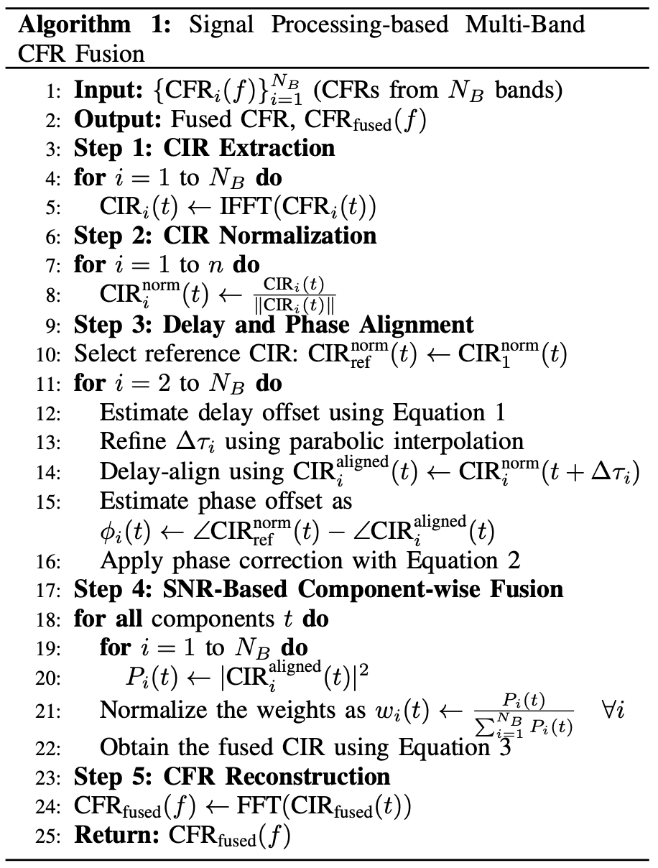
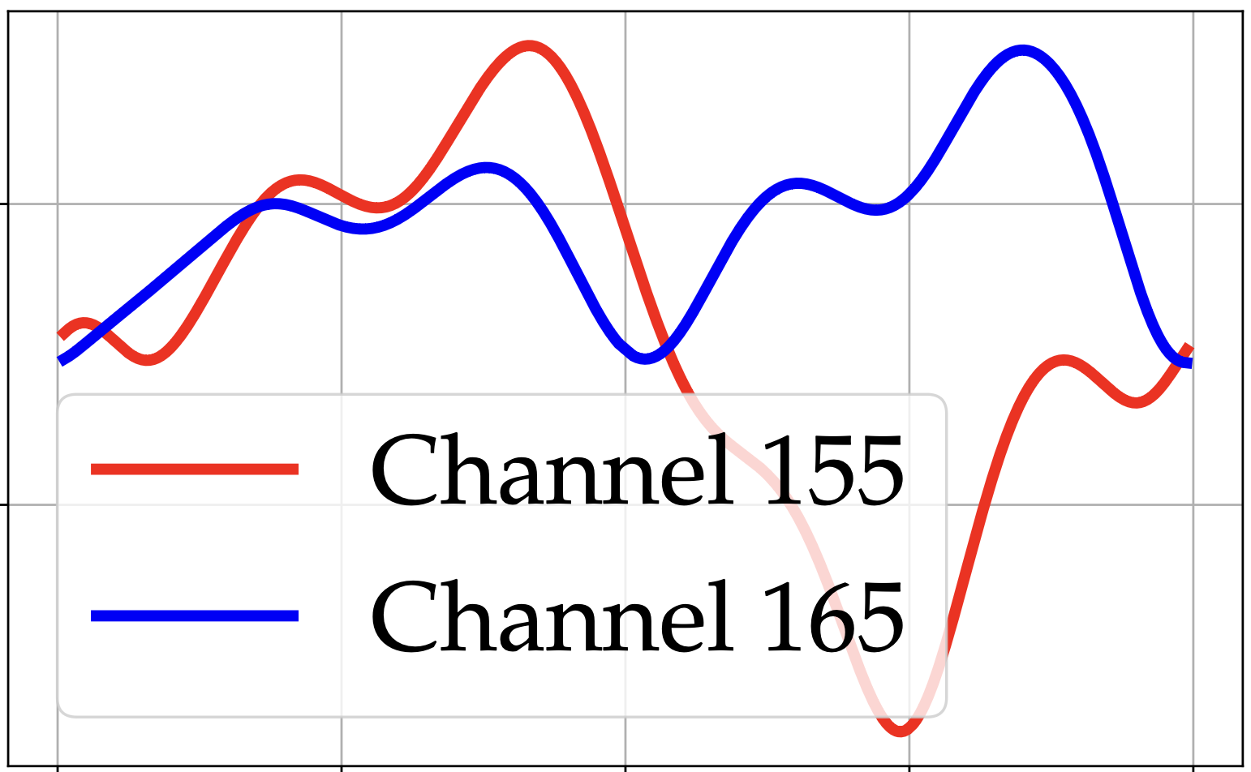
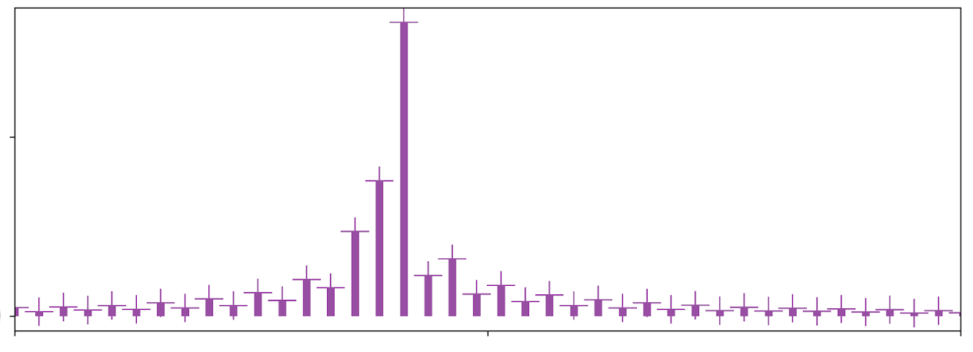
Signal-Processing based CFR Fusion
Step 1 & 2: Extract CIR and Normalize
Step 3: Delay and Phase Alignment
Step 4 & 5: Comp.-wise Fusion &
CFR Reconstruction

Slide 11
Performance of the Heuristic Algorithm
One access point (AP) and one station (STA) is considered
CFR from channel 36 and 163 are fused
The fused band is used to beamform in channel 36
Signal-Strength-based heuristic fusion is not very robust
We focus on domain adaptive learning-based approach

Slide 12
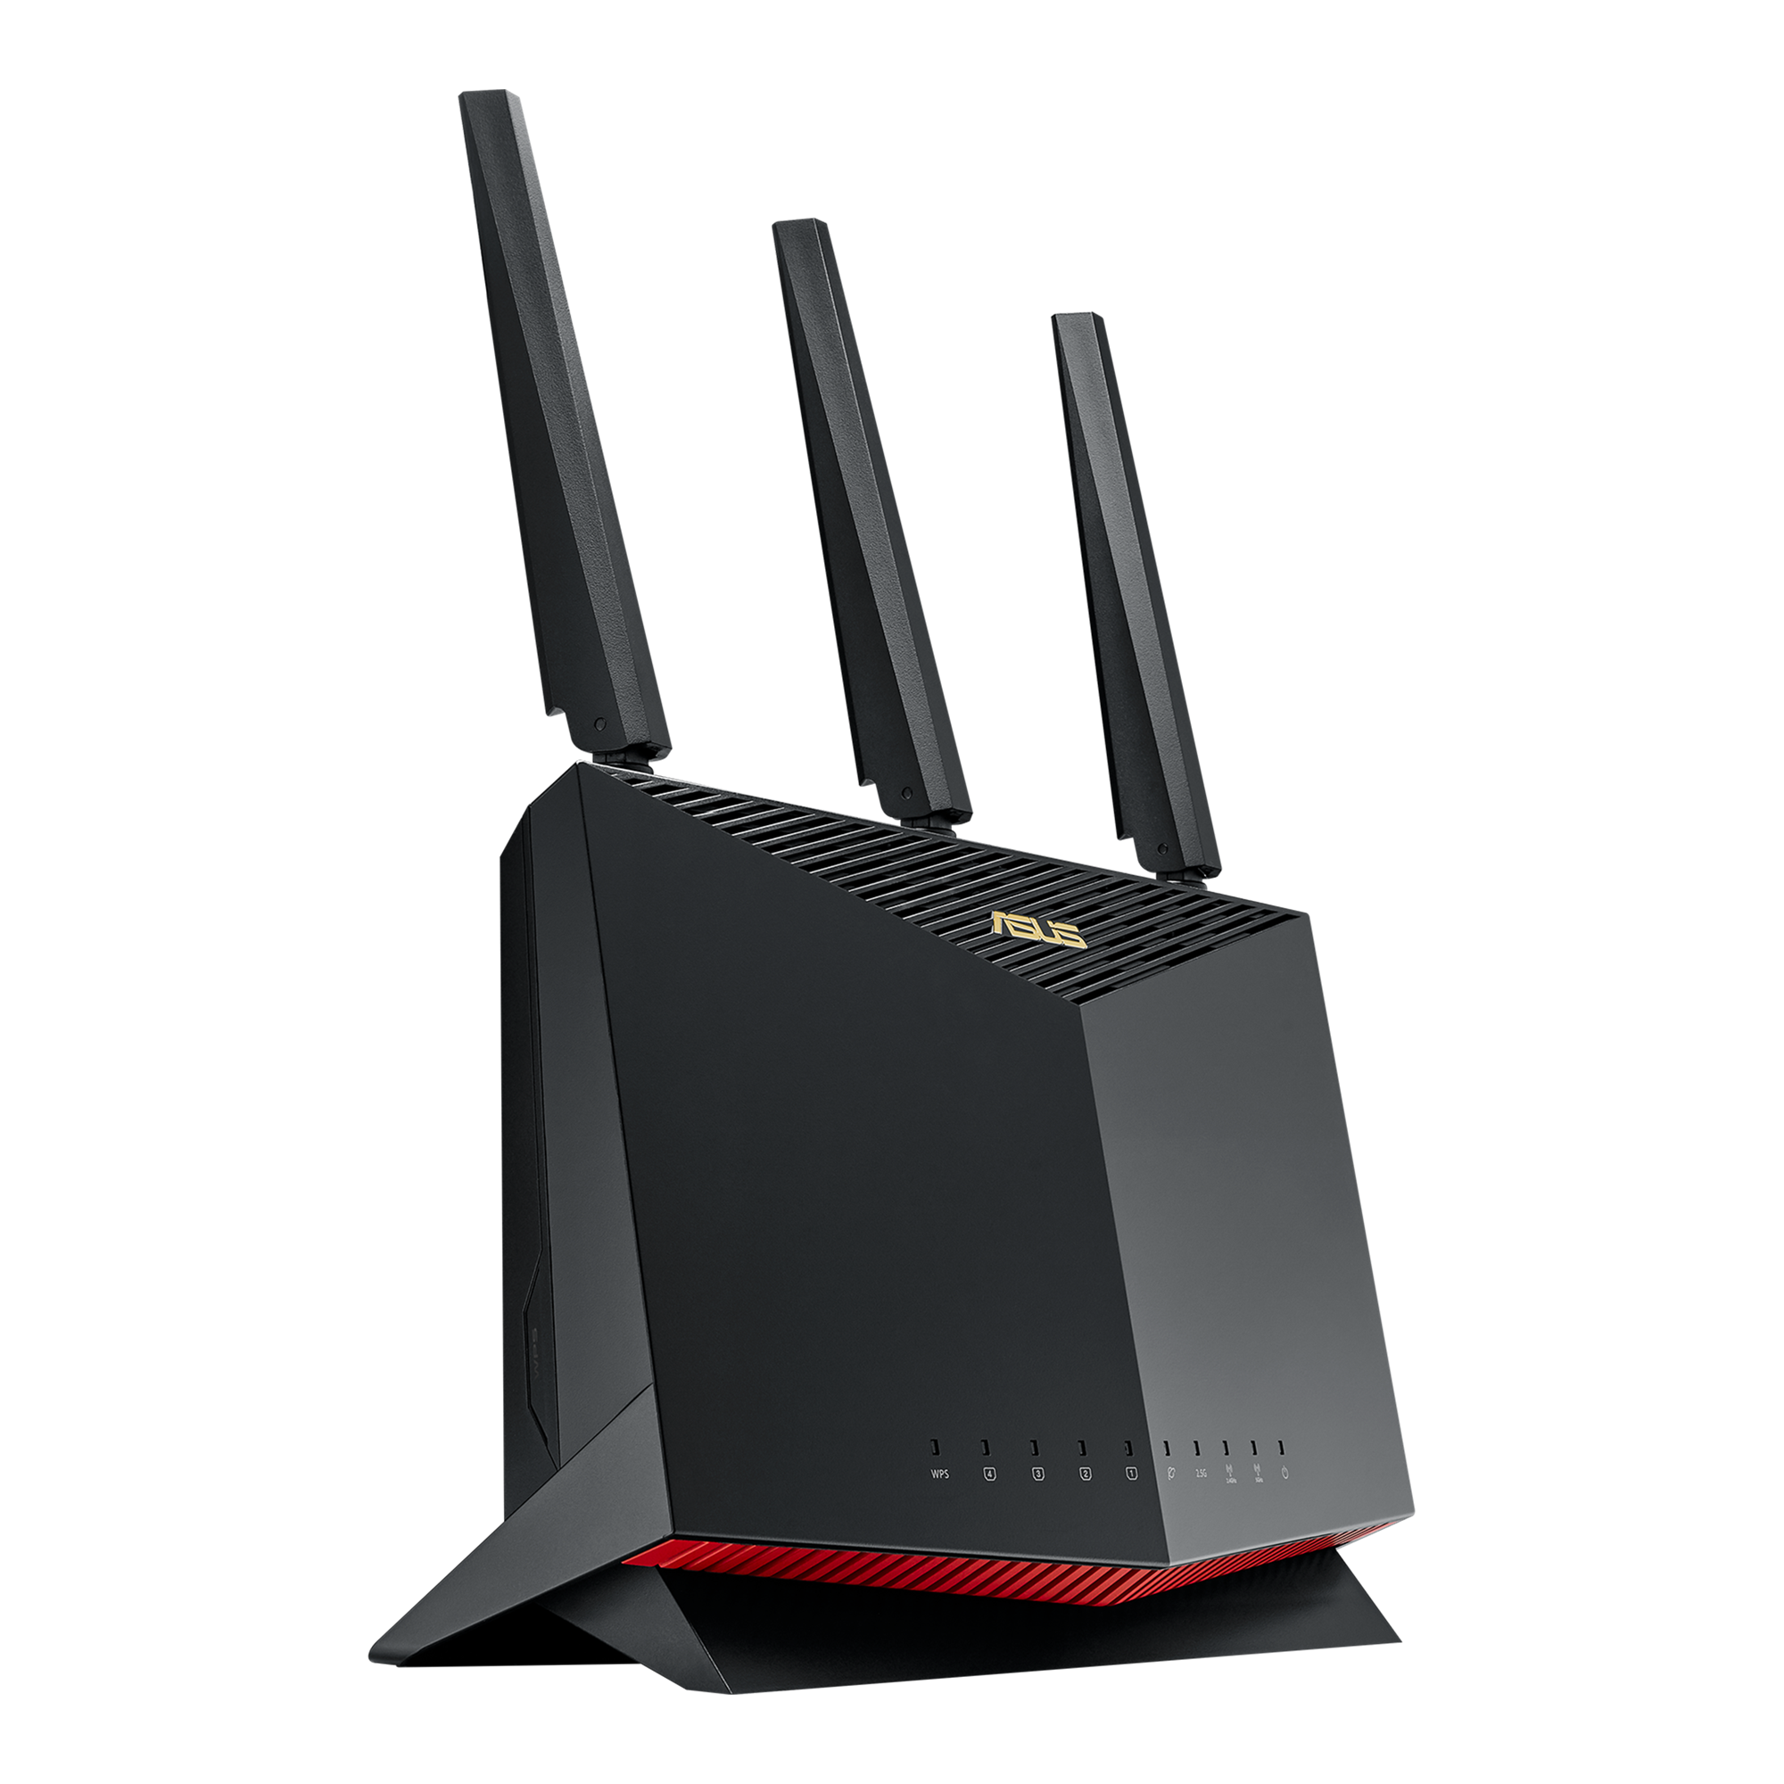

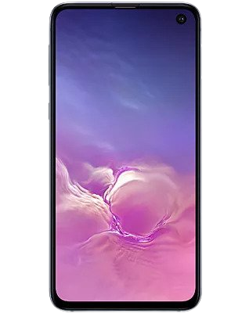
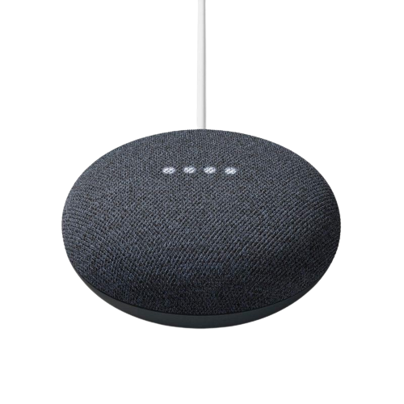
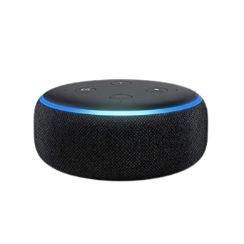
BandWeave Walkthrough
1
Pilot Frames for Band 1,2….N_{B}
BandWeave
Beamformer
BandWeave
Beamformee
3
Three Phase BandWeave Learning Algorithm
6
2
5
For band 1,2…N_{B}
4
Estimate Steering Matrix
Obtain Beamforming Feedback from H_{fused}(f)
Obtain H_{fused}(f) from H_{fused} (t)
Estimate CFR, H(f)
Obtain CIR, H(t)
Apply Precoding
BandWeave Beamformed Data

Slide 13



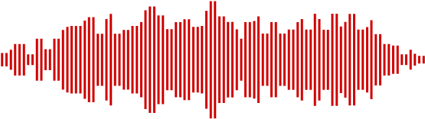
BandWeave Learning Algorithm
BandWeave Learning Algorithm
Phase 1
Supervised Pre-training
Phase 2
Simulation in the Loop Fine-tuning
Phase 3
Online Feedback Aware Adaptation

Slide 14
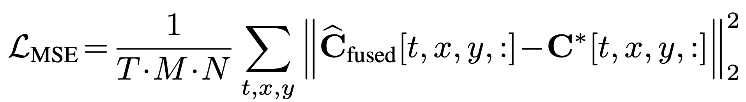
Phase-1: Supervised Pre-training
CIRs are projected into embeddings via encoder
Embeddings are concatenated and processed by multi-head self-attention module
Algorithm 1 as pseudo-ground-truth with the loss as:
CIR-Band-1
CIR-Band-N_{B}
Per-Band Encoder
(Conv1D / Projection)
Per-Band Encoder
(Conv1D / Projection)
Token Embeddings
Token Embeddings
Concatenate +
Positional Encoding
Multi-Head Self-Attention Module
Decoder Head
Fused CIR Output

Slide 15
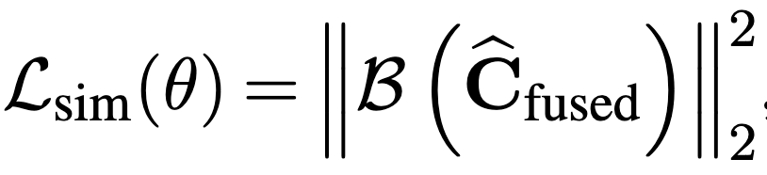
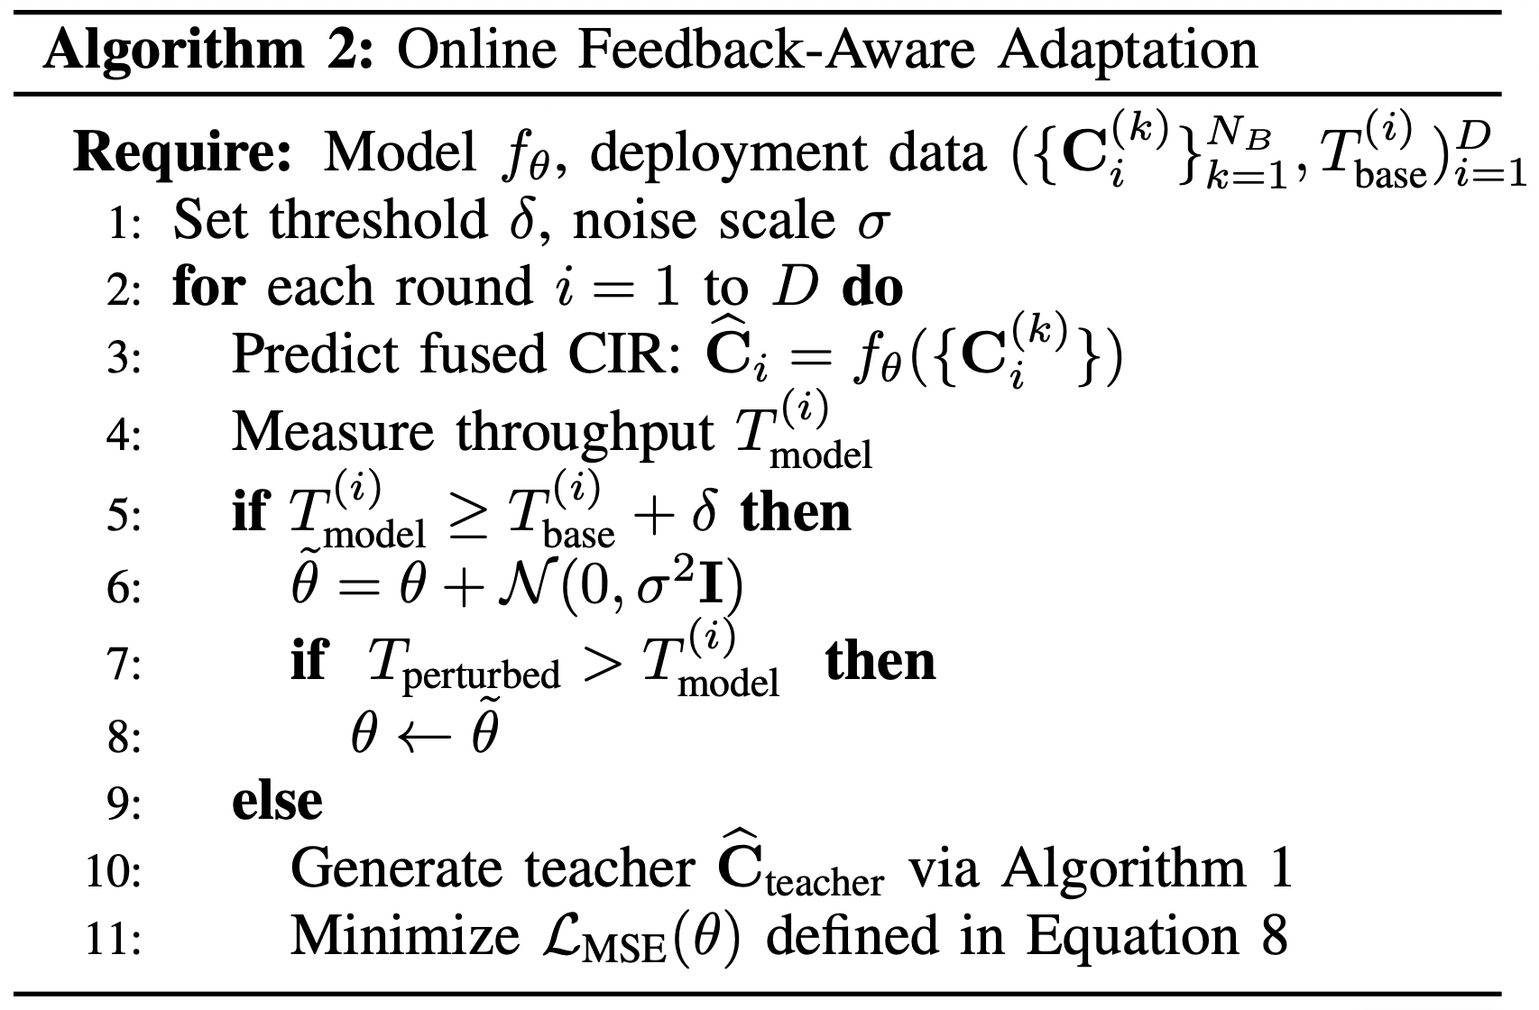
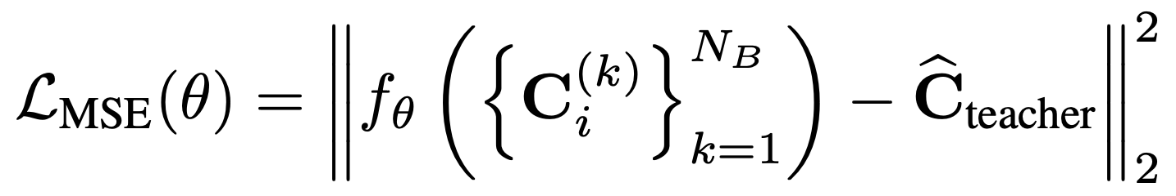
Phase-2 and 3: Finetuning and Online Adaptation
Phase 2: Finetuning through Simulation in the Loop
Fused CIR is evaluated in a full-stack simulator to obtain BER
Model parameters are fine-tuned to minimize BER
Phase 3: Online Feedback Aware Adaptation
Step 1: If performance is better than the baseline, apply gradient-free perturbations to refine the model
Step 2: Otherwise, fine-tune using Algorithm 1 as surrogate supervision

Slide 16
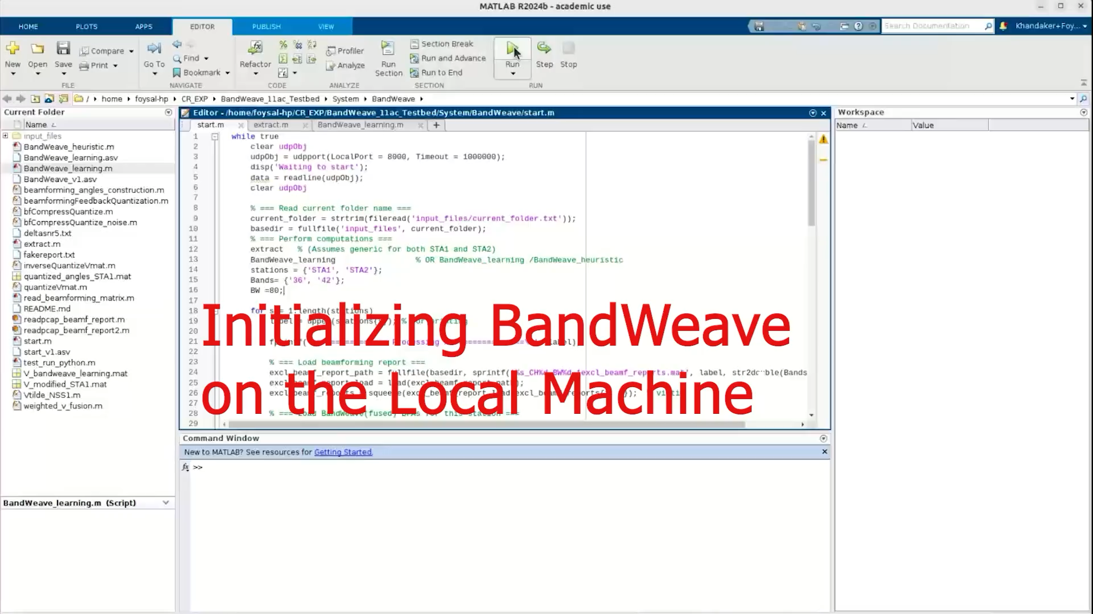
BandWeave Experimental Setup
Evaluated BandWeave on IEEE 802.11ac MU-MIMO and mmWave SU-MIMO testbeds
Tested across LoS, NLoS, and dynamic scenarios in three environments

Slide 17
Performance Analysis of BandWeave (1)
Achieves up to 7.5x throughput gain and 4.9x BER reduction over SOTA
Robust in non-contiguous bands, achieving up to 12.6% throughput gain and 7.1% BER reduction
Performance with Varying Channel Condition
Performance with Non-Contiguous Band

Slide 18
Performance Analysis of BandWeave (2)
Online adaptation boosts performance by ~7 %, reaching up to 15% total throughput gain
BandWeave achieves up to 20x lower latency and 18x lower energy than SOTA (HiSAC)
Impact of Online Adaptation
Inference-time and Energy Consumption Analysis

Slide 19

Possible Next Steps?
✅ Multi-Band Fusion within the Same Frequency Range (e.g., 5 GHz Wi-Fi bands)
This work 💪
⚠️ Fusion Across Different Frequency Ranges (e.g., 2.4 GHz ↔ 5 GHz ↔ mmWave)
⚠️ Generalizable channel representation
Future Directions 🚀

Slide 20

BANDWEAVE: Enhanced Channel Estimation in
MIMO Networks with Multi-Band Fusion
THANK YOU
K Foysal Haque
Haque.k@northeastern.edu

Slide 21


Slide 22
BandWeave Backup Slides

Slide 23
Transformer Architecture
Step 1: Per-Band Encoding
→ We input CIRs from multiple bands
→ Each CIR is converted into tokens (delay × antenna)
→ encoder maps them into embeddings
Step 2: Add Structural Information
→ Add delay positional encoding + antenna embedding
→ Each token now contains signal + temporal + spatial context
Step 3: Cross-Band Concatenation
→ Tokens from all bands are concatenated into one sequence
→ Enables joint processing across frequencies
CIR-Band-N_{B}
CIR-Band-1
Per-Band Encoder
(Conv1D / Projection)
Per-Band Encoder
(Conv1D / Projection)
Token Embeddings
Token Embeddings
Concatenate +
Positional Encoding
Multi-Head Self-Attention Module
Decoder Head
Fused CIR Output
Step 4: Transformer Encoder
→ The concatenated tokens pass through 2 transformer layers
→ Each layer has: Multi-head self-attention,
Feedforward network

Slide 24
Transformer Architecture
Per-Band Encoder (Projection Layer)
→ Conv1D / Linear projection + activation (ReLU)
→ Purpose: map CIR components → embedding space
Transformer Encoder (Cross-Band Learning)
→ 2 Transformer encoder layers
→ Each layer consists of:
Multi-head self-attention
Feedforward network (FFN)
Decoder
→ 2-layer MLP
CIR-Band-1
CIR-Band-N_{B}
Per-Band Encoder
(Conv1D / Projection)
Per-Band Encoder
(Conv1D / Projection)
Token Embeddings
Token Embeddings
Concatenate +
Positional Encoding
Multi-Head Self-Attention Module
Decoder Head
Fused CIR Output

Slide 25
Covariance Matrix Adaptation Evolution Strategy (CMA-ES)
1. Initialize search
Start from current parameter estimate
Define a search distribution (center + spread)
2. Generate population
Sample multiple candidate parameter sets around the current estimate
Each candidate = a slightly perturbed model
3. Evaluate fitness
Compute objective (e.g., validation loss) for each candidate
4. Select best candidates
Keep top-performing solutions
Discard low-performing ones
5. Update search distribution
Shift the center toward better candidates
Adapt the search shape to:
  emphasize directions that improved performance
  reduce exploration in poor directions
6. Iterate
Repeat sampling → evaluation → update
Gradually converges to optimal parameters

Slide 26
Performance Analysis of BandWeave (3)
Performance with Heterogenous Bands
2 band vs 3 band Fusion Performance

Slide 27
Additional Slides

Slide 28
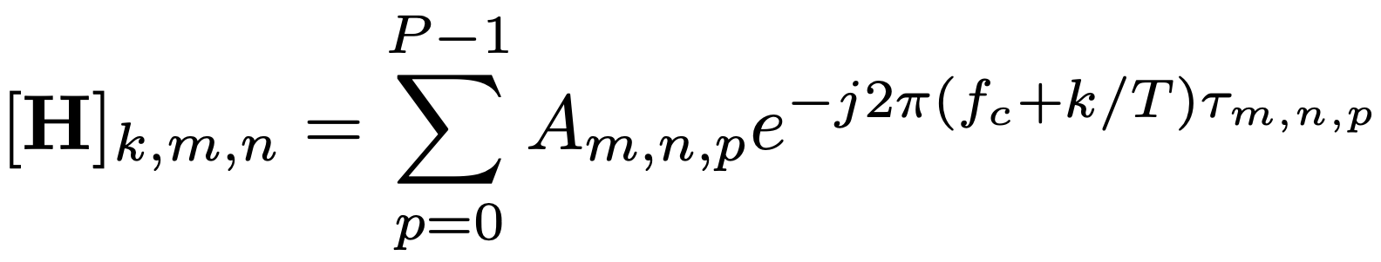
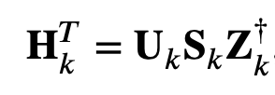
Compressing CFR with SVD
The CFR is a 𝐾×𝑀×𝑁
matrix 𝐇 for each beamformee
𝐔_{𝑘} and 𝐙_{𝑘} are 𝑁×𝑁 and 𝑀×𝑀 unitary matrices,
while the singular values are collected in the 𝑁×𝑀 diagonal matrix 𝐒_{𝑘}
𝐕_{𝑘} is defined by collecting the first 𝑁SS ≤ 𝑁 columns of 𝐙_{𝑘}

Slide 29
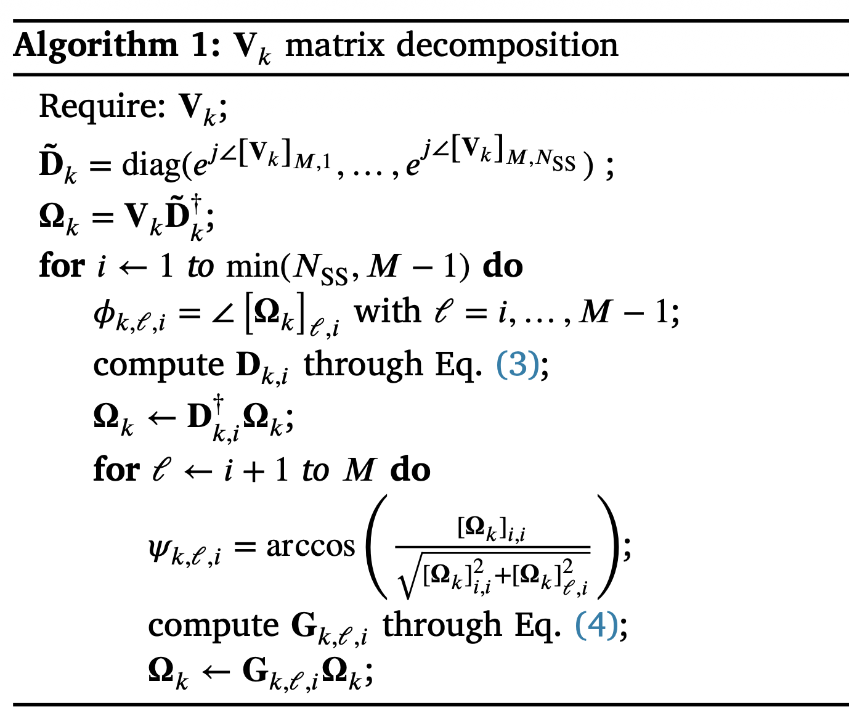
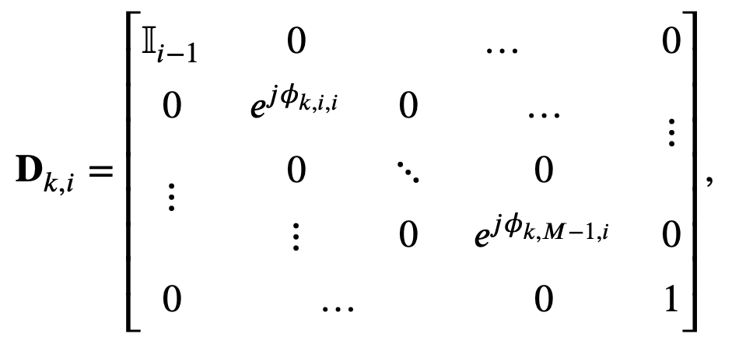
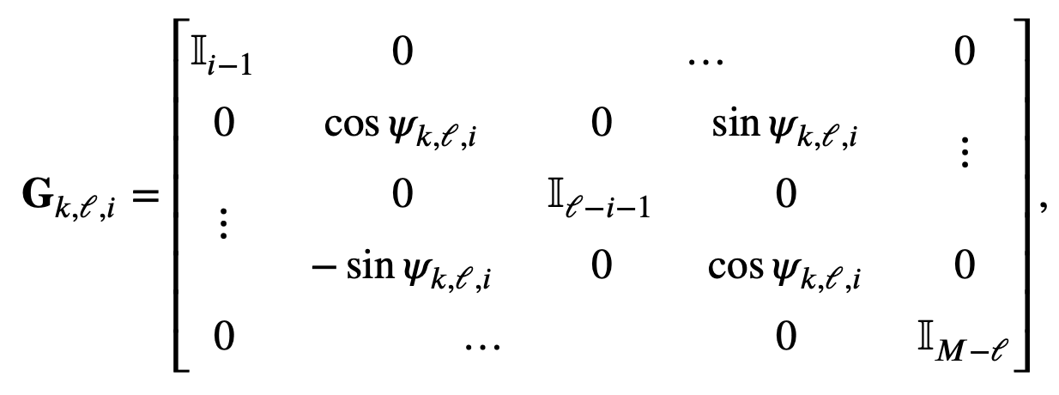
Compressing CFR with SVD

Slide 30
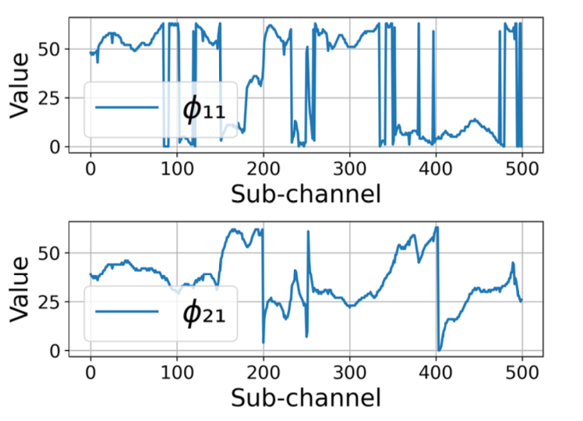
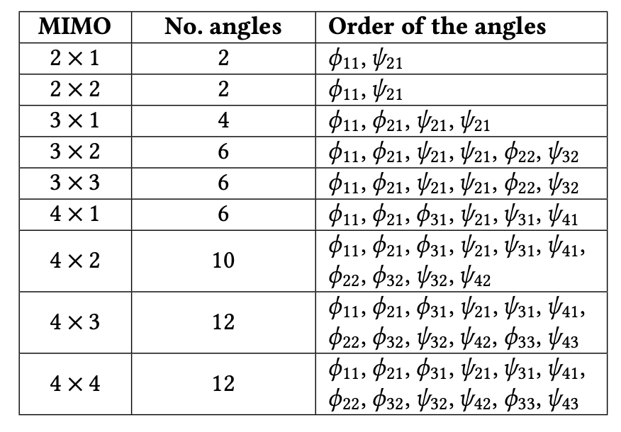
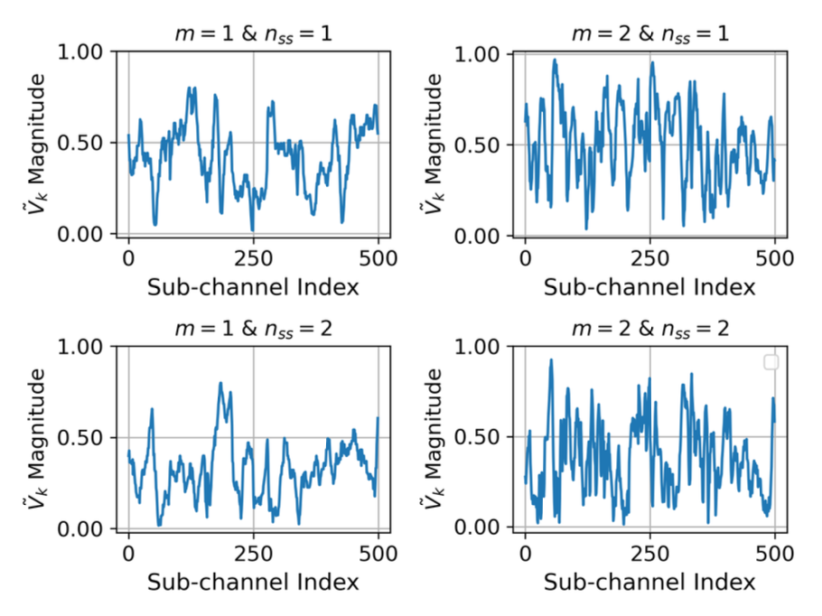
BFAs vs MU-MIMO Config

Slide 31
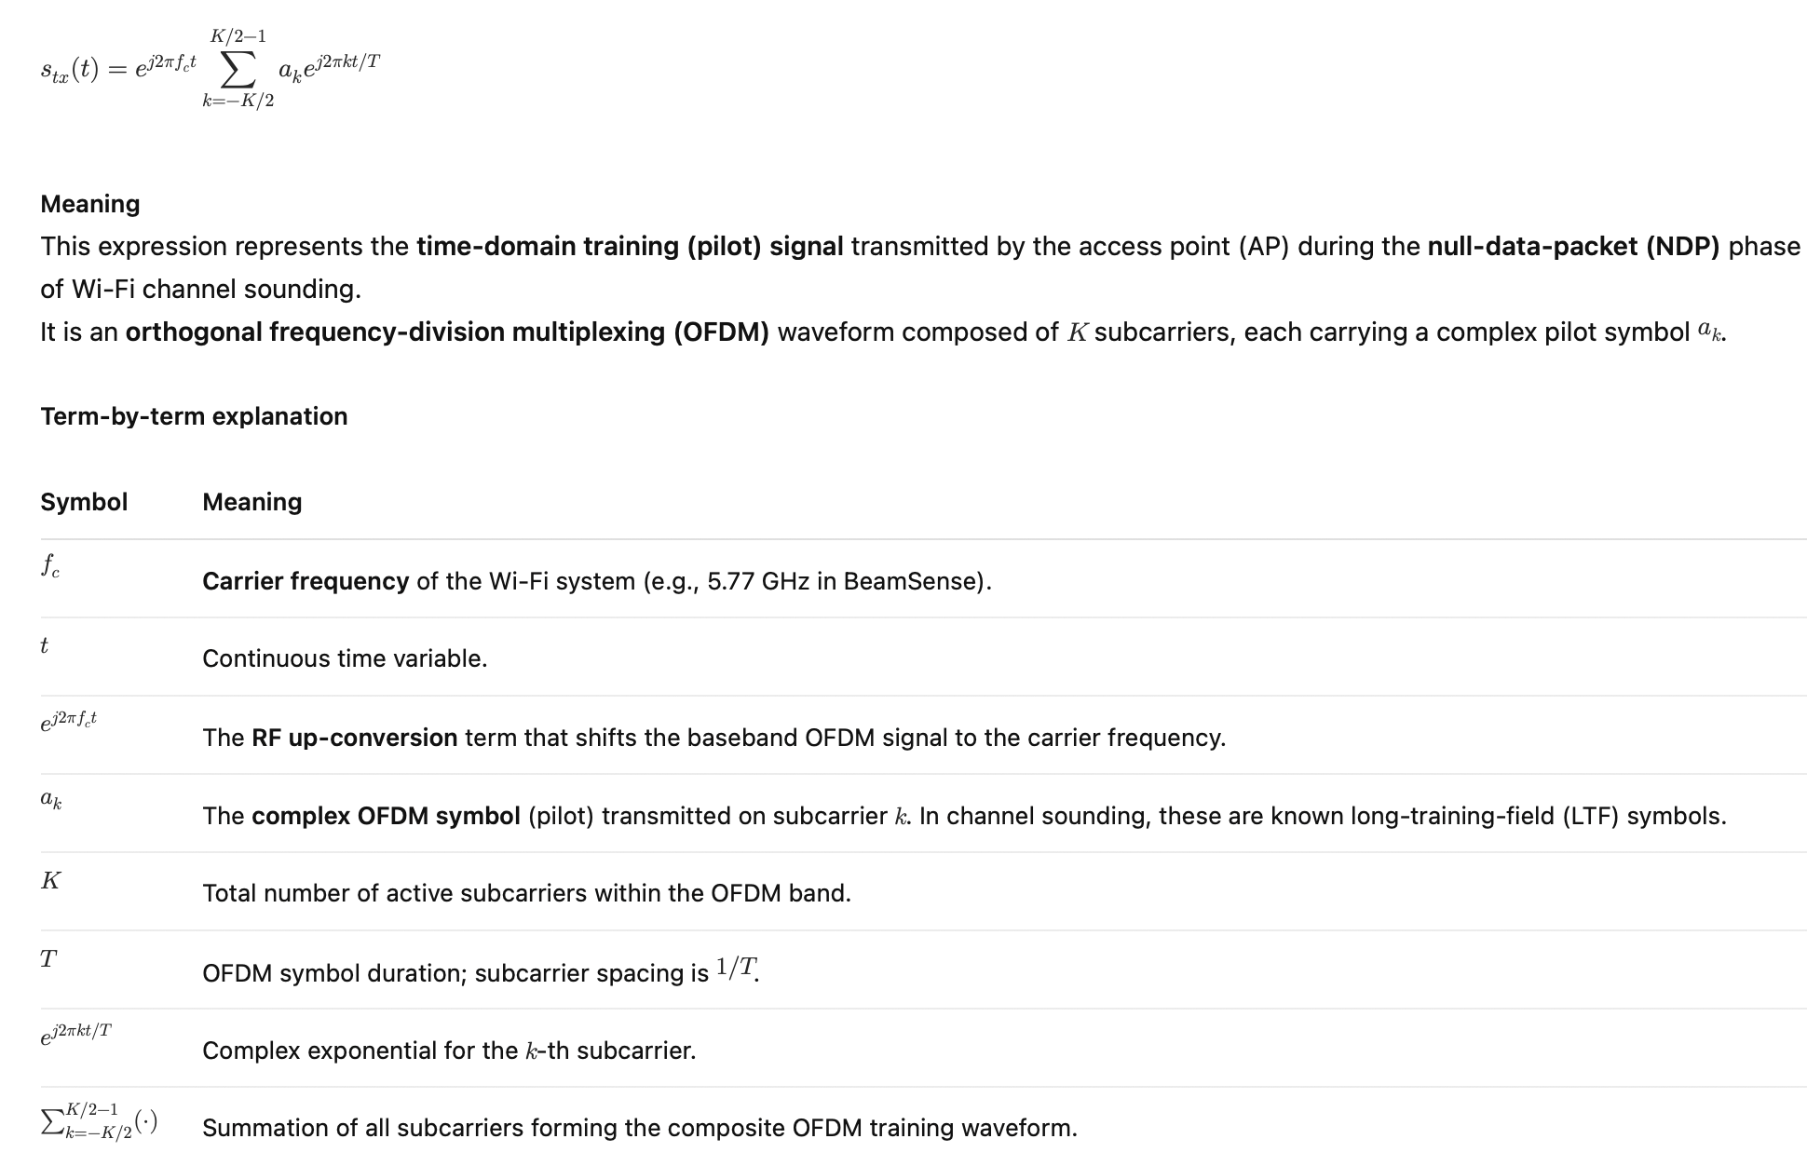
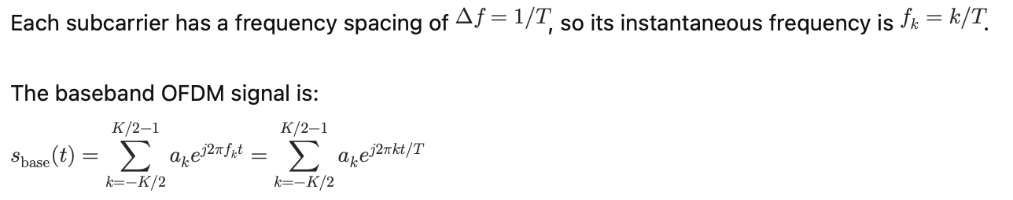
LTF Equation

Slide 32
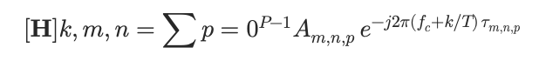
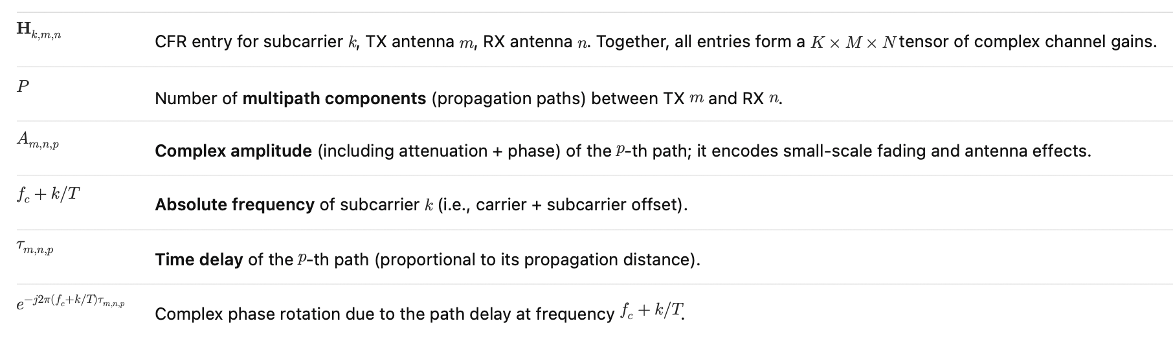
CFR Equation

Slide 33
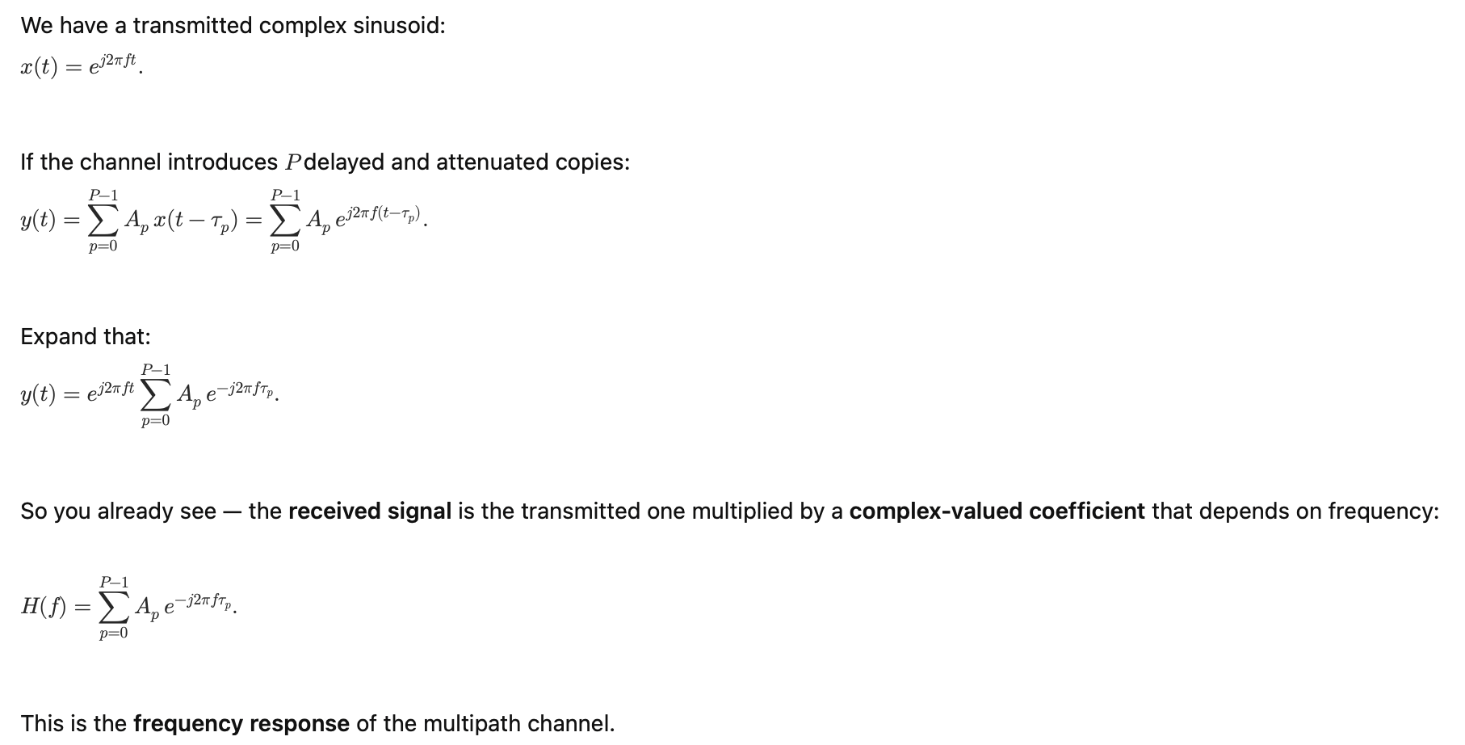
CFR Equation

Slide 34
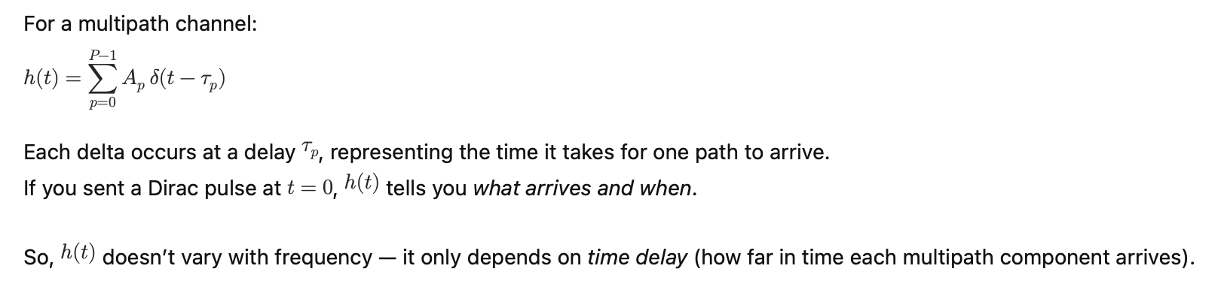
CIR Equation

Slide 35
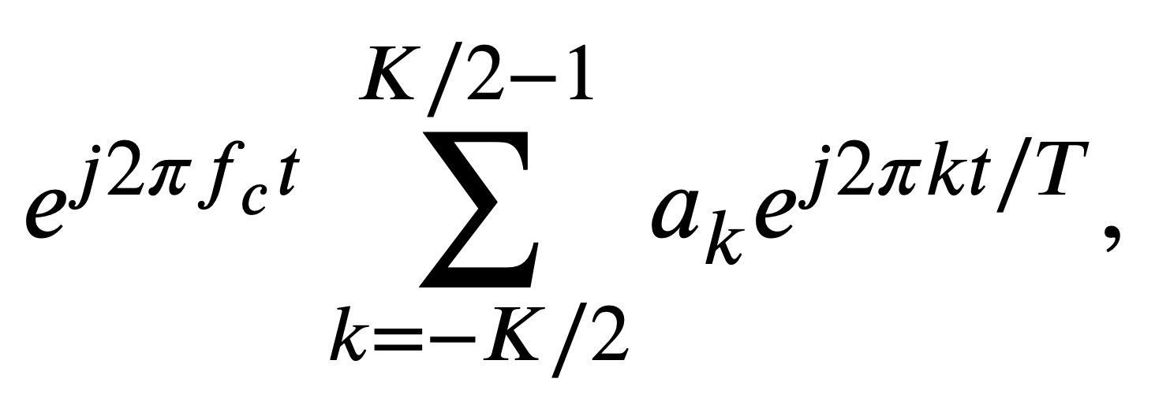
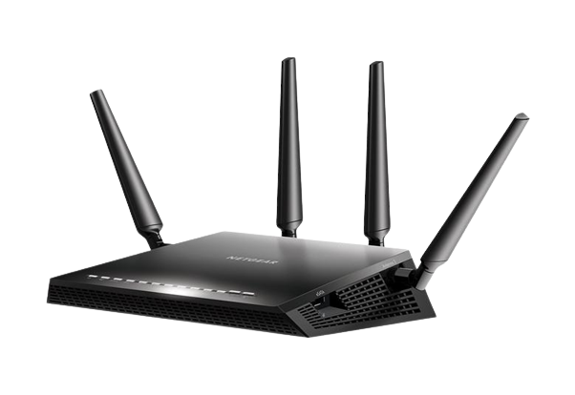
From CFR to BFI
1
2
Null Data Packet (NDP)
MU-MIMO Beamformees
MU-MIMO Beamformer
Estimate CFR, H
Compress CFR, V_{k}
Create BFI Frame
Beamforming Feedback Information
4
3

Slide 36
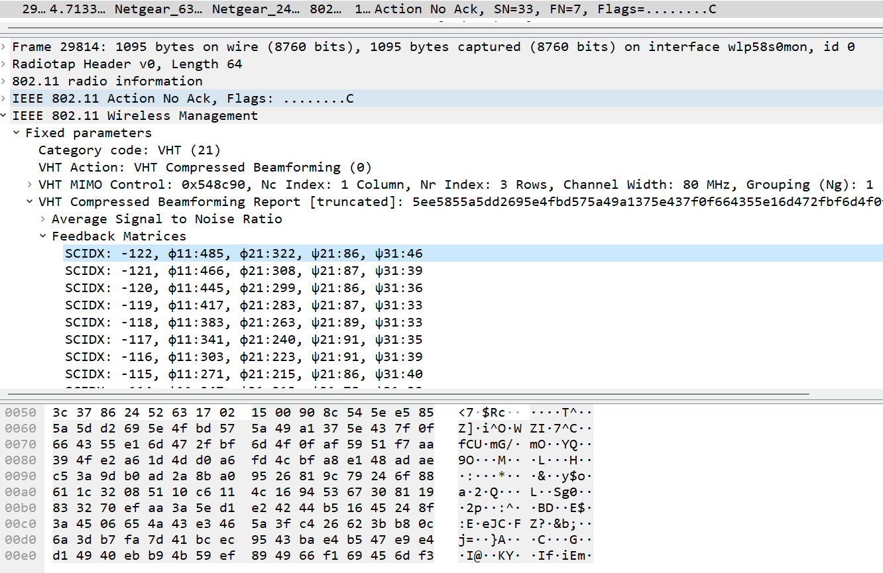
Beamforming feedback matrices
Transmitted unencrypted
Packet Bytes

